Slide 1
TM
Notes:
Energy Safe Kids is sponsored by the National Energy Foundation.

Slide 2


Think!
Talk!
Take Action!
Notes:
We are going to Think!, Talk! and Take Action about energy and energy safety.

Slide 3
Presentation Topics
  Learn about energy.
Learn about properties
of natural gas.
Learn about
natural gas safety -
inside and outside.
Play the review game – Safety Sense.
TM

Slide 4

ENERGY
is the ability to do WORK.
Notes:
Let’s Talk! about energy now.
What is energy?
BRIEFLY allow students to answer.
Energy is the ability to do work.

Slide 5
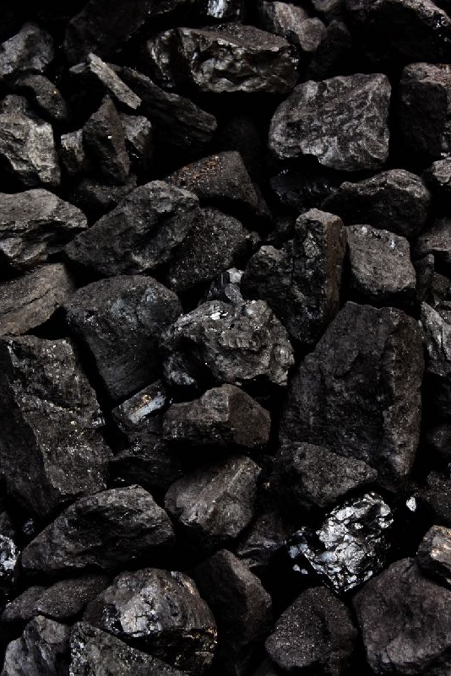
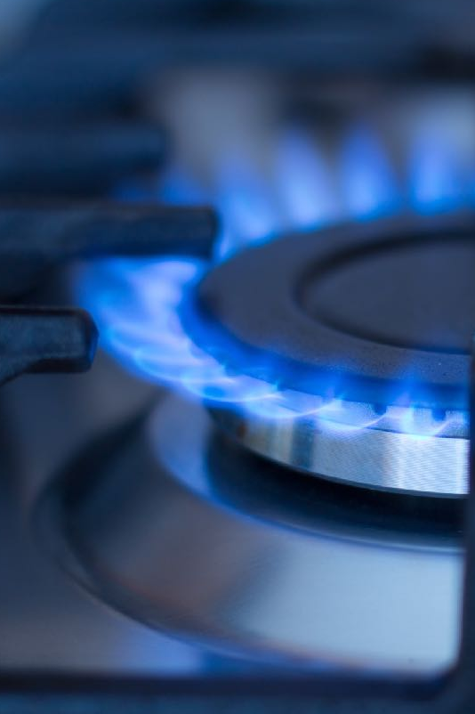
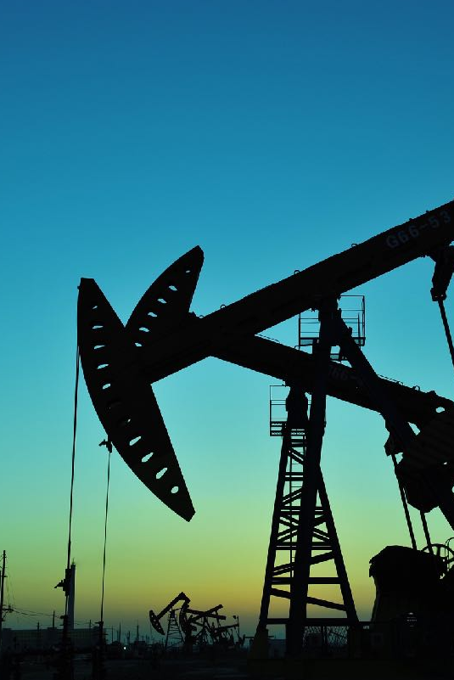
Nonrenewable
Energy Sources
Coal
Natural Gas
Oil
Notes:
We use energy to do almost everything, so it is important to understand where our energy comes from.
BRIEFLY discuss energy sources.
Nonrenewable resources can be depleted; someday we will run out.
Fossil fuels are in this category.
Natural gas is the primary source used to heat homes.
Oil is refined into gasoline and used as fuel for cars.

Slide 6
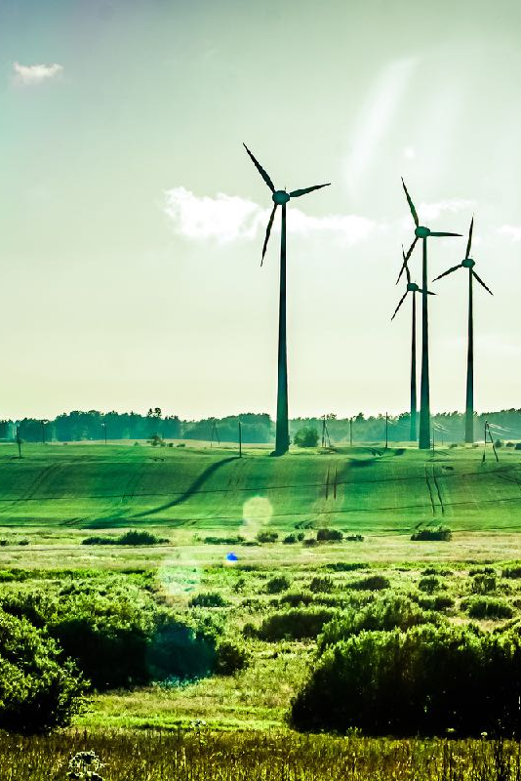

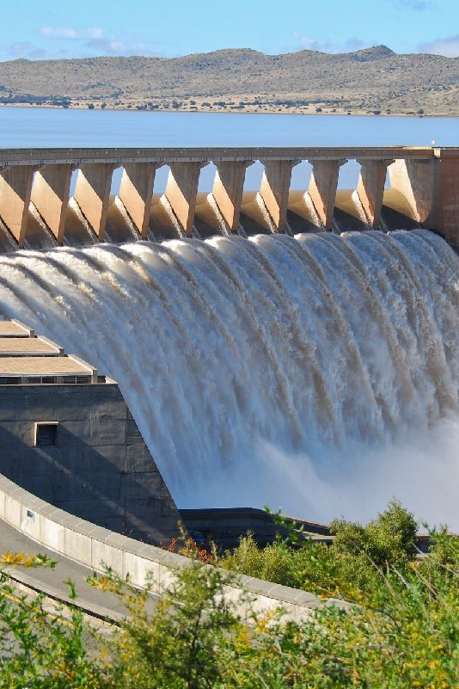
Wind
Sun/
Solar
Water/ Hydro
Renewable
Energy Sources
Notes:
Renewable resources are sources of energy that are naturally replaced; they go on and on.
Renewable resources include wind, sun (solar) and water (hydro).

Slide 7

What Is Natural Gas ?
Notes:
•Natural gas is used as an energy source for heat in homes, schools and businesses. It is also used to generate electricity.
•What is natural gas?
•Natural gas is a mixture of gases that formed a long time ago from the decay of plankton (minute marine organisms) that once lived in the ocean.
•The remains are buried and compressed by the weight of the silt and sand above them.
•Pressure and heat turn the sand and silt to rock, and the remains of the plankton into oil and gas.
•For student engagement have students put their hands together and press their palms together holding (but do not rub hands together) for five seconds. This generates heat in their hands.
•The main ingredient in natural gas is methane.
•Natural gas is often found with petroleum and other fossil fuels.
•If you would like to simulate the formation of natural gas, gather a clear plastic bin (shoe box size), approximately a gallon of sand, ½ cup of baking soda, 1 cup of vinegar, 1 cup of water.
•Ask for five student volunteers. The first to hold the plastic box, second to place one half the sand in the bottom of the container, third to sprinkle baking soda, fourth to place a second sand layer, fifth to pour water/vinegar (50 percent water, 50 percent vinegar).
•The weight of the sand and ocean water above changes the plankton remains into natural gas.
•Notice where the pockets of gas formed in the sand?
•To get the natural gas from the ground, companies drill down through the rock into pockets of gas and pump it to the surface.

Slide 8
Notes:
DO:
Have the bottle experiment set up ahead of time.
Pour a small amount (one-third cup) of vinegar in a clear plastic bottle.
Using a funnel placed into the neck of a balloon, put two spoonfuls of baking soda into a balloon.
With the round part of the balloon with the baking soda in it hanging down the side of the bottle, stretch the neck of the balloon and place over the opening of the bottle.
SAY:
Three common states of matter are solid, liquid and gas.
The bottle and the balloon are solids.
There is a liquid in the bottom of the bottle - vinegar.
There is a solid inside the balloon - baking soda.
When we mix these two compounds, we will make a gas - carbon dioxide.
DO:
If a student is helping to tip the baking soda-filled balloon; have both the student and yourself wear safety glasses.
When ready, tip the baking soda into the bottle.
The chemical reaction will make carbon dioxide gas which will inflate the balloon.
Hold tight to the balloon and the bottle neck in case it was not secured over the opening.
Retrieve safety glasses from student before he/she returns to seat.

Slide 9
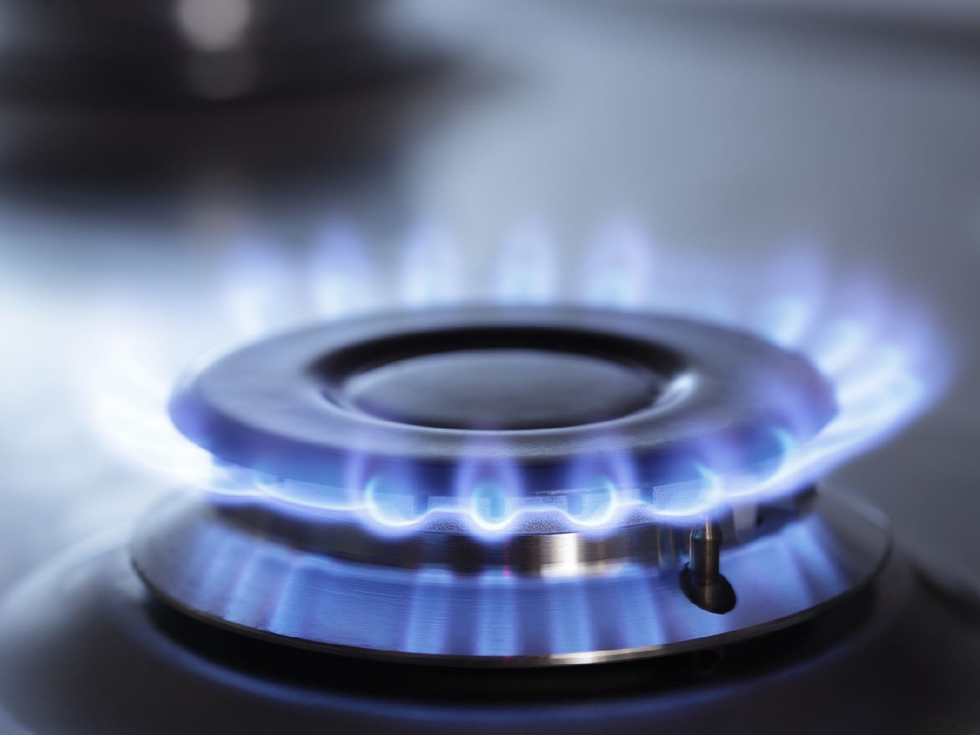
Properties of
Natural Gas
Its state of
matter
is a gas.
Notes:
There are three common forms of matter: solid, liquid and gas.
Natural gas is typically a gas, but can be liquefied.
It is sometimes called “gas” for short, but shouldn’t be confused with gasoline that fuels a car.
Gasoline is a liquid and natural gas is a gas.

Slide 10

A chemical called mercaptan is
added to natural gas for safety.
Properties of
Natural Gas
It is colorless.
It is odorless.
Notes:
Natural gas is colorless. Show the bottle/balloon -The gas inside the bottle is colorless too.
When it burns, it creates a blue flame.
Natural gas is odorless.
Natural gas is combustible and can be dangerous. Utility companies add a chemical called mercaptan, which smells like rotten eggs, so you know if there is a natural gas leak in your home.

Slide 11
Properties of
Natural Gas
It is lighter than air.
Notes:
Natural gas is lighter than air.
Show the bottle/balloon -The gas inside the bottle moved outward filling up the balloon.
It can move around your home.
If there is a natural gas leak, you may smell the mercaptan upstairs and not downstairs, even if the leak is downstairs.

Slide 12
Properties of
Natural Gas
It is combustible.
Notes:
Natural gas is a combustible gas.
Combustible means that it can burn.
Have the students repeat the word. Add hand motion for “flame,” wavy upward motion
Natural gas has a very limited range of flammability.
This means that it takes a precise combination of air, natural gas AND an igniter (match, lighter, grill igniter) before it can burn.

Slide 13
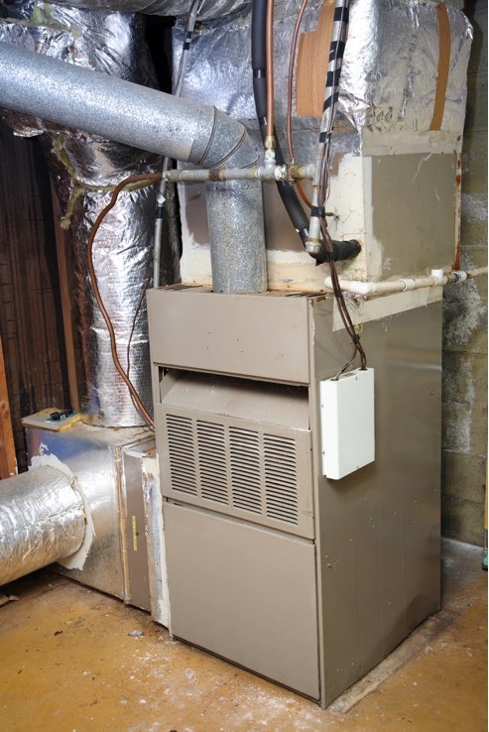
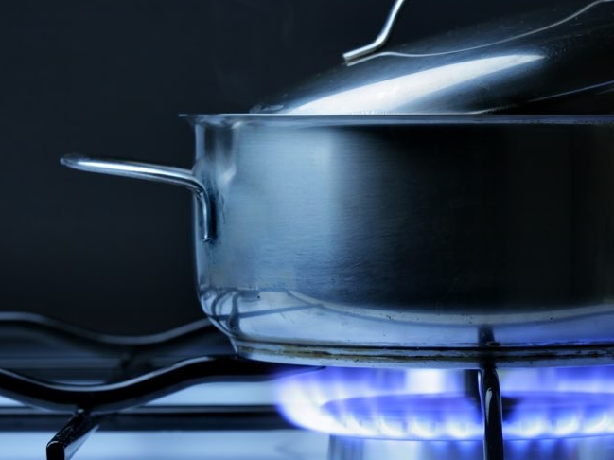
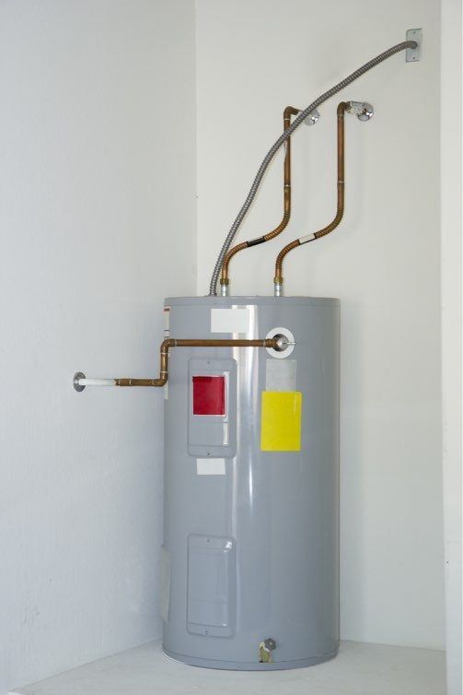
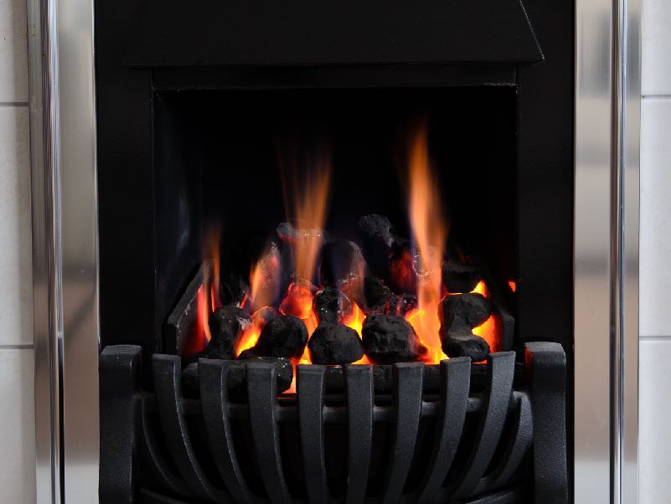
Cleaner
Hotter
How Do We Use
Natural Gas?
Brighter
Reliable
Notes:
Natural gas is a fuel that is used to heat buildings, cook food, dry clothes, heat water and even produce electricity.
Do NOT have students name the appliances, rather go over them quickly as you mention all the devices which may use natural gas.
Natural gas is a popular fuel choice because it burns cleaner (no smoke), hotter and brighter than other fossil fuels.
Natural gas gives off heat and light when it burns.
Natural gas is reliable.
Because natural gas travels through pipes which are buried underground it is less likely that stormy weather will disrupt the supply.

Slide 14
Have natural gas appliances maintained and inspected.
Play it Safe Inside
Never inspect natural gas appliances without an adult’s supervision.
Do not store flammable or combustible materials near any
gas appliances.
Natural Gas Safety
Keep areas around furnace and water heater clutter-free.
TM
Notes:
We want you to Take Action! and be Energy Safe Kids.
Remember that to be an Energy Safe Kid, you should always have an adult with you when inspecting your natural gas appliances.
Natural gas appliances need to have good air flow.
Keep areas around natural gas appliances clean and clutter free.
Do not store flammable or combustible materials around natural gas appliances.
Never store cans of paint or aerosols near any natural gas appliance.
Do not play around or on natural gas appliances or hit the valves carrying the natural gas to them.
Have an adult make sure that the vents and flues are clean (from inside and outside of the house).

Slide 15
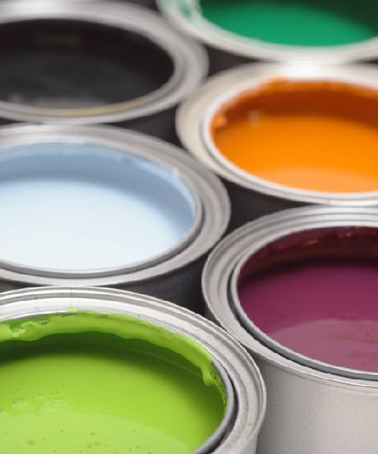

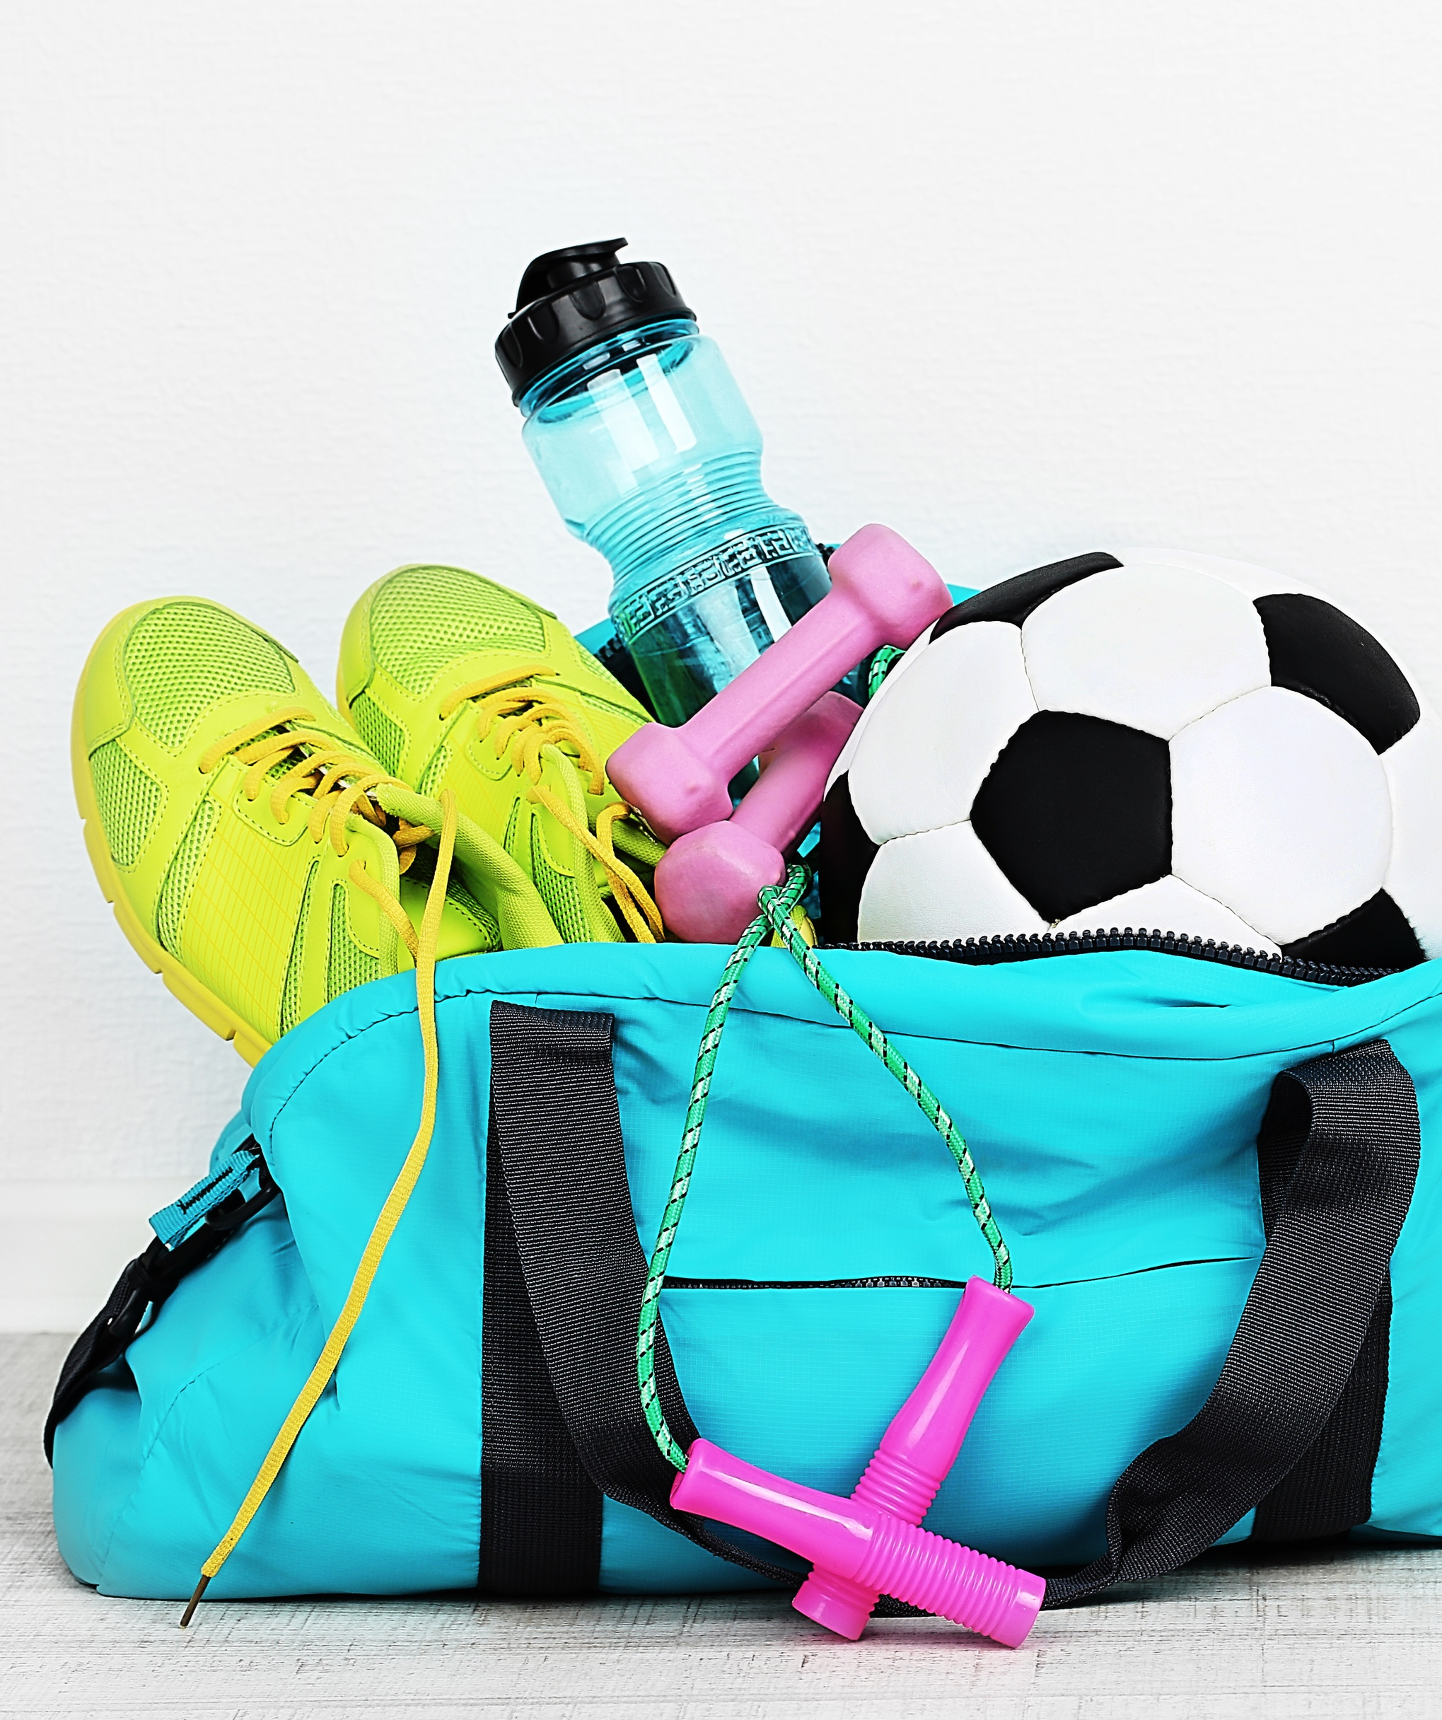
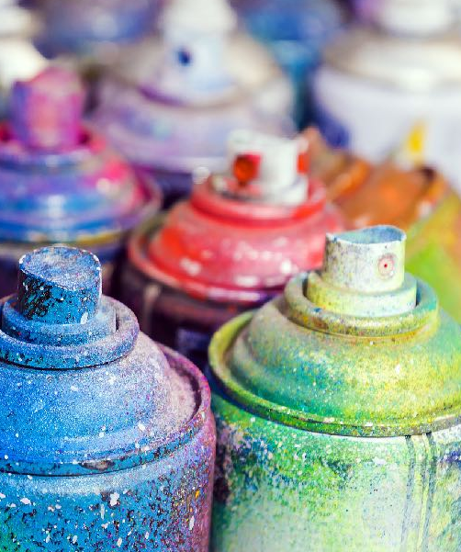
X
X
Keep the
area clean!
X
X
Notes:
After each response have student make an X by crossing their arms and say “No, never” and then move arms outward
Is it ok to store paint anywhere on or near the furnace?
NO, never! Because it can catch fire or block the air flow.
Is it ok to store paper, boxes or trash near the furnace?
NO, never! Because they can catch fire or block the air flow.
Is it ok to store aerosols or spray cans on or near the furnace?
NO, never! Because they can catch fire or block the air flow.
Is it ok to store your sports bag around the furnace?
NO, never! Because it blocks the air flow.

Slide 16
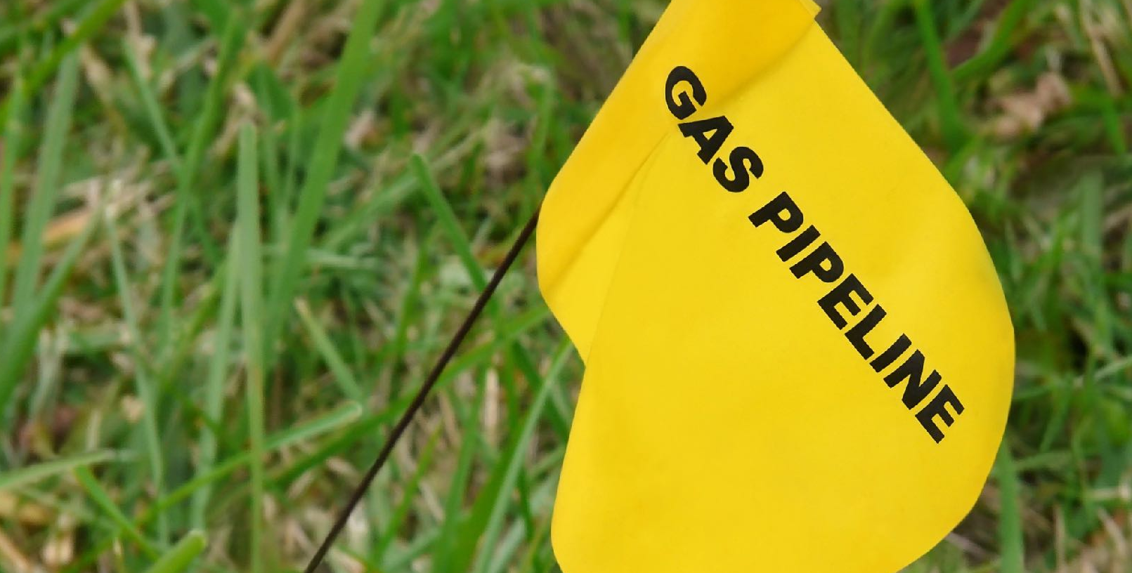
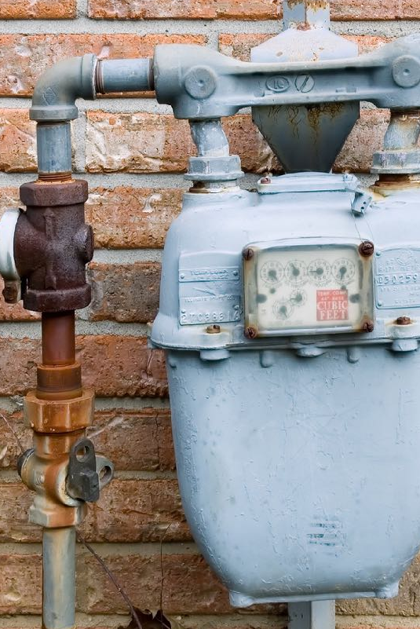
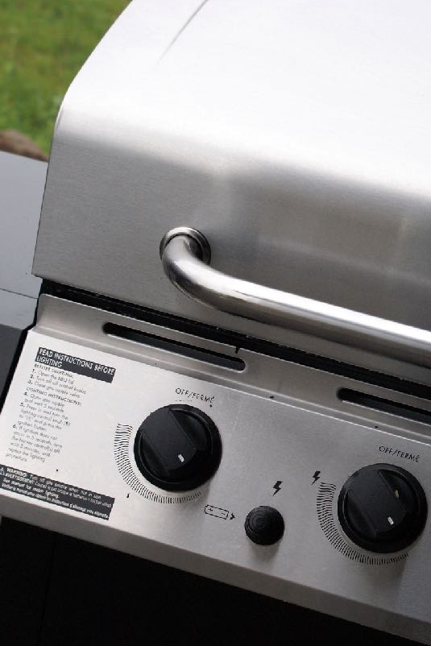
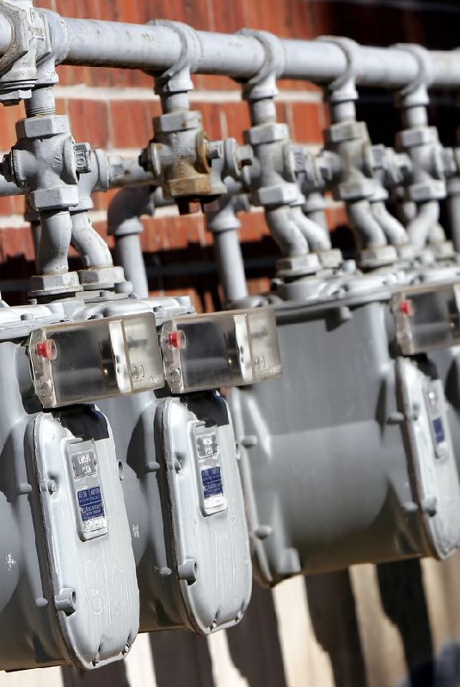
Play It Safe Outside
Be
pipeline
aware.
Do not play around
natural gas equipment.
Notes:
To be Energy Safe Kids, you should never play around natural gas equipment (such as gas meters, pipes, grills, pool heaters, etc).
Never hit equipment or meters with sticks or throw rocks at them.
Keep equipment or meters clear of clutter - Have adults CAREFULLY clear away snow, leaves, branches, etc.
Be pipeline aware.
Natural gas is delivered through pipelines, which makes it a safe and reliable energy source.
Above ground markers indicate where these pipelines are buried.

Slide 17
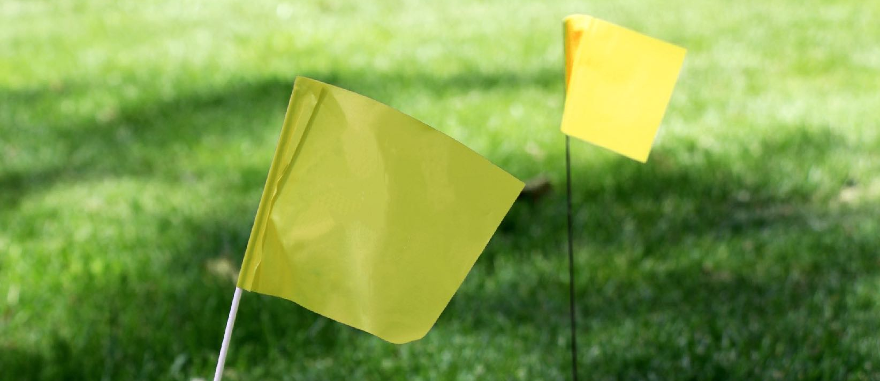


Do NOT move or pull out marker flags. They show the location of underground pipelines.
Notes:
Explain to students that before any digging occurs at home or in a community, someone must call 811 so that pipeline locations underground are properly marked above ground.
NEVER move or pull out marker flags.
These markers are important because they help people know where not to dig.
Hitting pipelines can cause damage and serious incidents.
Natural gas lines are marked with yellow flags, markers or paint.
Electricity lines are marked with red.
Water lines are marked with blue.
Other colors mark things like cable and telephone (orange) and sewer lines (green).

Slide 18
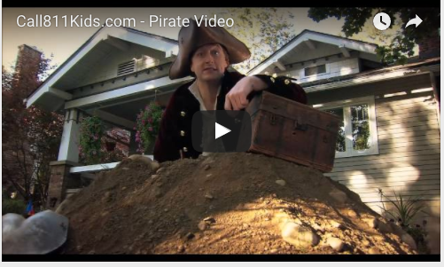
Click here to go to the Call 811 Pirate video on YouTube
Call 811 before you dig.
Notes:
Teachers show the Call 811 Before You Dig - Pirate Video. It is found on the Common Ground Alliance website or on YouTube.
Use the following links for access
energysafekids.org
youtube.com/watch?v=8mLoG9jUkBQ
call811.com/damage-prevention/toolkits/811-videos-psas-and-supporting-tools
Encourage others in the school to share it with their students, perhaps even sharing it during the announcements.

Slide 19

See
Hear
Smell
Signs of a Natural Gas Leak
Trust your senses!
Bubbling water,
blowing dirt
Rotten egg -
MERCAPTAN
Hissing sound
Notes:
Often when there is a natural gas leak, we can use our senses to know.
See
If there is a dead area in the middle of a green area of plants or grass, it could be a natural gas leak.
If there are bubbles coming up in water there could be a natural gas leak.
If there is blowing dirt, and it is not windy, it could be a natural gas leak.
Hear
If you hear a “hissing” sound coming from the ground or a pipe, it could be a natural gas leak.
Smell
Briefly review mercaptan and remind the students that it smells like rotten eggs.
Remember that natural gas is lighter than air so it can move around or can be smelled in one place but not another.

Slide 20
Leave the area immediately with the door open.
Tell an adult
right away.
Go to a safe
area away from the leak, call 911.
What to Do if You Suspect a
Natural Gas Leak
Notes:
If you notice any of the things on the last slide or think for any other reason that there is a natural gas leak, Take Action! and act fast.
Have students do hand motions with you,
hands with thumbs out, closed fist in front of you and them move over shoulder for get out, leave.
talk - use both hands - fingers and thumbs open and close (like bird beak)
tell an adult - thumb and pinkie finger act like a phone to ear
Leave the area immediately.
Tell an adult right away.
Go to a safe area away from the leak, call 911.

Slide 21
LEAVE, TELL AN ADULT and CALL 911 if you notice any of these signs.
Do NOT do anything that may create a spark.
Do NOT try to repair the pipe or stop the leak.
Do NOT return until it is safe.
What Not to Do if You Suspect a Natural Gas Leak
Notes:
If you think there is a natural gas leak there are some things you should be sure NOT to do. Have students make an X with their arms crossed.
Do not do anything that might create a spark.
Do not use a light switch.
Do not use the garage door opener.
Do not let anyone smoke or light a flame of any kind.
Do not try to repair the pipe or stop the leak yourself.
Do not go back to the area until it is safe.

Slide 22

Headache
Dizzy
What to do if
you suspect carbon monoxide
poisoning:
Signs of carbon monoxide
poisoning
GET OUT,
TELL AN ADULT and CALL 911!
Carbon monoxide is a poisonous gas.
There is NO odor.
Drowsy, etc.
Notes:
Occasionally when there is an inadequate supply of air, any fuel (oil, coal, kerosene, wood or natural gas) can burn inappropriately and create carbon monoxide.
Any kind of fuel and any kind of fuel burning appliance (furnace, water heater, stove, oven, etc.) can produce carbon monoxide.
Carbon monoxide is a colorless and odorless poisonous gas which can make you sick.
Carbon monoxide can accumulate, or gather, when the flue or vent to a fuel burning appliance is blocked, typically by soot, nests, or other debris, such as snow.
Keep appliances in well ventilated areas.
Symptoms of carbon monoxide poisoning are:
Feeling sick
Headaches
Dizziness
Nausea and/or vomiting
Confusion
Drowsiness or being tired
If you suspect carbon monoxide, GET OUT IMMEDIATELY, TELL AN ADULT and CALL 911!

Slide 23
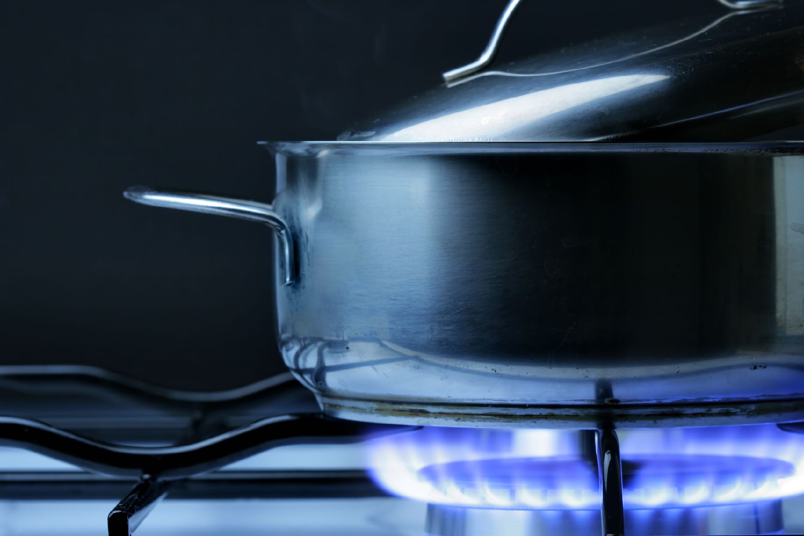
Natural gas is safe,
clean and efficient!
Notes:
Natural gas is a safe, clean and efficient energy source which makes our lives more comfortable.
Natural gas is efficient because it burns cleaner (no smoke), hotter and brighter than other fossil fuels.

Slide 24
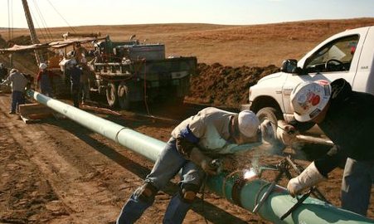
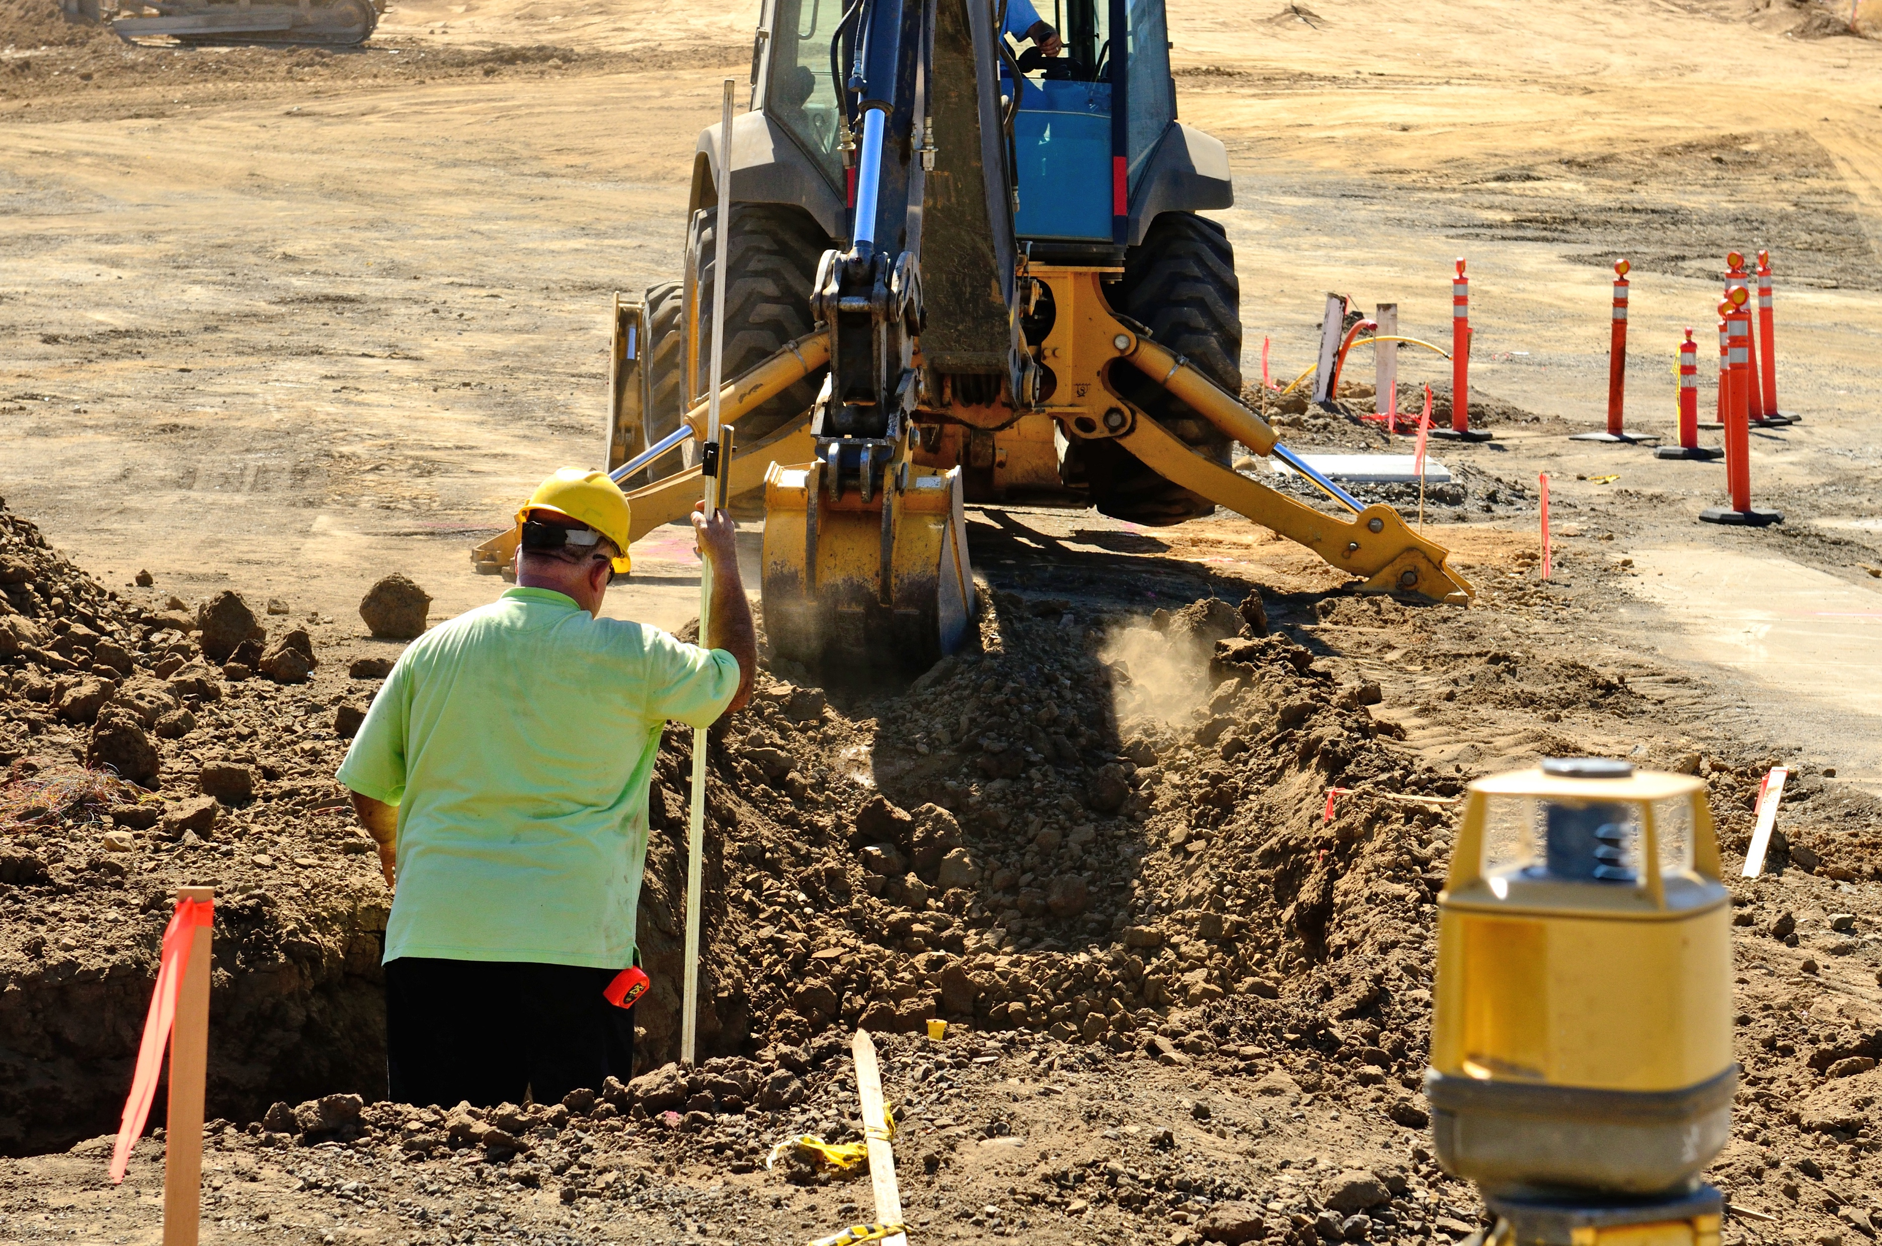
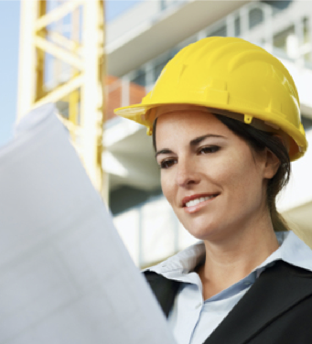
Can you picture yourself working in the energy field?
Notes:
Have you thought about working in the energy field?
Energy jobs offer promising opportunities.
Can you picture yourself installing natural gas pipelines?
Or maybe you can see yourself designing a delivery system for natural gas to a new housing development or working as an engineer in a natural gas power plant?

Slide 25
Safety Sense Review Game
READY?
Notes:
Tell students – how to play the review game:
They must remember many points of knowledge that were mentioned in the presentation.
Students can be called upon individually or as a class (if you have several) or to the group as a whole.
They complete the circle of safety by answering 10 questions. The goal is to be 100 percent correct.
With each correctly answered question, students are 10 percent closer to completing the circle.
Are you READY?

Slide 26

Can you smell carbon monoxide?
Notes:
Can you smell carbon monoxide?

Slide 27
10%
NO
Notes:
No

Slide 28

True or False:
If you see flammable items or clutter around your furnace, an adult should move them away.
Notes:
TRUE or FALSE: If you see flammable items or clutter around your furnace, an adult should move them away.

Slide 29
20%
TRUE
Notes:
True. Keep the area around your furnace clean and free of clutter.

Slide 30

TRUE or FALSE:
If you see a natural gas meter or pipeline, you can touch and play around it.
Notes:
TRUE or FALSE: If you see a natural gas meter or pipeline, you can touch and play around it.

Slide 31
30%
FALSE
Notes:
False. You should never play around natural gas equipment (such as gas meters, pipes, grills, pool heaters, etc).

Slide 32
Should everyone have a carbon monoxide detector in their home?
Notes:
Should everyone have a carbon monoxide detector in their home?

Slide 33
40%
YES
Notes:
Yes

Slide 34

On your phone, what numbers would you touch if you were going to dig in your yard?
Notes:
On your phone, what numbers would you touch if you were going to dig in your yard?

Slide 35
50%
811
Notes:
811
Call 811 to have underground pipes and cables located and marked before you dig.

Slide 36
Never store papers, boxes or bikes on top of or around your ___________.
Notes:
Never store papers, boxes or bikes on top of or around your _________.

Slide 37

60%
FURNACE
Notes:
Furnace

Slide 38
You can smell this chemical that is added to natural gas to give it a rotten egg odor.
Notes:
You can smell this chemical that is added to natural gas to give it a rotten egg odor.

Slide 39

70%
MERCAPTAN
Notes:
Mercaptan

Slide 40
Name three senses that can help you detect a natural gas leak.
Notes:
Name three senses that can help you detect a natural gas leak.

Slide 41


80%
See
Hear
Smell
Notes:
See, Hear, Smell.

Slide 42
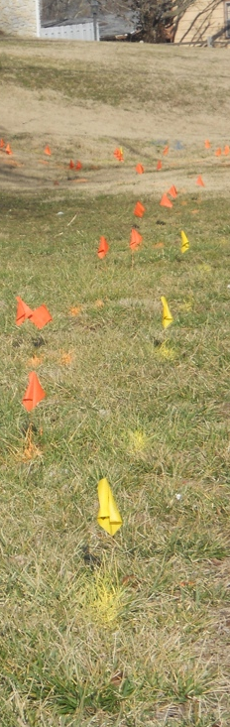
Do not move or pull out marker flags you see because they show underground ___________.
Notes:
Do not move or pull out marker flags you see because they show underground _________.

Slide 43
90%
PIPELINES
Notes:
Pipelines. Hitting pipelines can cause damage and serious incidents.

Slide 44
What three things should you do
if you smell the rotten egg smell of mercaptan in or around your home or school?
Notes:
What three things should you do if you smell the rotten egg smell of mercaptan in or around your home or school?

Slide 45
100%
Get out or leave the area.
Tell an adult.
Call 911.
Notes:
Get out or leave the area.
Tell an adult.
Call 911.

Slide 46
Safety Sense Completed
100% Safe
Notes:
Congratulate the students on being smart Energy Safe Kids. They have completed “Safety Sense.”

Slide 47
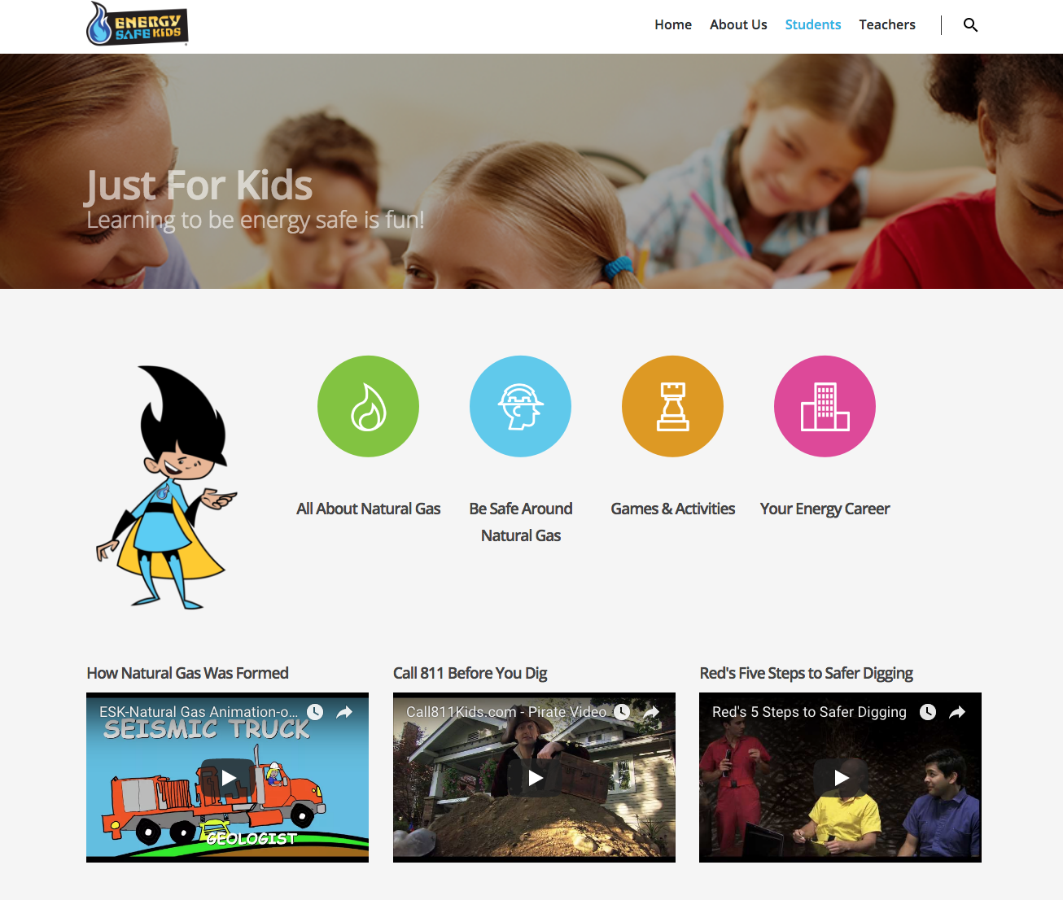

Digital Connection
Notes:
The Energy Safe Kids website is new and has so much information for students, parents and teachers.
Teachers will find resources for classroom use: lesson plans, activities and facts about natural gas in the United States.
Students and their families can learn about natural gas basics, safety and careers and play an online game, “Gas Dash” and test their safety IQ against “The Interactive Natural Gas Safety Poster.”
The object of “Gas Dash” is to avoid dangerous safety scenarios, while answering quiz questions on safety to complete the game in the shortest amount of time.
The interactive poster is a fun way to review natural gas safety and test your knowledge. The words in the title of the poster light up with each correct answer.

Slide 48
You can be an
Energy Safe Kid!
TM
Brought to you by:
Notes:
You can be an Energy Safe Kid!
Brought to you by the National Energy Foundation.

