Slide 1
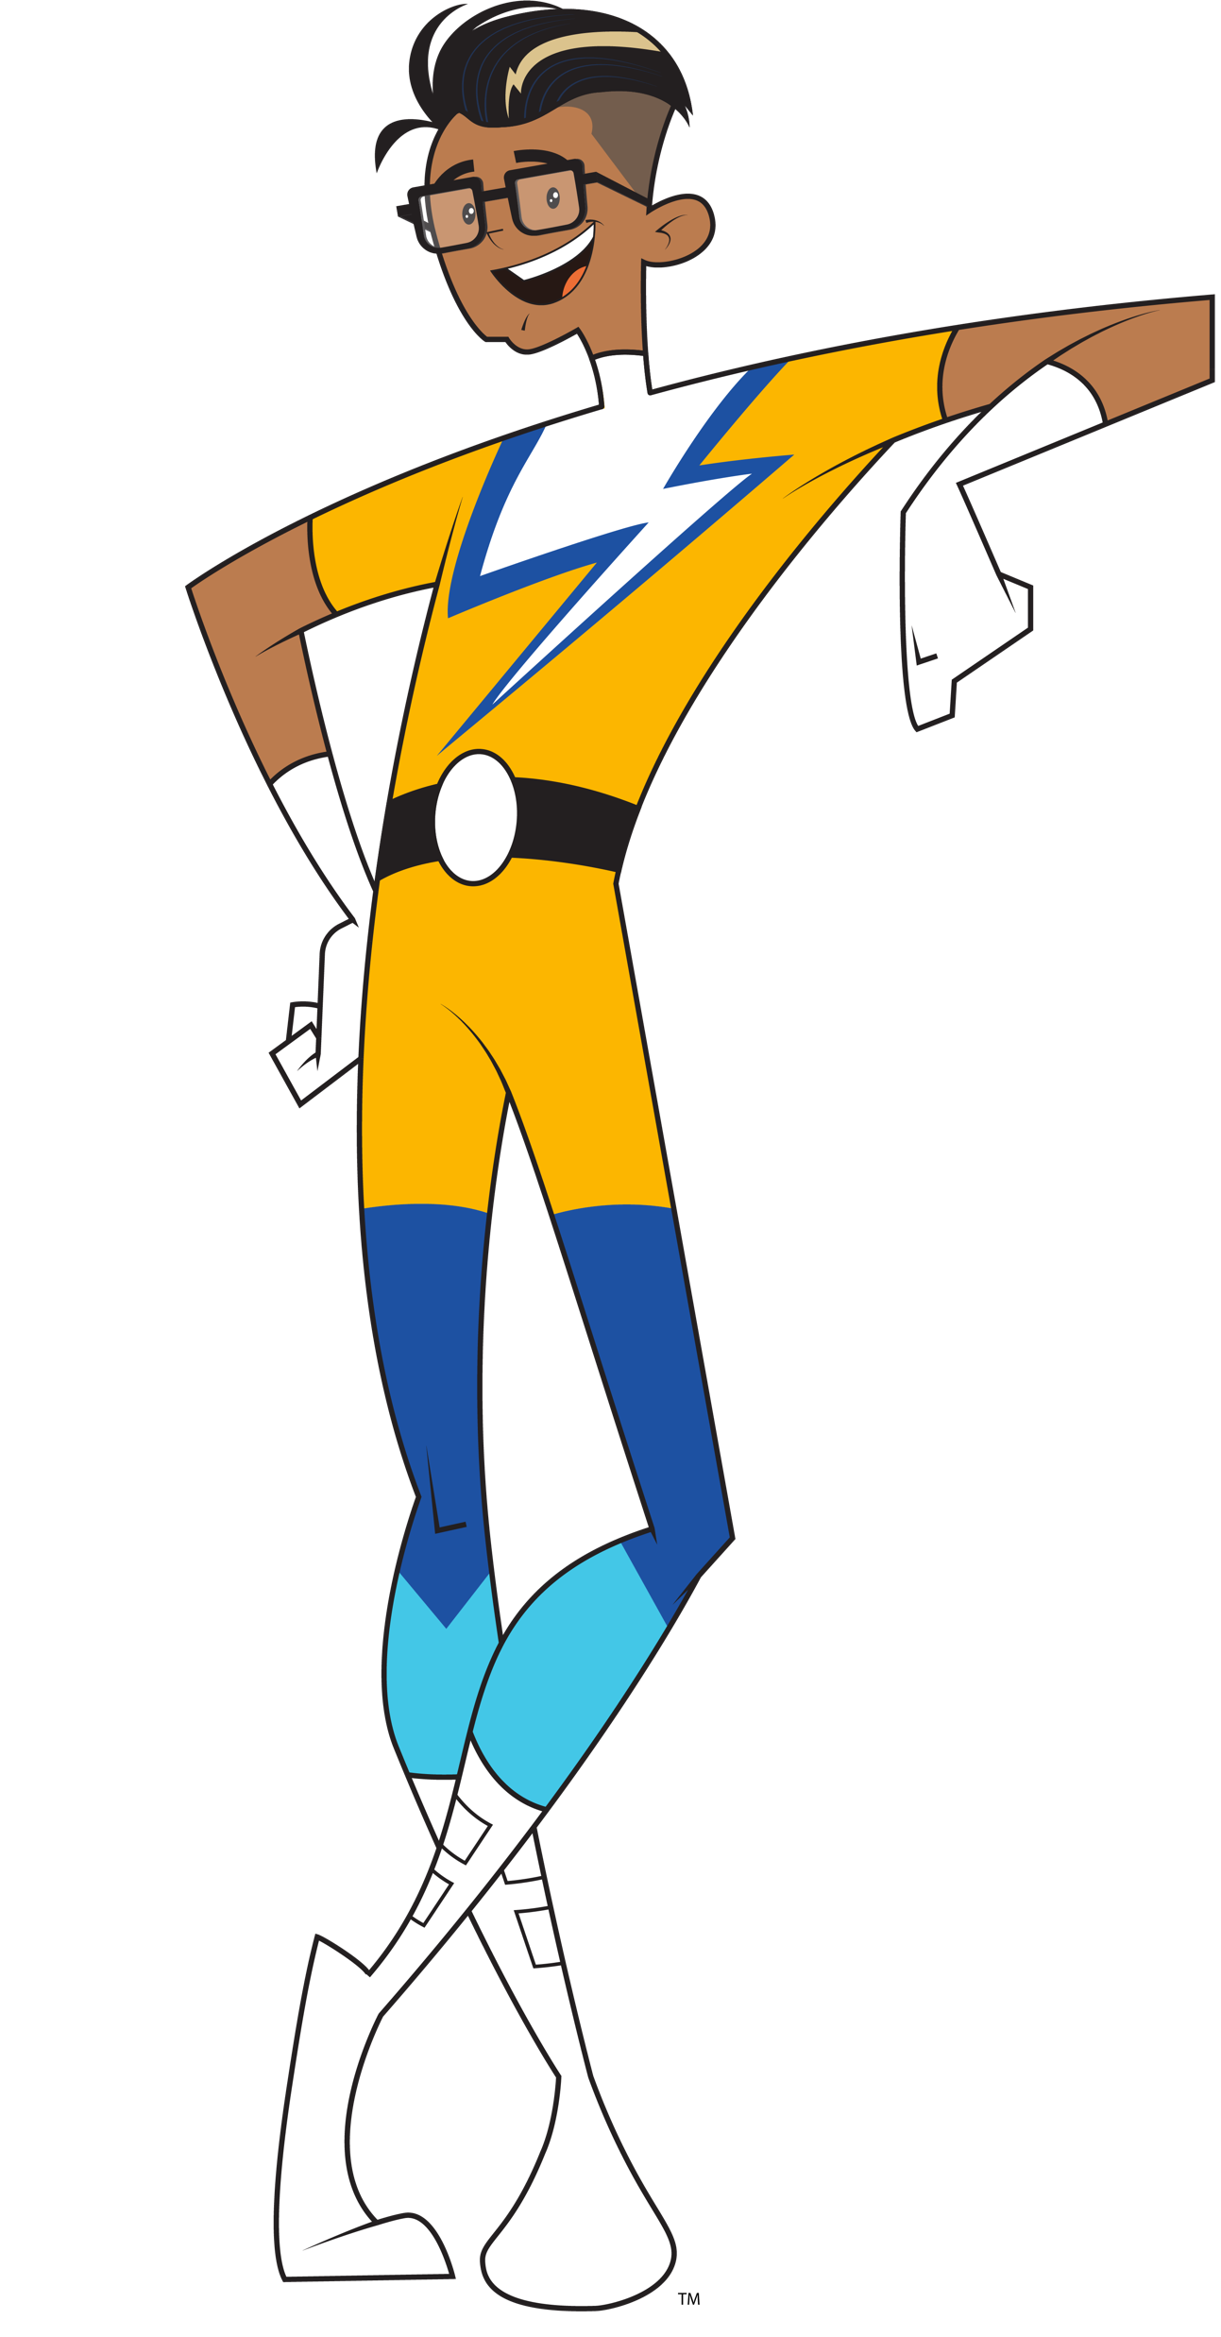


Brought to you by:
TM
Notes:
Hello everyone and welcome to Energy Safe Kids, brought to you by your local electric utility company and the National Energy Foundation (NEF).

Slide 2
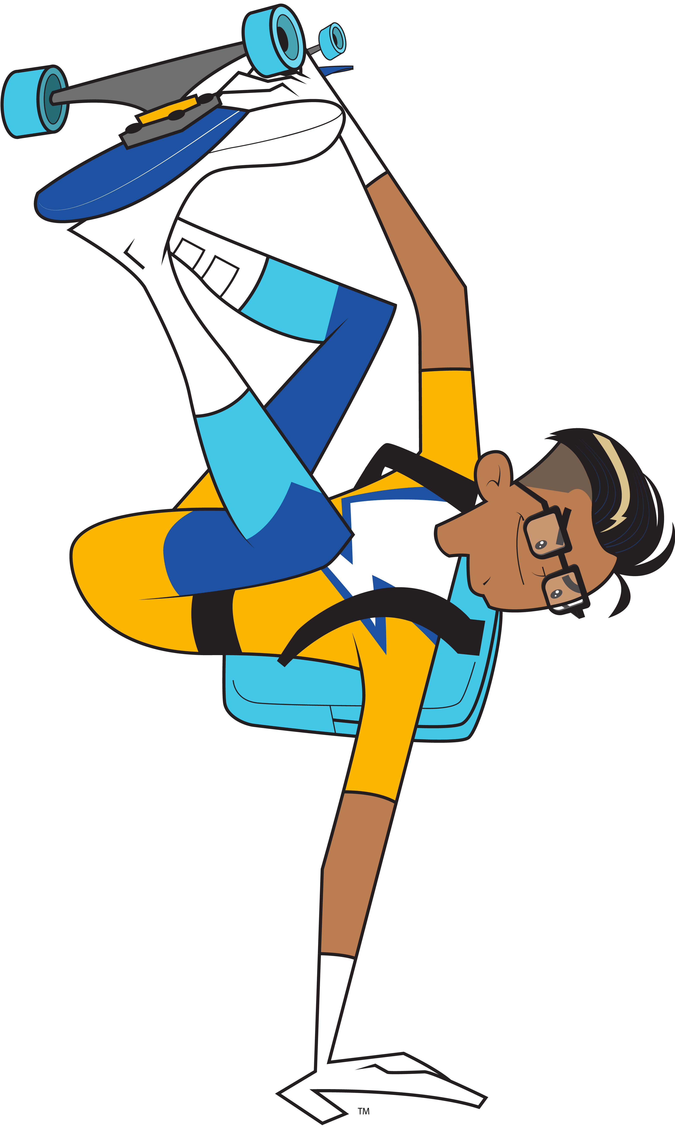
Think!
Talk!
Take Action!
about electrical safety!
TM
Notes:
As part of the presentation, tell the group that we are going to Think!, Talk! and Take Action! about electrical safety.
We will see our superhero when it is time to play the Damage Prevention LINGO game.
Damage and prevention are two big words. Damage means to break something and prevention means to keep it from happening.
Playing Damage Prevention LINGO will help you learn to be safe around electricity.
You can be a damage prevention hero and teach others about safety.

Slide 3
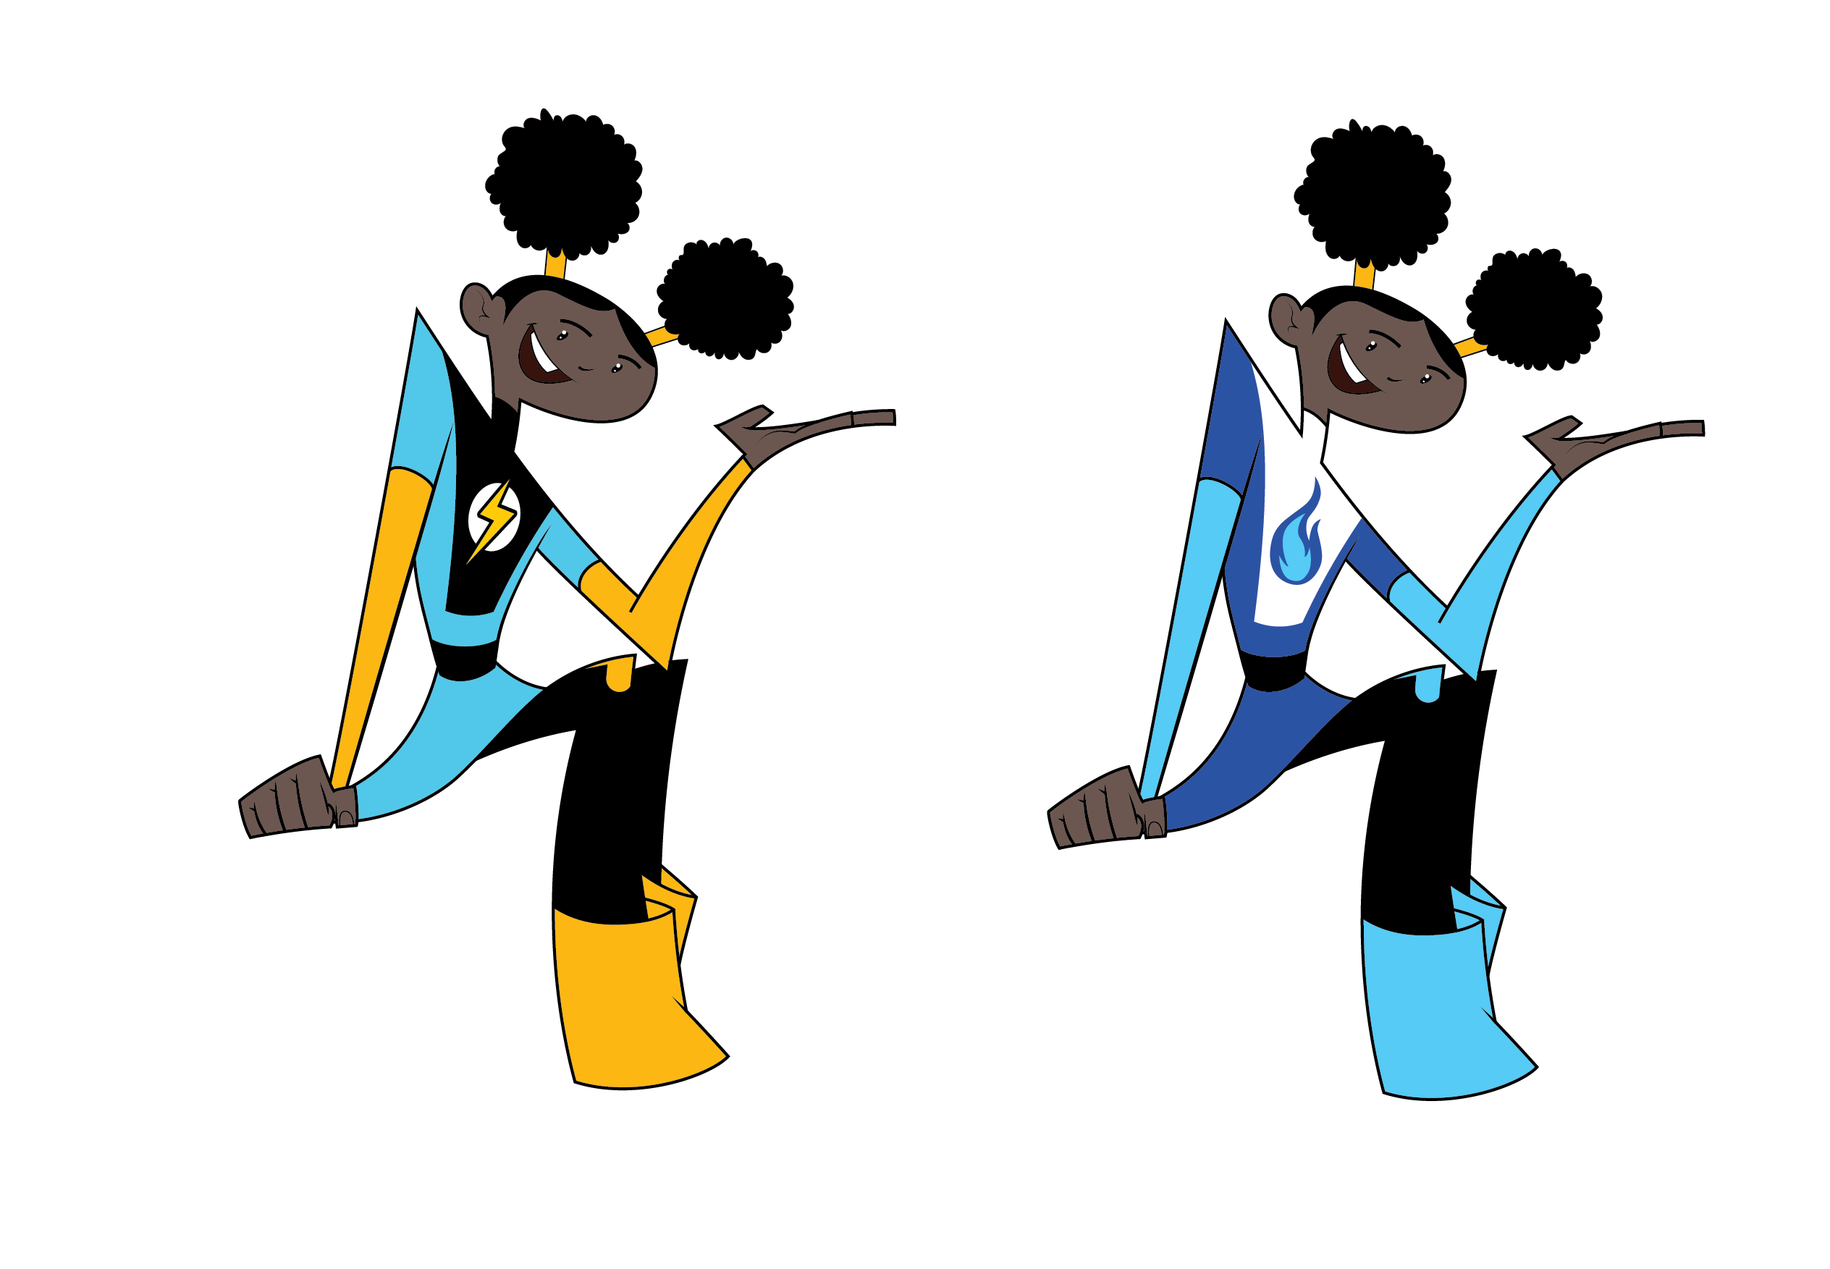
What We Will Do Today
  Learn about energy.
Learn about properties of electricity.
Learn about electrical safety,
inside and outside.
TM
Play "Play it Safe LINGO” and
"Electrical Safety Sense" review games.
Notes:
LINGO is like BINGO if you have LINGO cards. If not, it’s a good review for students to yell out the correct answer.
The review activity at the end of the presentation is called Electrical Safety Sense.

Slide 4

ENERGY
is the ability to do WORK.
Notes:
Let’s Talk! about energy now.
What is energy?
BRIEFLY allow students to answer.
Energy is the ability to do work.

Slide 5
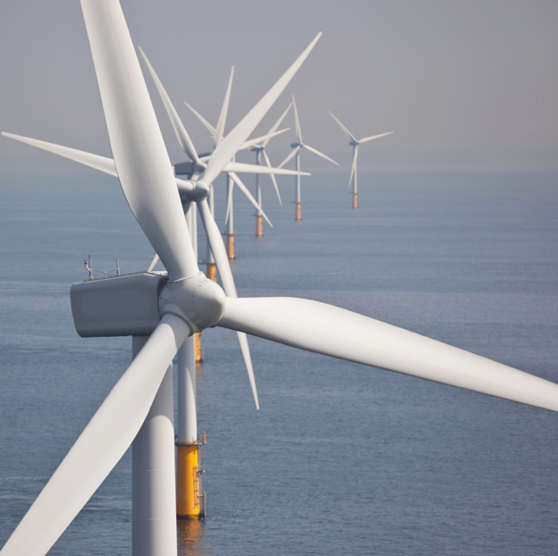
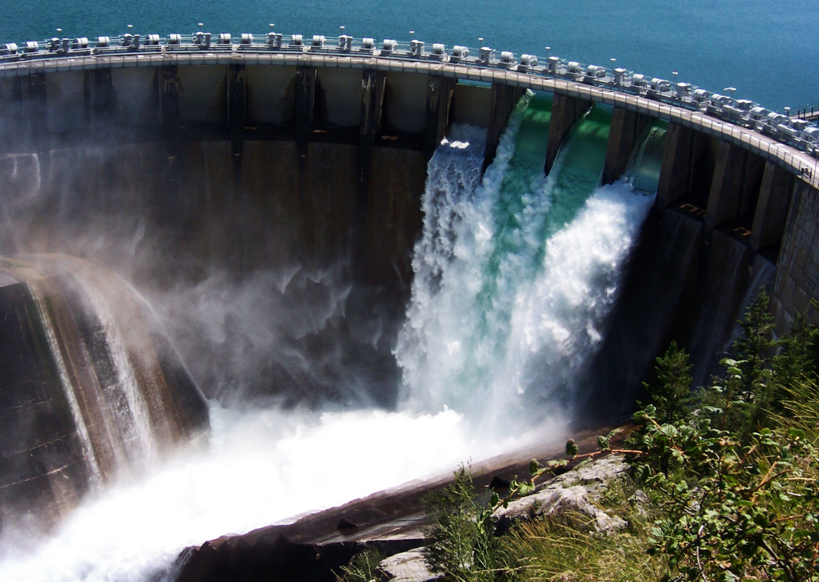

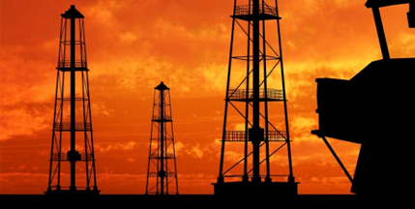
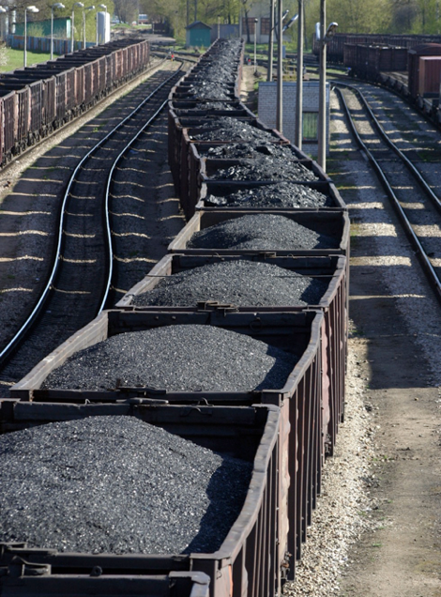
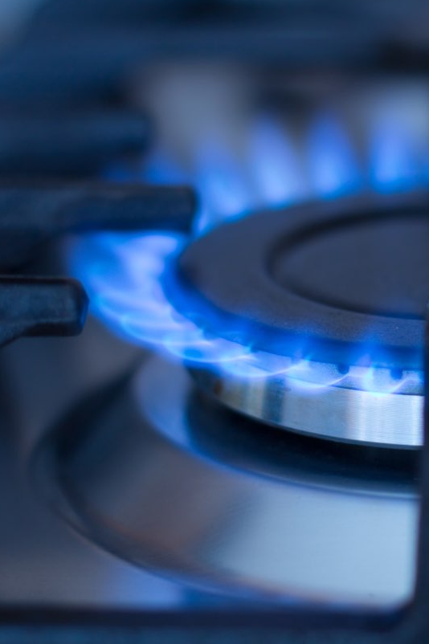
Renewable and Nonrenewable
Energy Sources
Notes:
Animation from Energy Sources to Renewable and Nonrenewable happens automatically and with a 2 second delay.
We use energy to do almost everything, so it is important to understand where our energy comes from.
Energy comes from renewable and nonrenewable resources.
Renewable resources are sources of energy that are naturally replaced, like wind, water and solar.
Nonrenewable resources are sources that take a long time to make and once they are gone, they are gone. Our fossil fuels, coal, oil and natural gas, are nonrenewable.
We use renewable and nonrenewable resources to generate electricity.
Let’s talk about electrical safety.

Slide 6
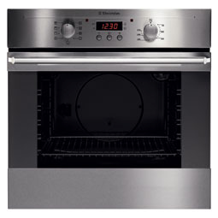

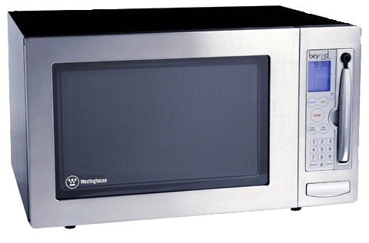
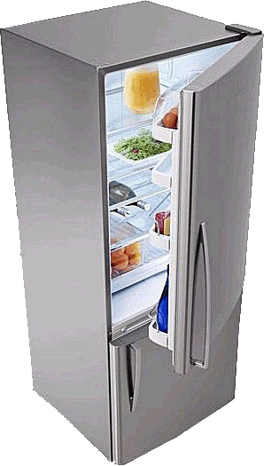
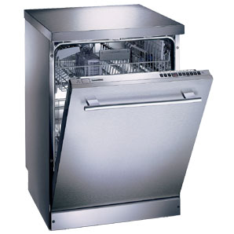


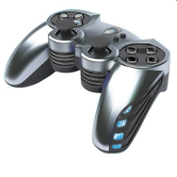
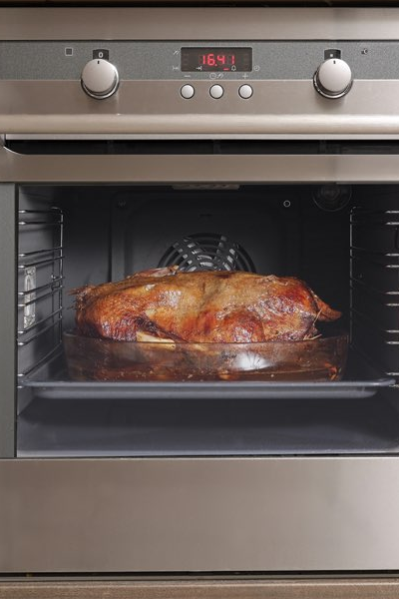
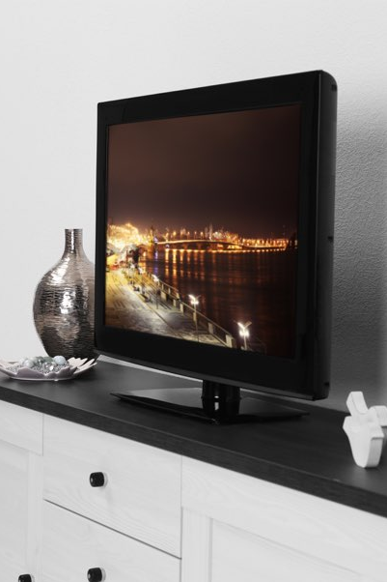
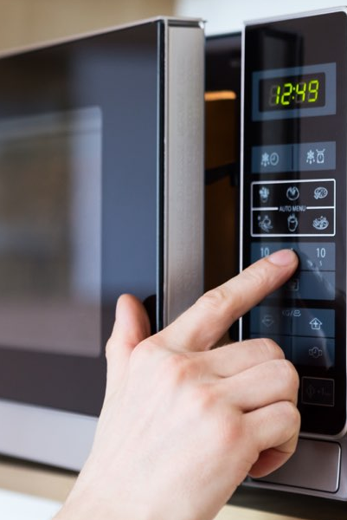
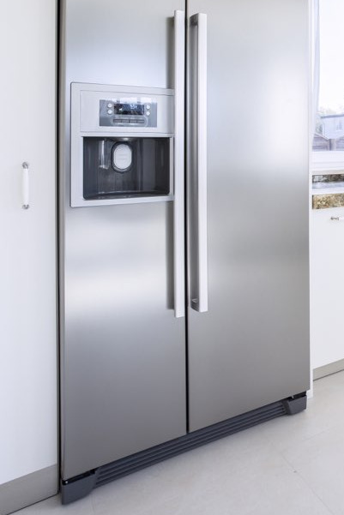
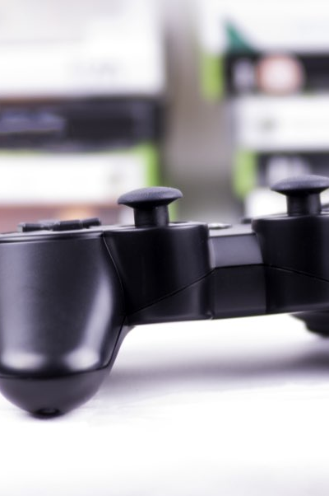
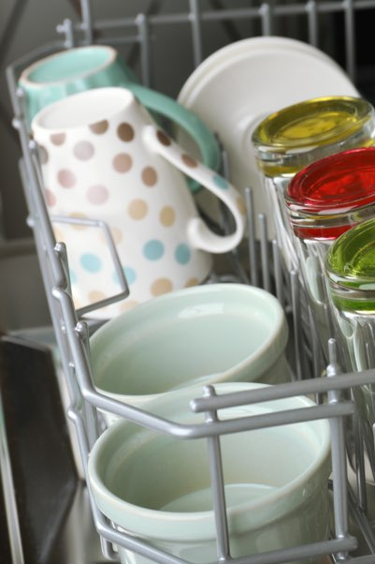
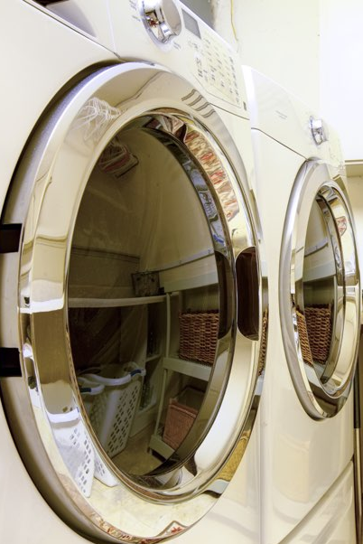
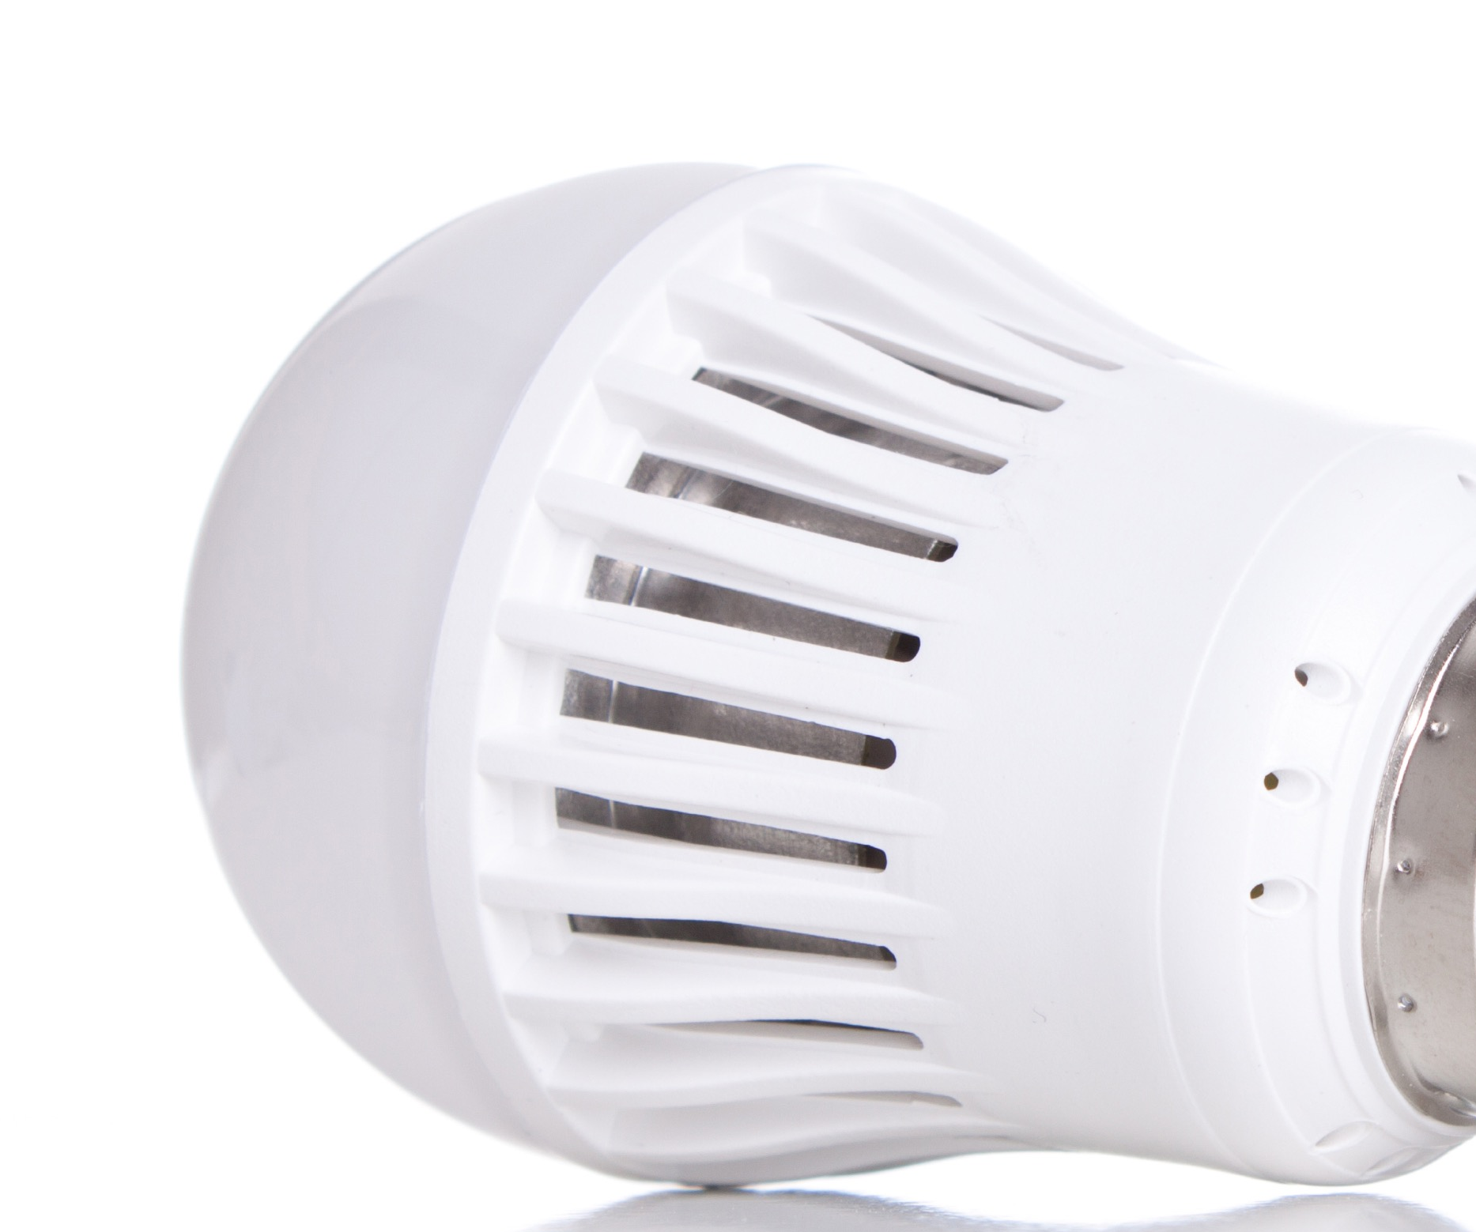
We use electricity for virtually everything
at home and at school.
Notes:
Electricity is an energy source that is used to heat buildings, cook food, dry clothes, heat water and give us light.
Look at all the ways we use electricity.

Slide 7
What is electricity?
Electricity is the flow of electric charge.
It needs a path to travel on, a circuit.
Notes:
What is electricity?
Electricity is the flow of electrons.
It needs to travel on a path. A complete path is called a circuit.

Slide 8
What do we need for electricity to flow?
An energy source
A conductor to carry electrical energy
A load to use the energy
example:
battery
example:
wire
example:
light bulb
Notes:
For electricity to work, it needs to travel on a circuit, like cars travel on a racetrack. Review three things needed to make a circuit from the slide.
An electrical circuit allows energy to be changed from one form to another.
Batteries contain chemical energy that changes into electrical energy.
The electrical energy moves through the wire but some of it is changed into heat energy due to resistance in the wire.
The light bulb changes the energy again, from electrical energy into light and more heat energy.

Slide 9


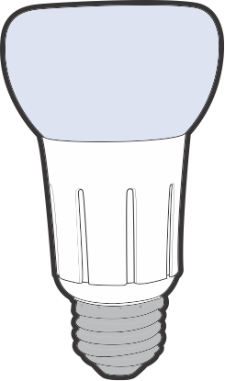
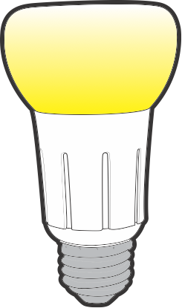
Circuits can be open or closed.
Closed circuit: Electricity can flow.
Open circuit:
No electricity can flow.
Notes:
An electrical circuit can be open or closed.
Click to show a diagram of an open circuit.
When the circuit is open, the path is broken, and no electricity can flow.
Click to show a diagram of a closed circuit.
This is how a light switch works. It opens and closes the circuit. When the switch is off, the electrical pathway is not complete, so no electricity can flow.
When you flip the switch, you close the circuit and the light turns on.
Stay on the closed circuit diagram.
Watch the video for a kid-friendly demonstration of the energy stick: vimeo.com/541759849

Slide 10
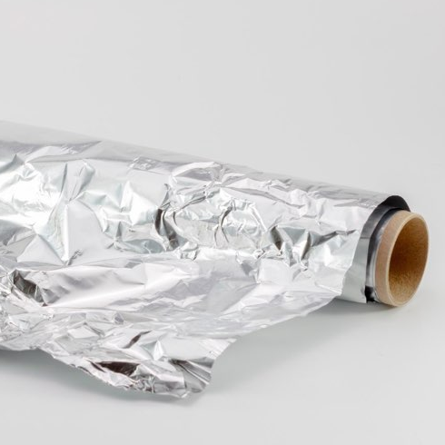
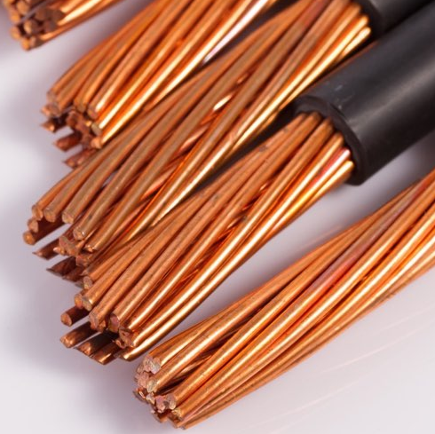

Conductor
material that allows electricity to
pass through easily
Notes:
We just saw that electricity needs a path. The path of a circuit is made using a conductor, like wire.
A conductor allows electricity to flow through it easily, like metal wires do.
Three examples of conductors are: aluminum foil, wire and people.
Remember, that wires connected to an outlet are not safe to touch. You can get shocked or burned. (Remind kids that some of the electricity is converted to heat.)

Slide 11



Insulator
does not allow electricity to flow easily
Notes:
An insulator does not let electricity flow through easily.
Three examples of insulators are: paper, plastic and rubber.
The energy stick you saw in the video is made of plastic which is an insulator. However, the ends are metal which is a conductor. You act as a conductor when you touch the metal ends.
Recap results of conductor insulator experiment.
Which one was a conductor? (aluminum foil) Wires and people are also conductors.
Which was an insulator? (paper) Rubber and plastic are also insulators.
Watch this video for a kid-friendly demonstration: vimeo.com/541761999

Slide 12
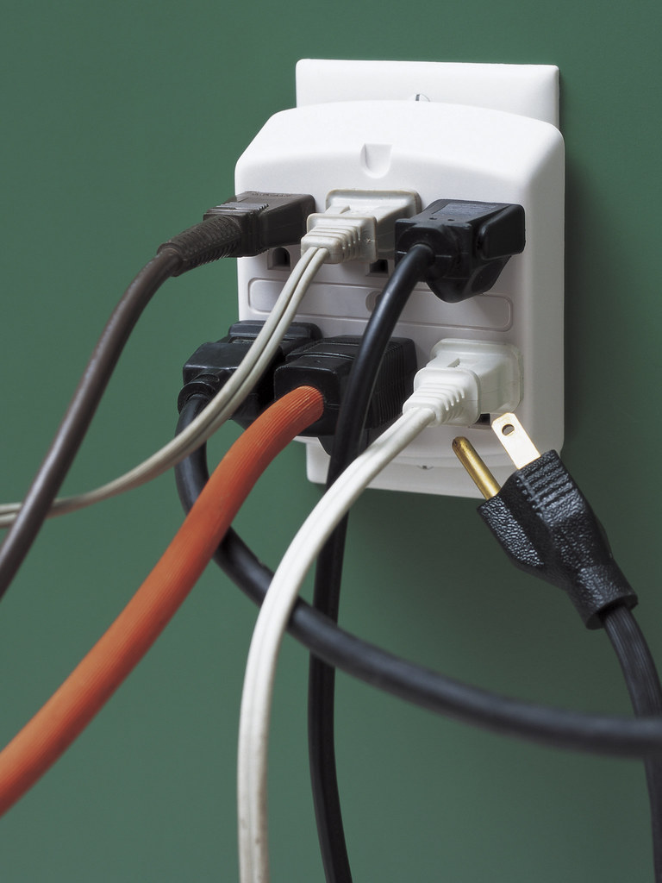
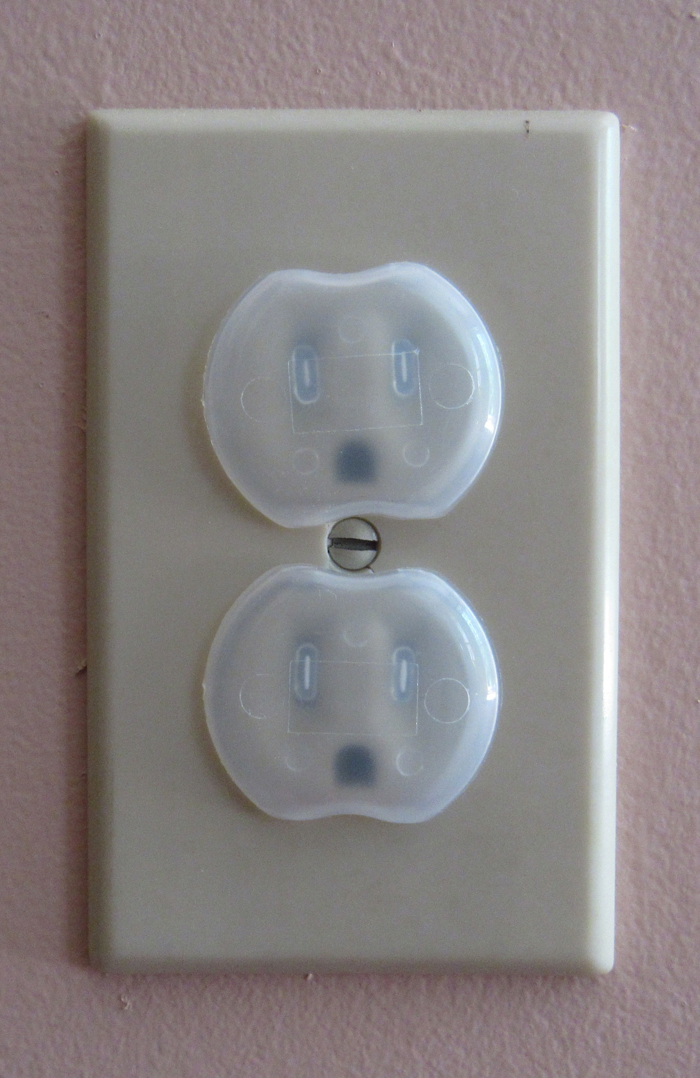
Play it safe inside.
Never stick anything into
an outlet
except a plug.
Overloaded outlets can be a fire hazard.
Notes:
Some of the electricity is converted to heat as it goes through the wires.
Overloaded outlets can be a fire hazard. Do not overload outlets with plugs.
Use outlet caps. They can protect small children from shock and burns.

Slide 13
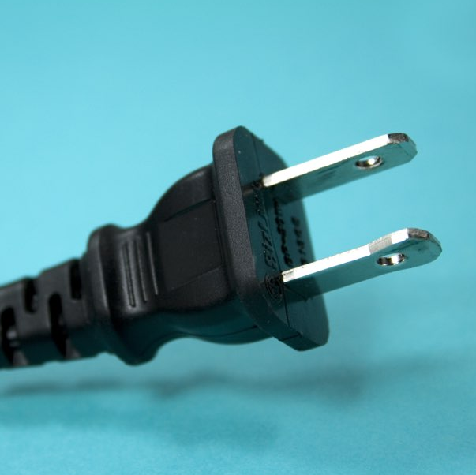
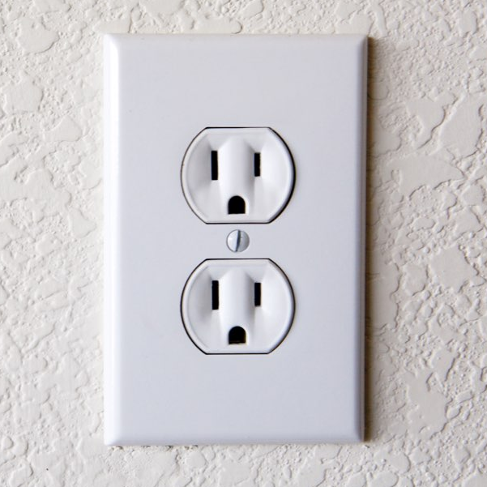
  Only pull on the rubber plug, not the cord, when you are unplugging something.
  Use outlet caps.
Play it safe inside.
Always:
Electrical Safety
Notes:
Now let’s explore electrical safety inside.
Play it safe inside. Always:
Unplug appliances using the rubber plug, not the cord.
Use outlet caps. They can protect small children from shock and burns.

Slide 14

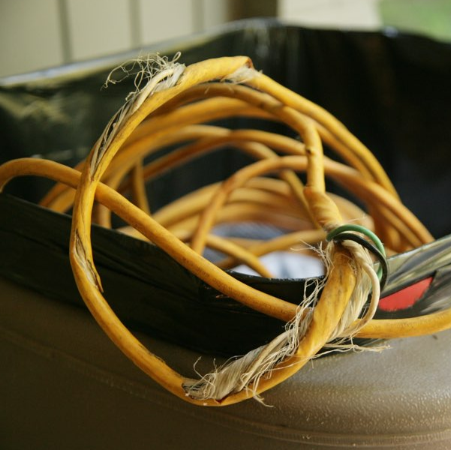
Play it safe inside.
Never mix water
and electricity.
Never touch or use frayed cords.
Notes:
Do not mix water and electricity.
Do not touch or use broken or frayed cords. It can be dangerous.

Slide 15
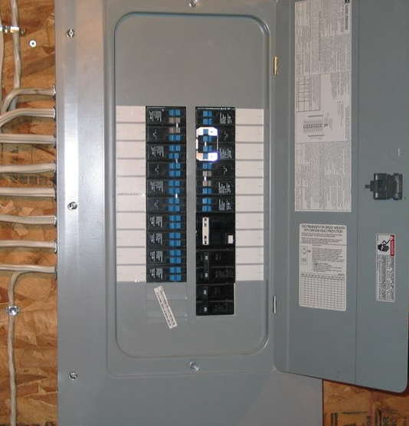
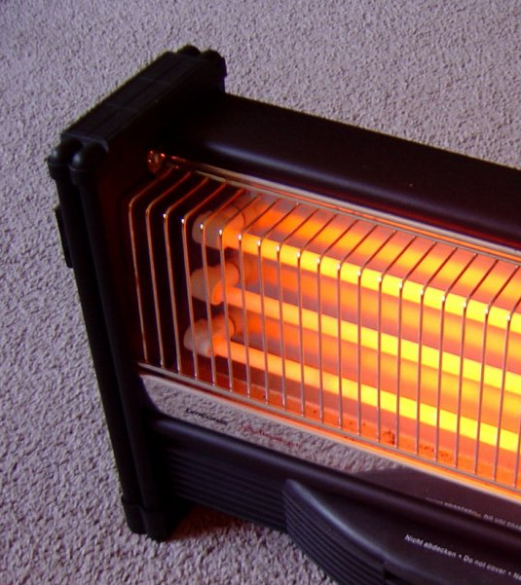
Play
it
safe
inside.
Notes:
More on electrical safety inside.
Do not touch electric equipment, like the circuit breaker box.
Never put utensils in the toaster while it is still plugged in.
Never use electric appliances or space heaters to dry clothes or bedding.
Things that use electricity often get hot, like light bulbs and this space heater. So keep the area around them clear to avoid a fire.

Slide 16
Time for
Play it Safe
LINGO

Slide 17
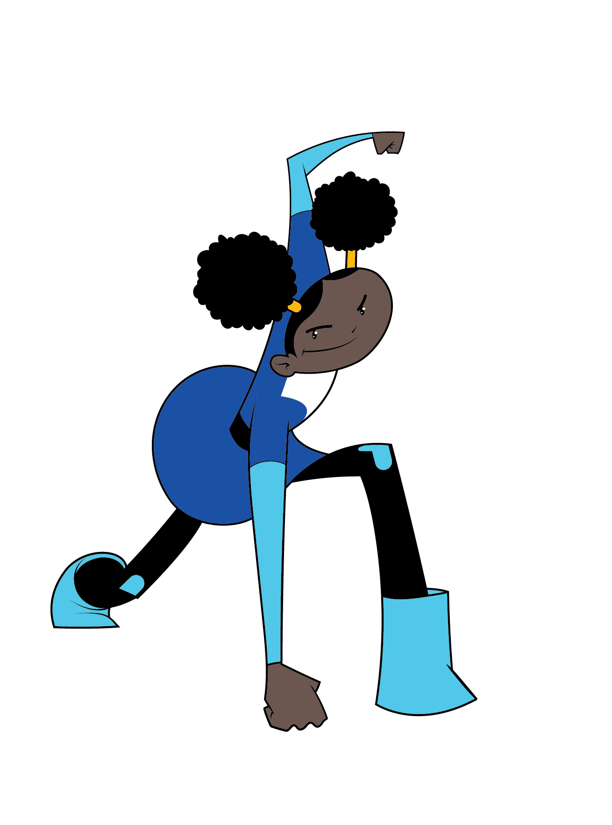
overloaded outlets
When too many appliances are plugged in, ______________
_____________ can be a fire hazard.
TM

Slide 18
frayed cord
Appliances with a broken or ________ _________
can be dangerous.
TM

Slide 19
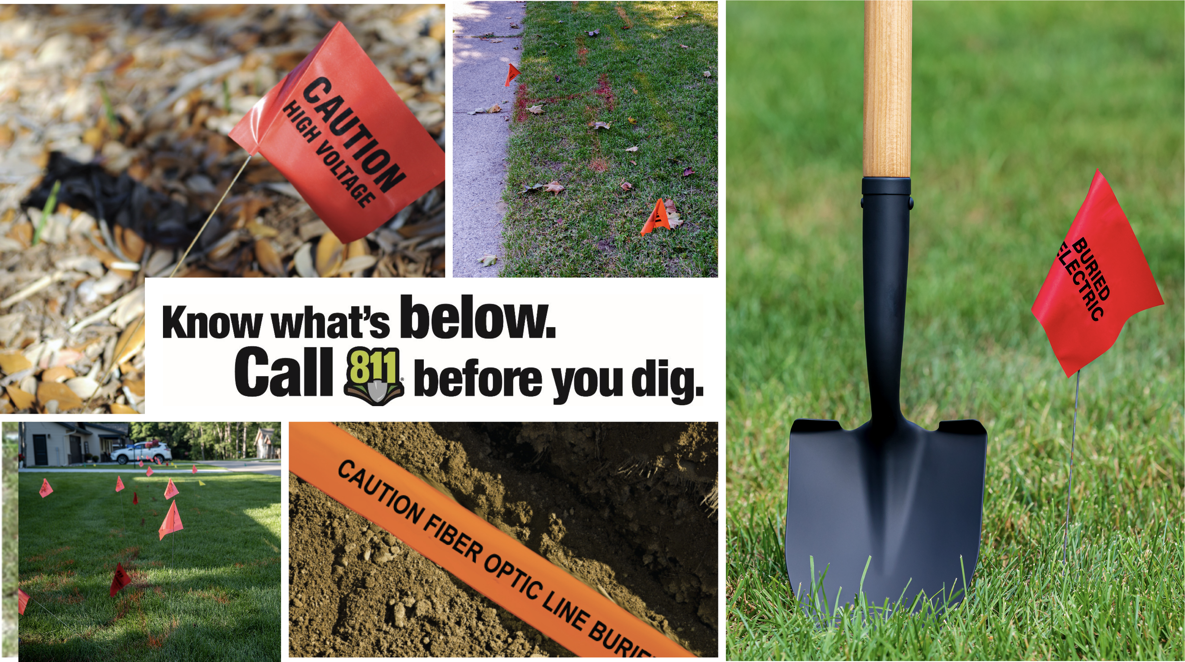
Notes:
Explain to students that before any digging occurs at home or in a community, someone must call 811 so that underground pipeline locations are properly marked above ground.
These markers are important because they help people know where not to dig.
Hitting buried electric power lines or communication lines can cause damage and serious incidents.

Slide 20
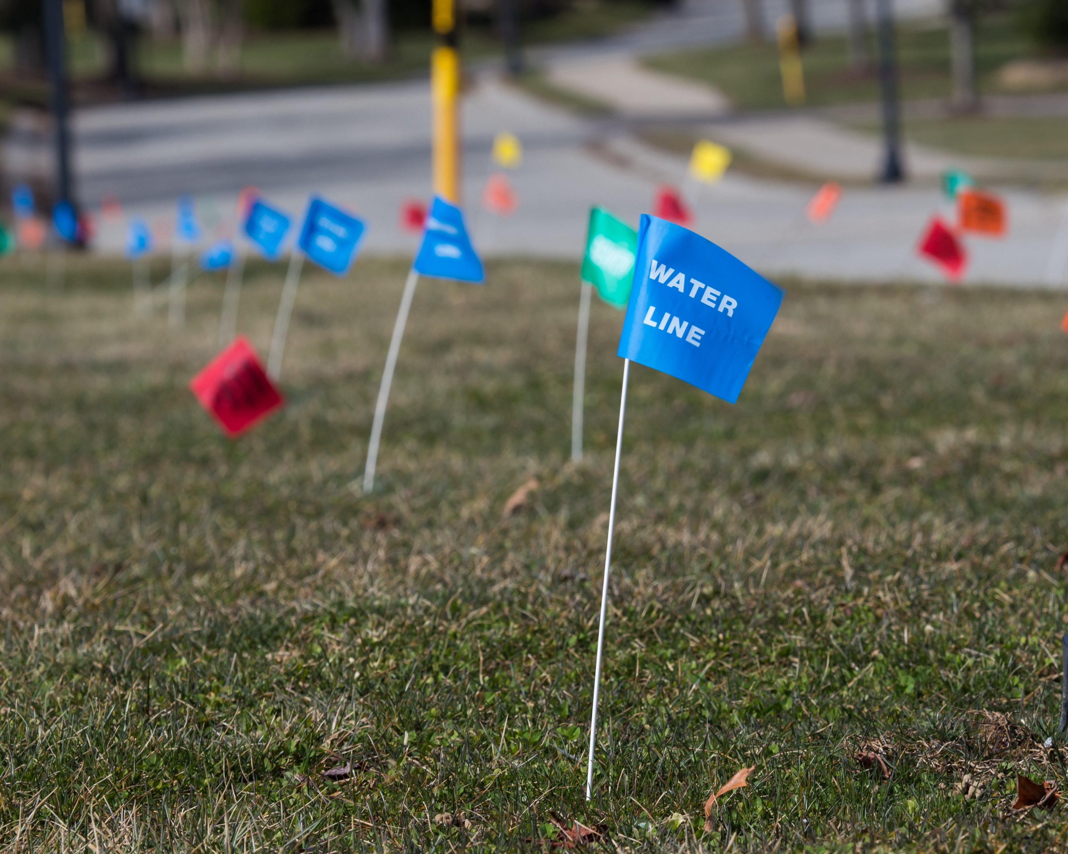

Know the COLOR CODE
WHITE: | Proposed Excavation
PINK: | Temporary Survey Markings
RED: | Electric Power Lines, Cables, Conduit and Lighting Cables
YELLOW: | Gas, Oil, Steam, Petroleum or Gaseous Materials
ORANGE: | Communication, Alarm or Signal Lines, Cables or Conduit
BLUE: | Potable Water
PURPLE: | Reclaimed Water, Irrigation and Slurry Lines
GREEN: | Sewer and Drain Lines
Do NOT move or pull out marker flags. They show the location of buried utility lines.
Notes:
Different colored flags mean different utilities are buried underground.
White flags or paint show where the someone wants to dig.
Electricity lines are marked with red.
Natural gas lines are marked with yellow flags, markers or paint.
Water lines are marked with blue.
Other colors mark things like cable (orange) and sewer lines (green).
NEVER move or pull out marker flags.
If you see flags that are laying around, you should leave them alone. Never put them back in the ground.

Slide 21

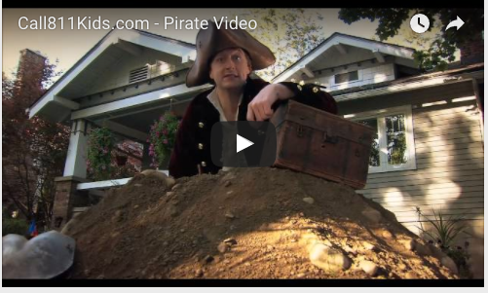
Call 811 before you dig.
Notes:
Teachers: Call 811 before you dig. The pirate video is found on the Energy Safe Kids website at energysafekids.org/electric/students or on YouTube at youtu.be/ipUdekpev0I.

Slide 22
Time for
Play it Safe
LINGO

Slide 23
811
Call _____ to have buried power lines and cables located and marked.
TM
Notes:
Call ____ to have buried power lines and cables located and marked.
811

Slide 24
Pay attention to these colorful things that can tell you what is below.
marker flags
TM
Notes:
Pay attention to these colorful things that can tell you what is below.
marker flags

Slide 25
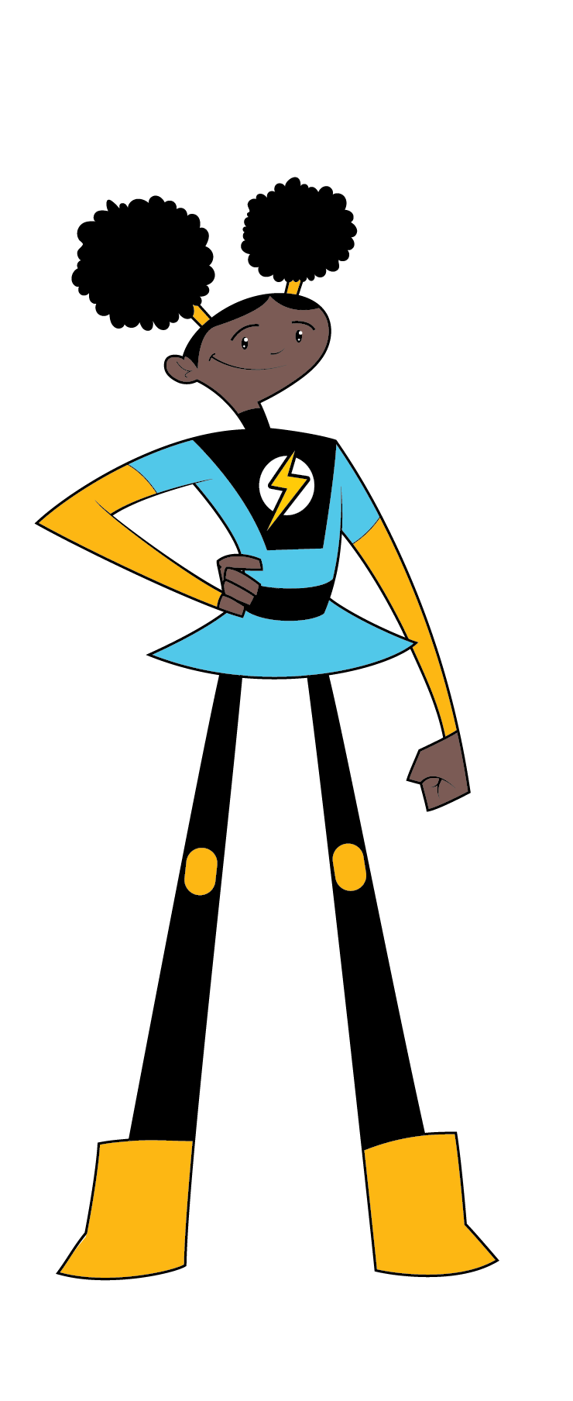
power lines
Call 811 to mark the location of utility cables and buried ___________ __________.
TM
Notes:
Call 811 to mark the location of utility cables and buried _____ _______.
power lines

Slide 26
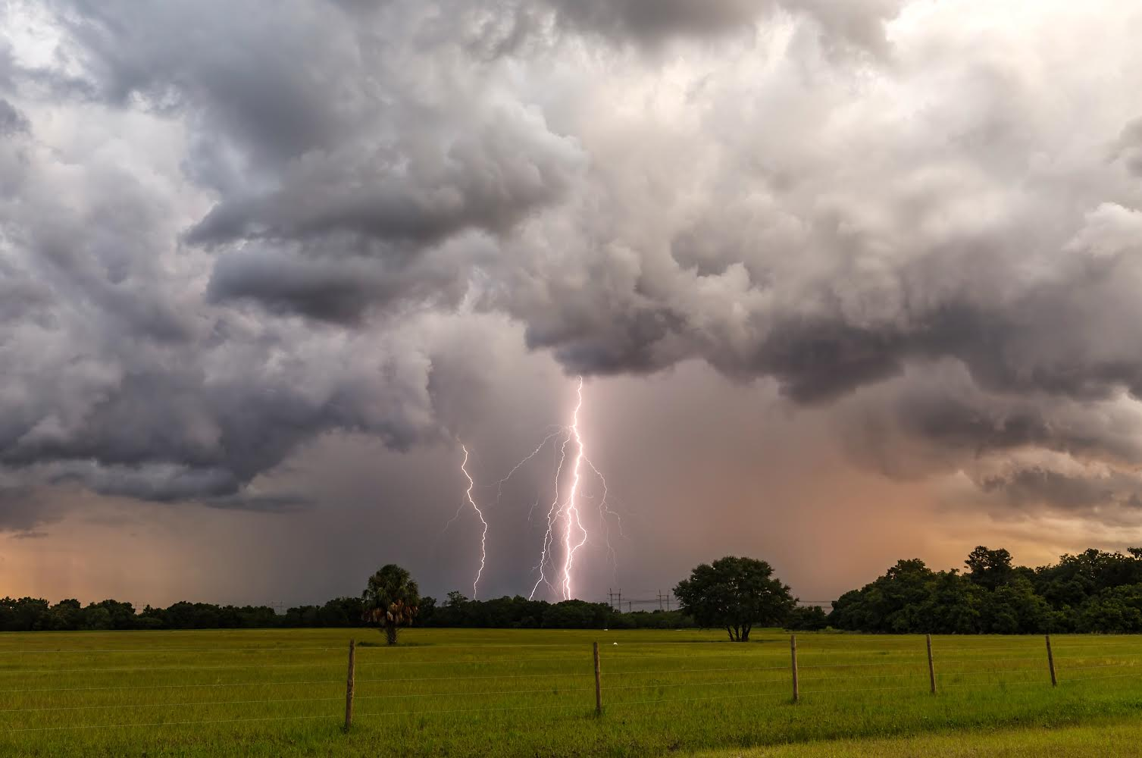
Electrical Safety Outside
Go inside when there is a storm.

Slide 27
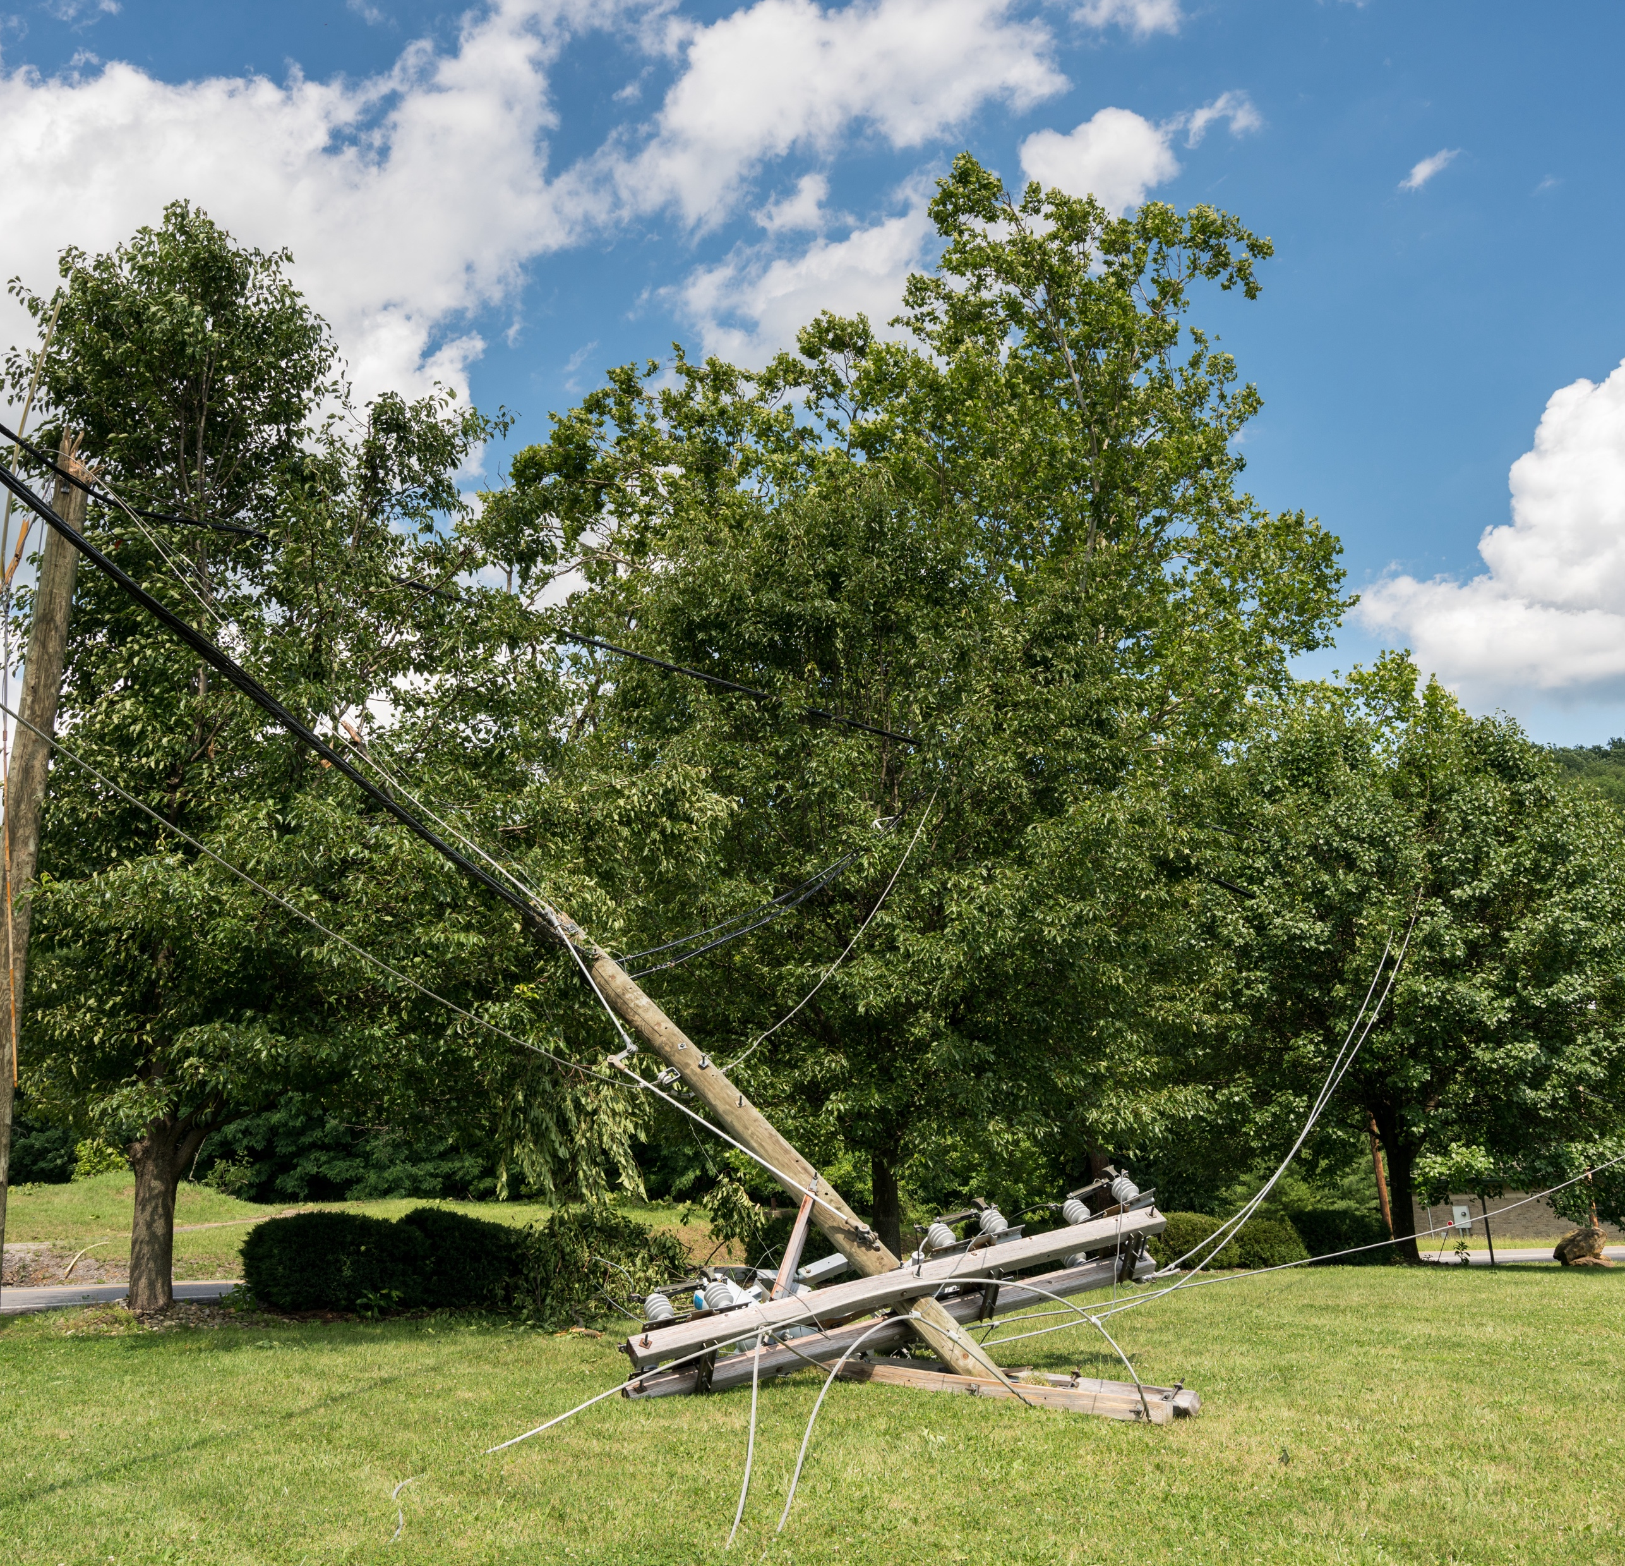
Electrical Safety Outside
  Stop, turn around and go the other way.
Notes:
Play it safe outside.
Do we know if the power lines still have electricity going through them?
We should always expect electricity to be going through the wires even if you don’t see sparks.
Stop, turn around and go the other way
Stay away from downed power lines.
Have an adult call 911 if you see downed power lines.

Slide 28
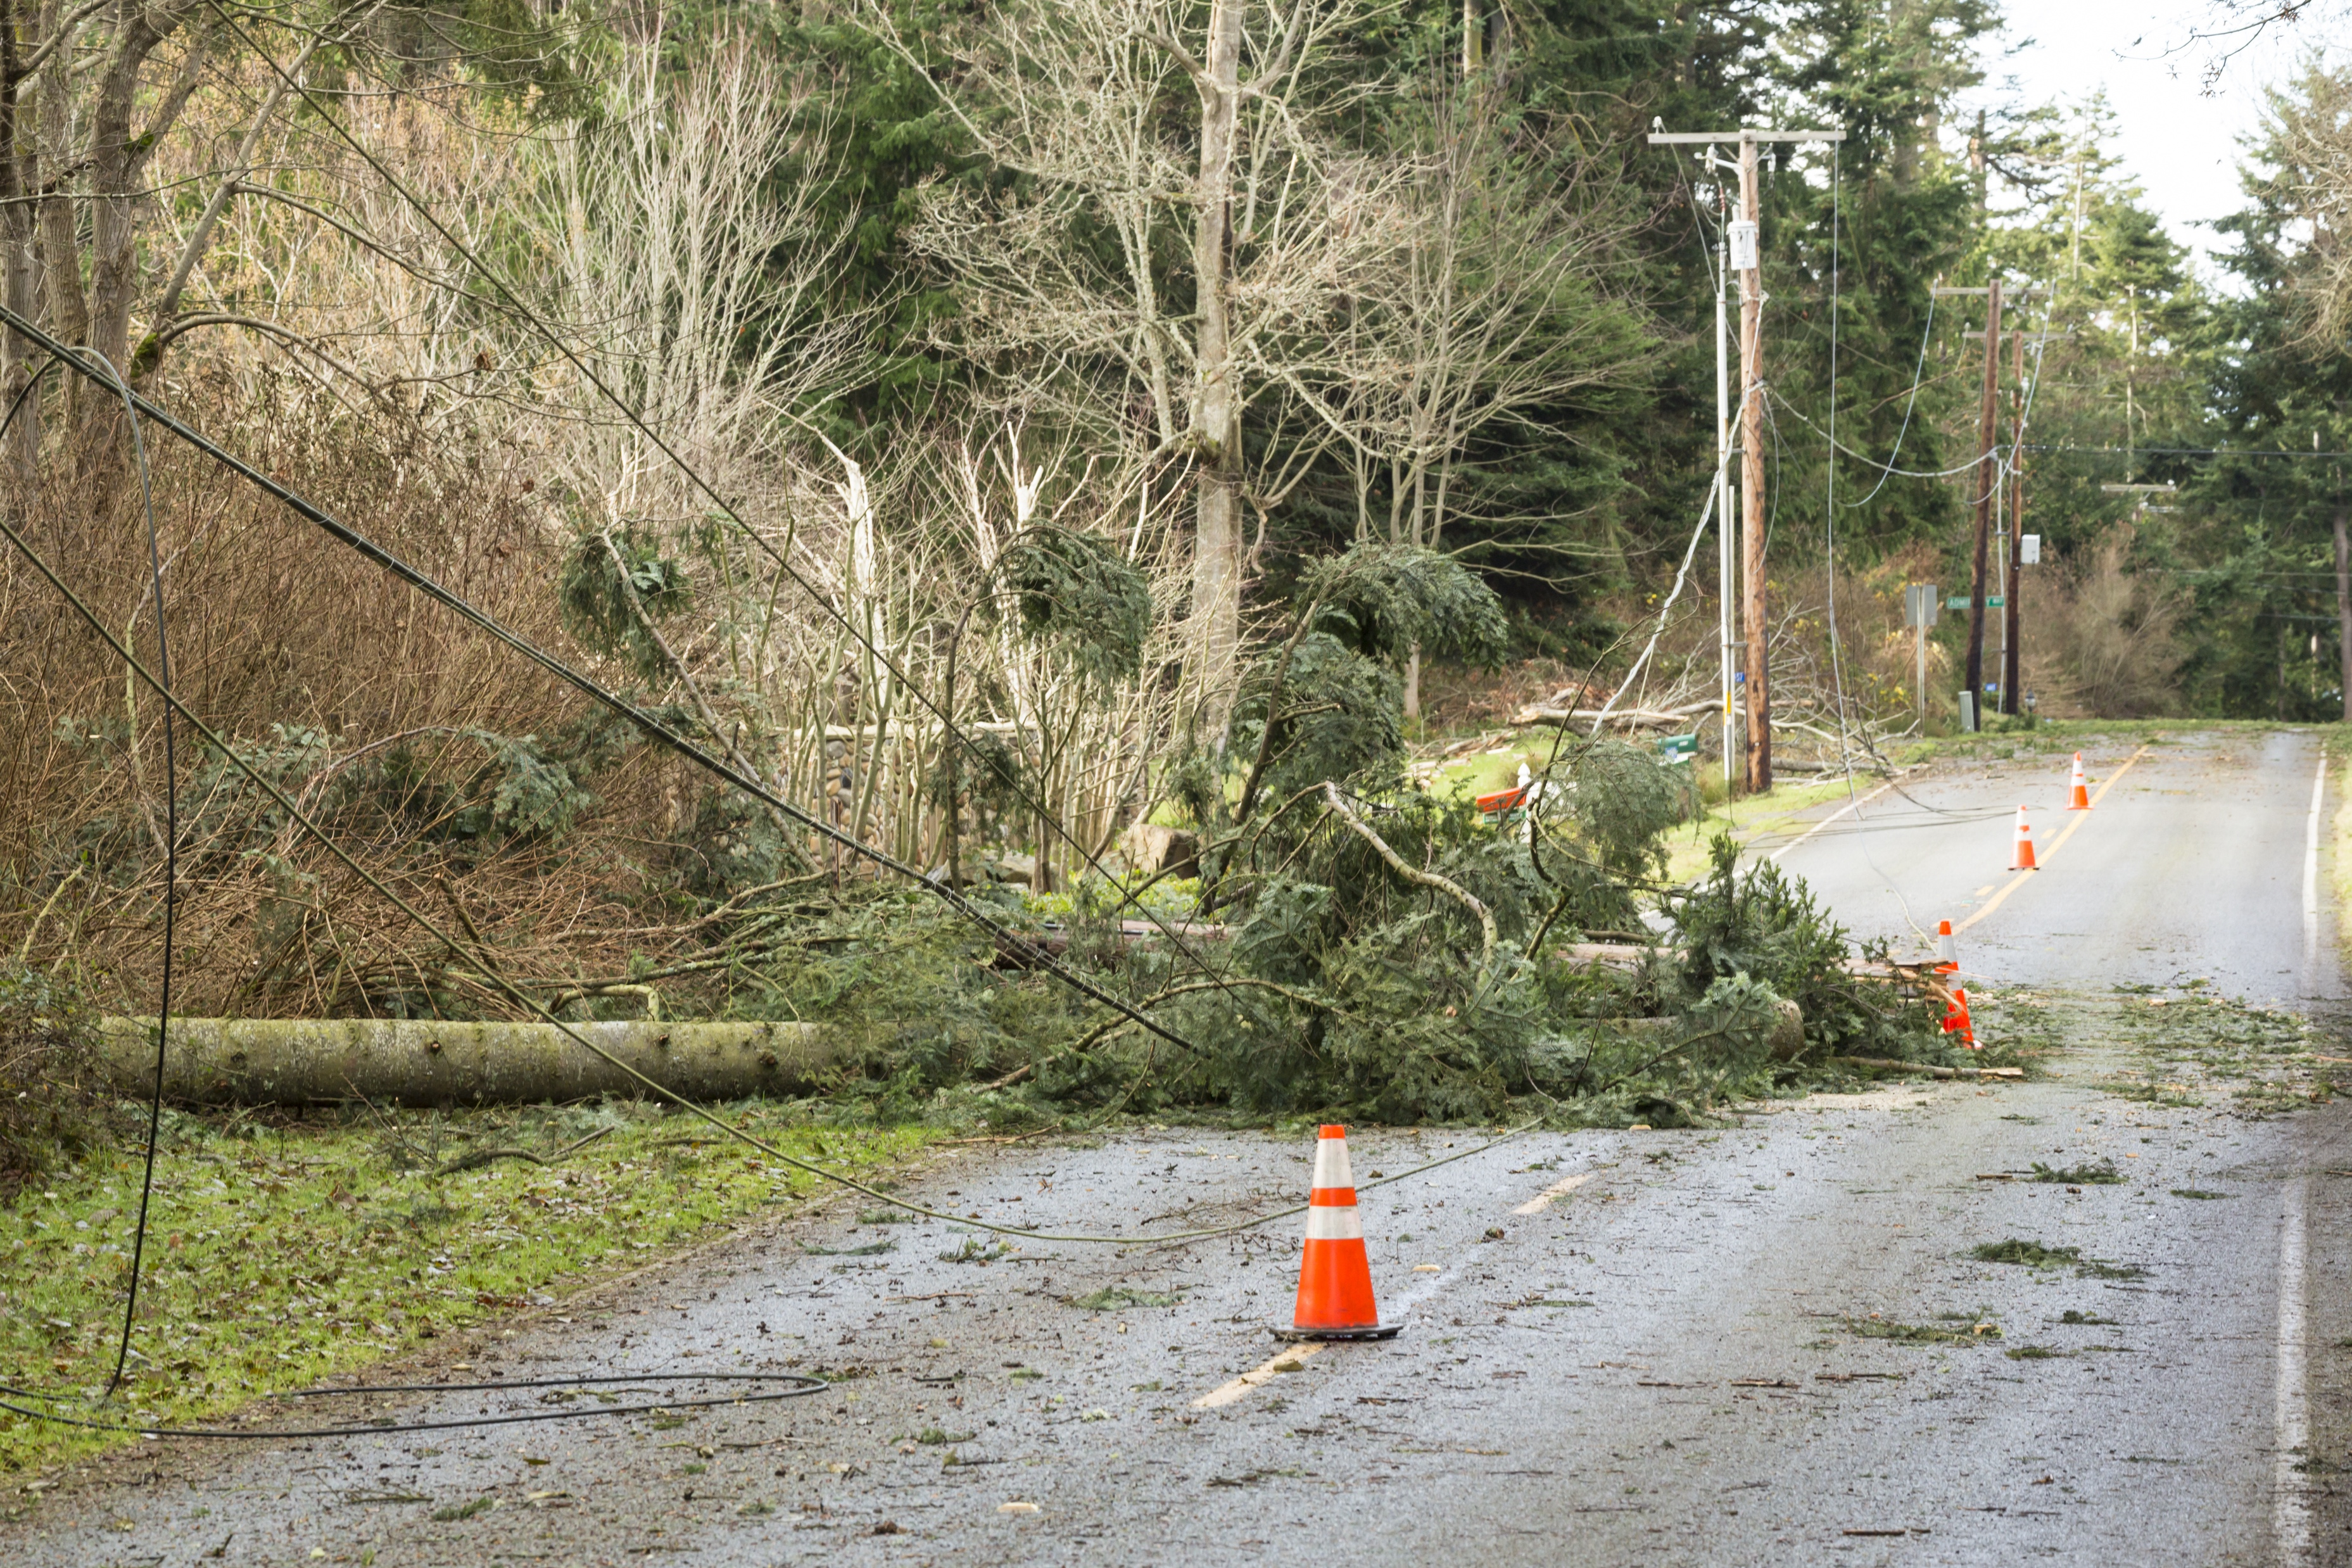
Electrical Safety Outside
  Stop, turn around and go the other way.
Notes:
Stop, turn around and go the other way.
Use hand motions. (both hands out in front of body for stop motion, then twirl hands around for “turn around” and then close fist thumbs out pointing backwards “go the other way”)
Stay away from downed power lines.
Have an adult call 911 if you see downed power lines.

Slide 29
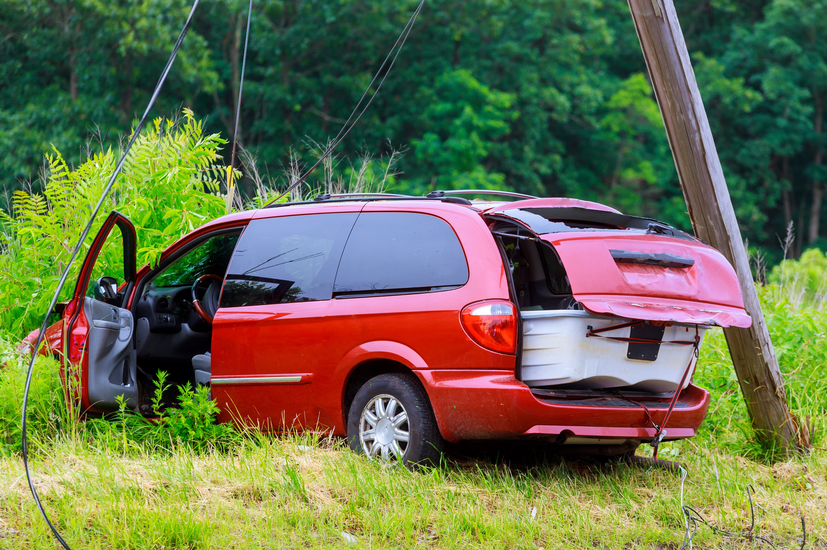
Electrical Safety Outside
  Stay inside the car and call 911.
Notes:
If power lines fall on your car, stay inside the car and call 911.
Do not touch anything metal on the vehicle.
Do NOT leave the vehicle until you are instructed by emergency personnel.
If you must get out of your car, do these four things:
Open the door but do NOT step out.
Stand on the edge of the doorframe. Remember NOT to touch anything metal.
Jump out with your feet together.
THEN hop away to a safe location. Keep your feet together the entire time you hop. Do NOT walk.
(If there is room, have the kids practice hopping three times in place with feet together.)
The energy in the downed power lines are more powerful CLOSER to the car. As you hop away from the car, there is less energy.

Slide 30
Time for
Play it Safe
LINGO

Slide 31
downed power lines
For electrical safety outside, stay away from ________ _________ __________.
TM
Notes:
For electrical safety, stay away from ____ ______ _______.
downed power lines

Slide 32
911
Tell an adult and call _____ if you see a downed power line.
TM
Notes:
Tell an adult and call ____ if you see a downed power line.
911

Slide 33
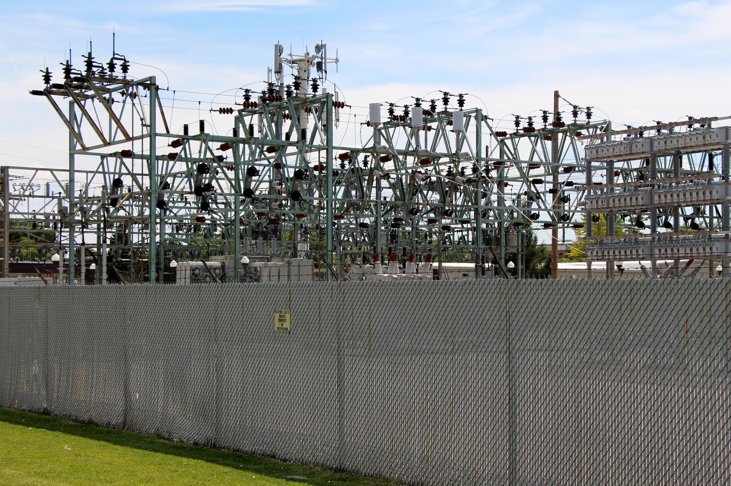
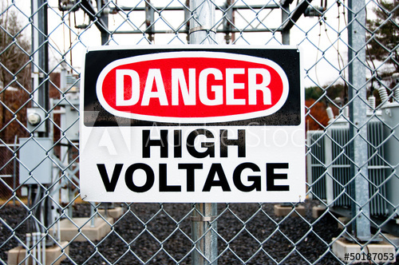
Play it safe outside.
Play far away from electrical equipment.
DO NOT climb substation fences.
Notes:
Stay away from electrical equipment.
DO NOT climb substation fences for any reason. If something goes over the fence like a ball or toy, it is gone.

Slide 34
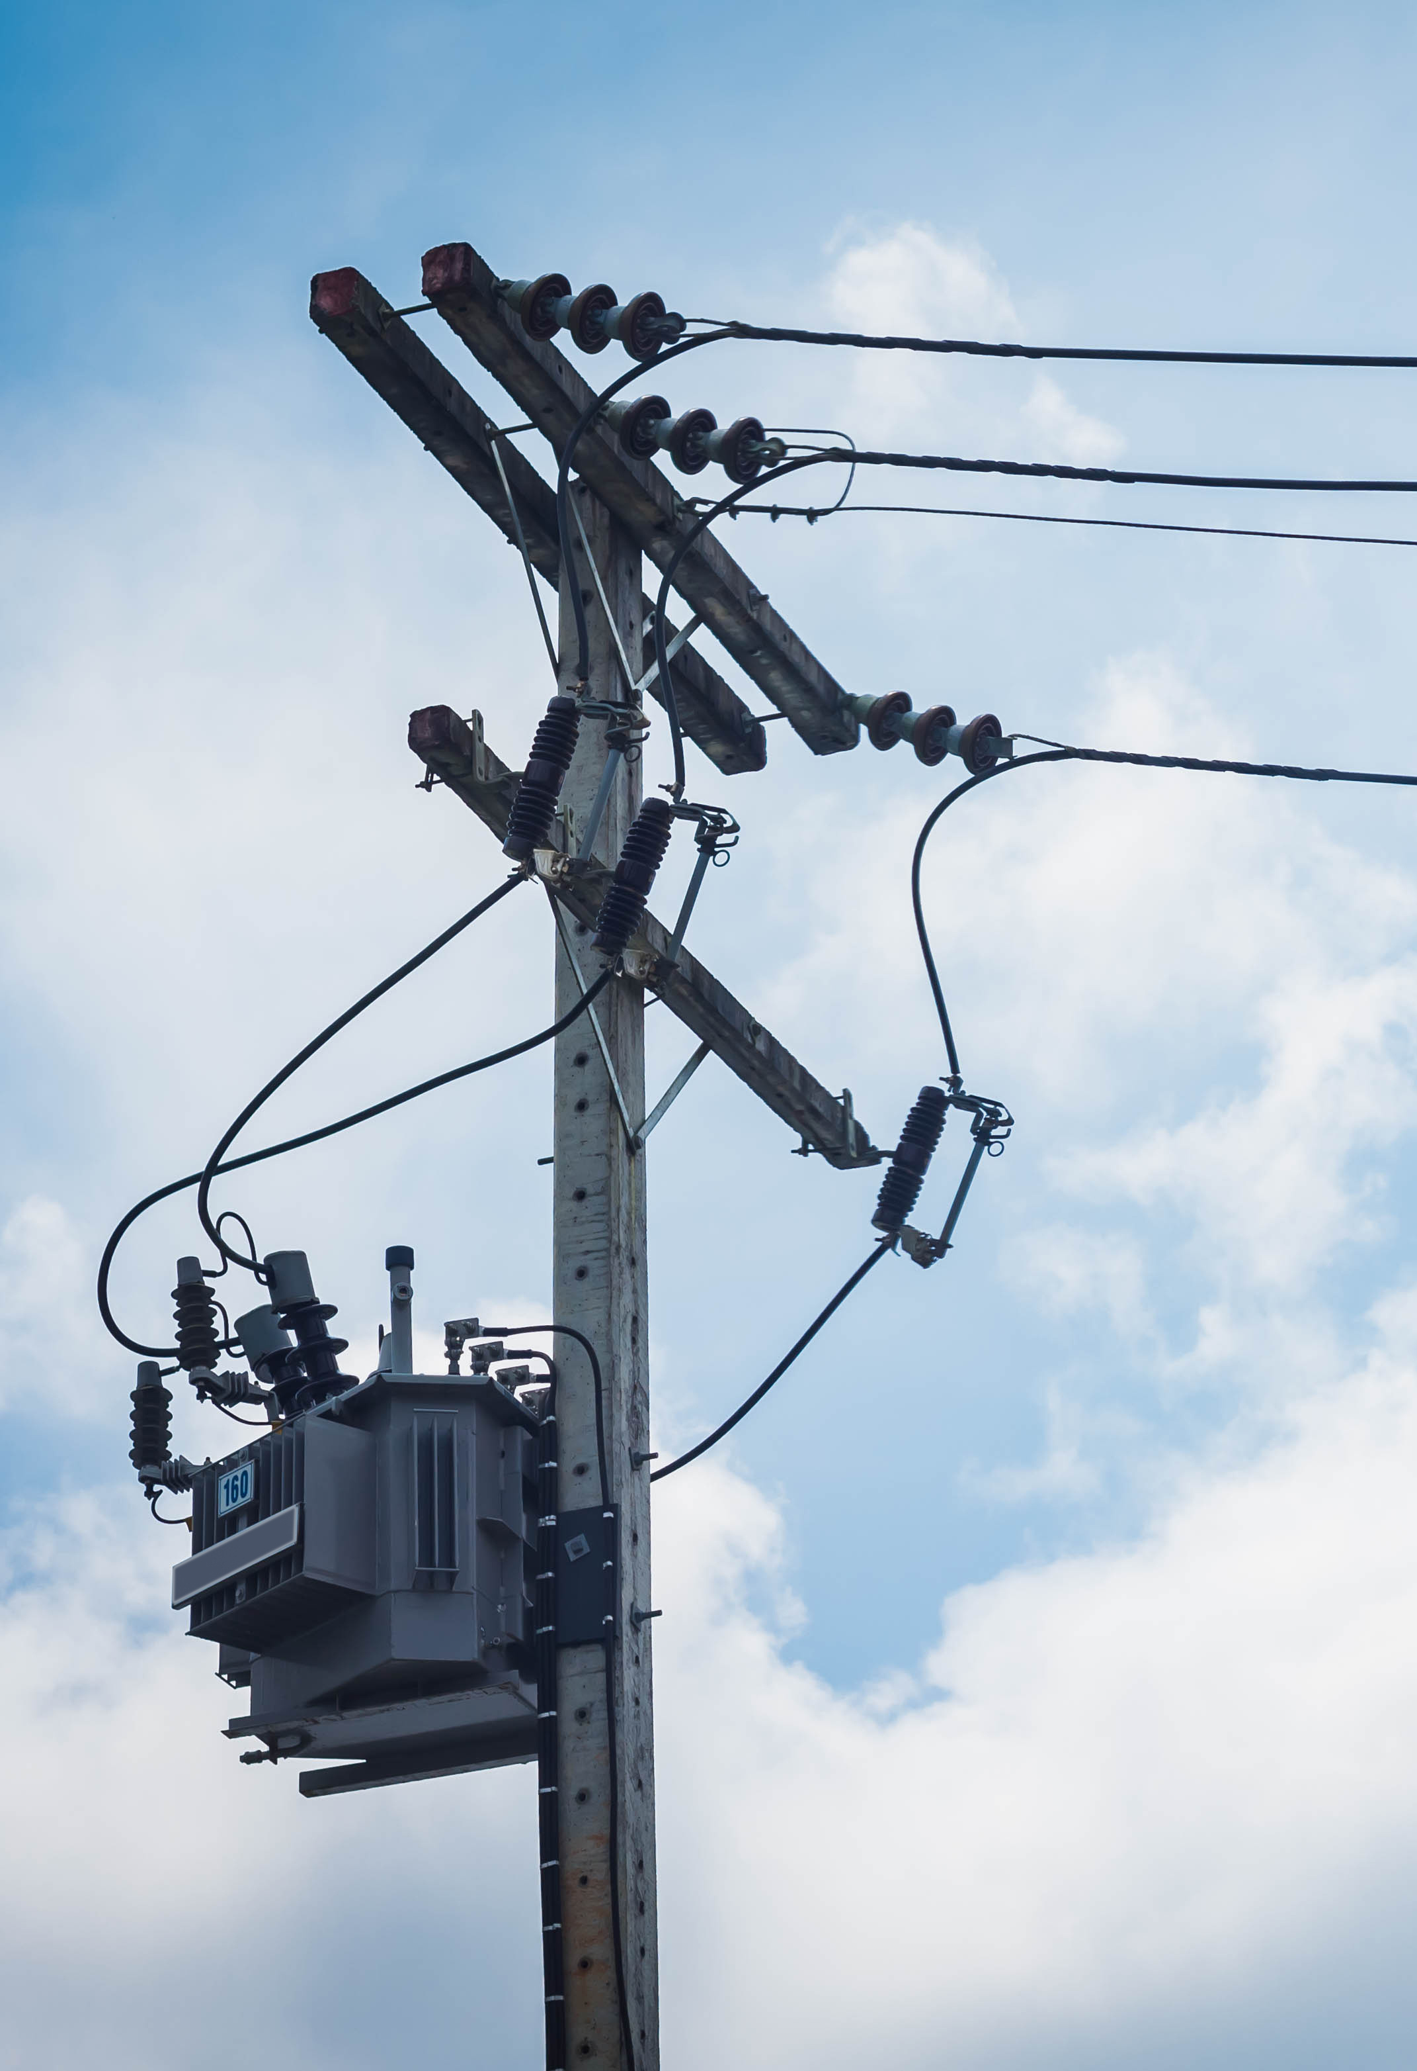
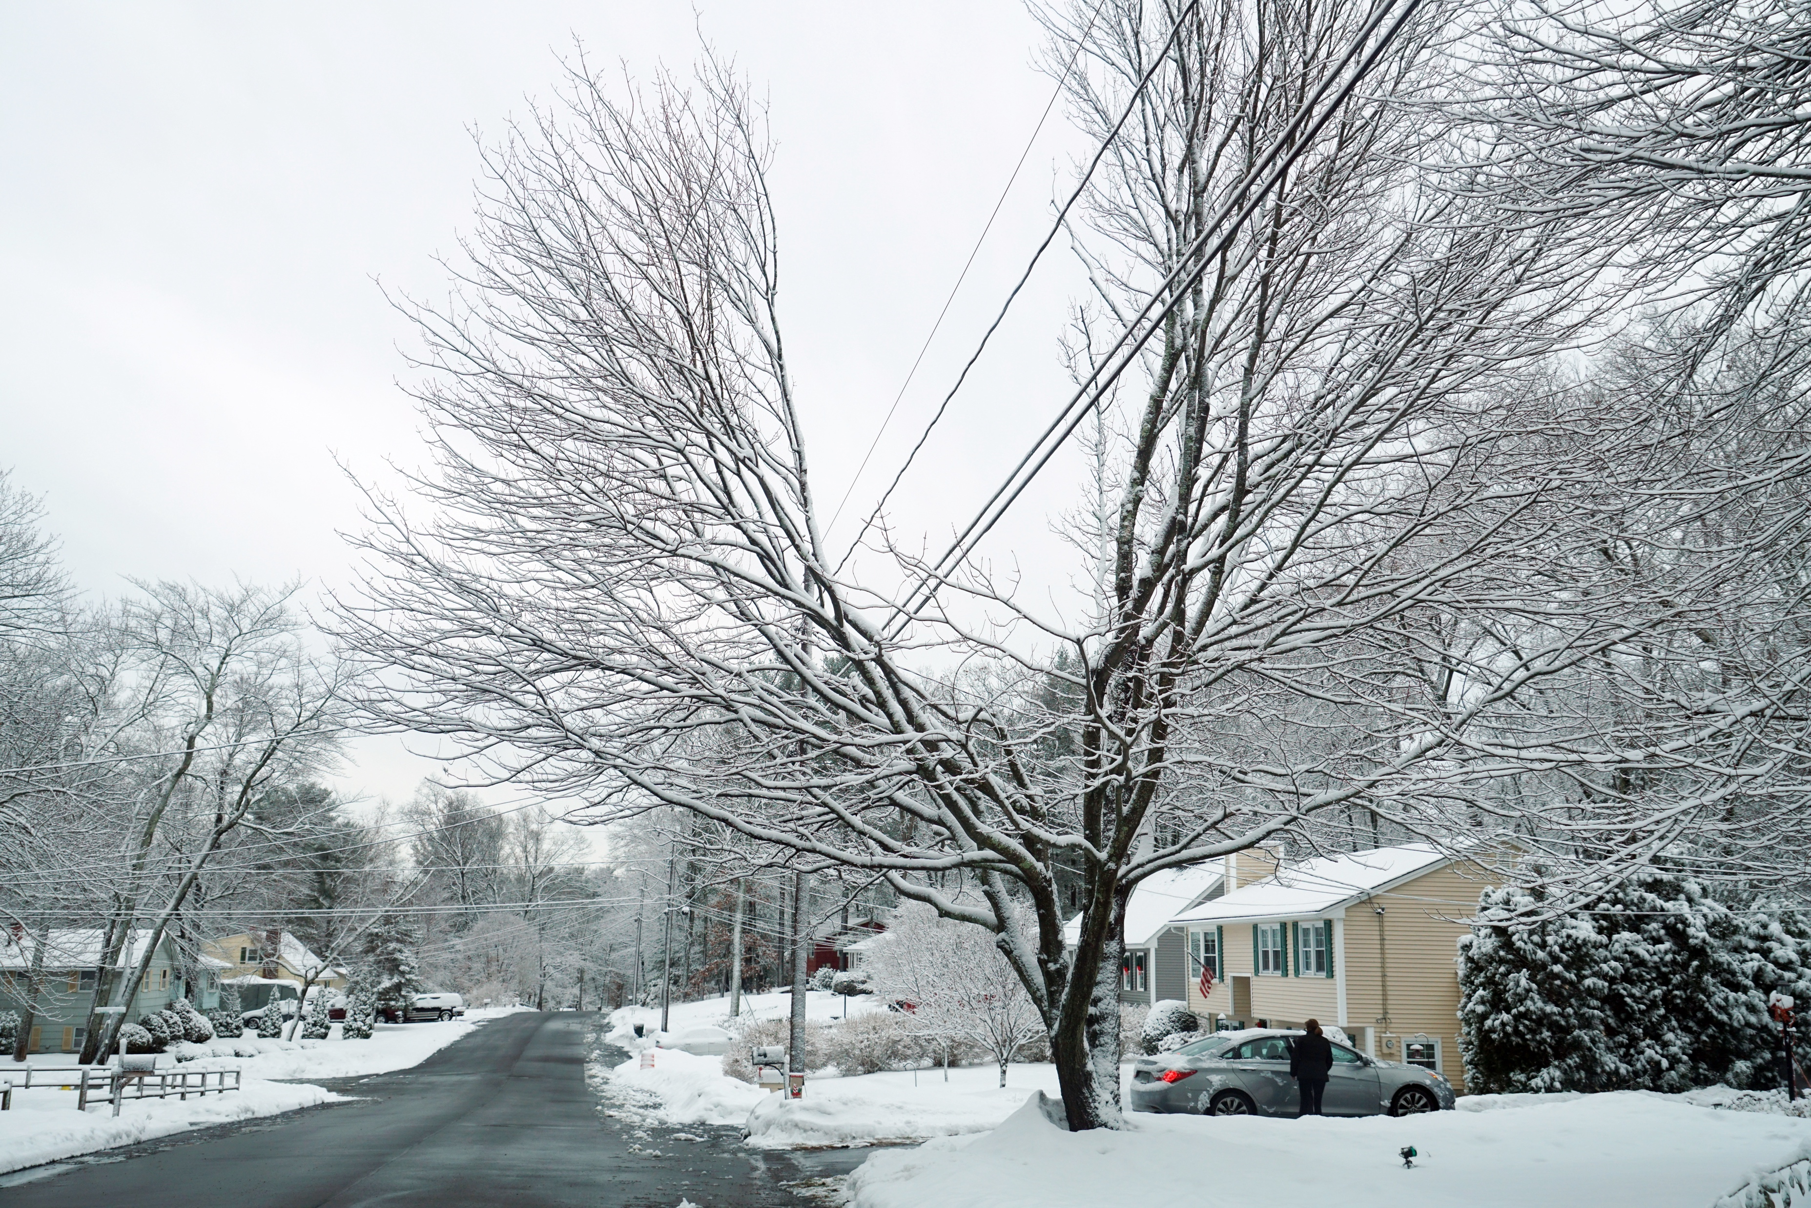
Play it safe outside.
power poles
power lines through tree top
Do not climb power poles or
trees near power lines.
Notes:
Do not climb power poles, especially ones with transformers at the top.
Do not climb trees near power lines.
Do not fly kites or drones around power lines. Let go of the kite immediately if it gets near wires.

Slide 35
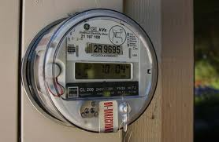
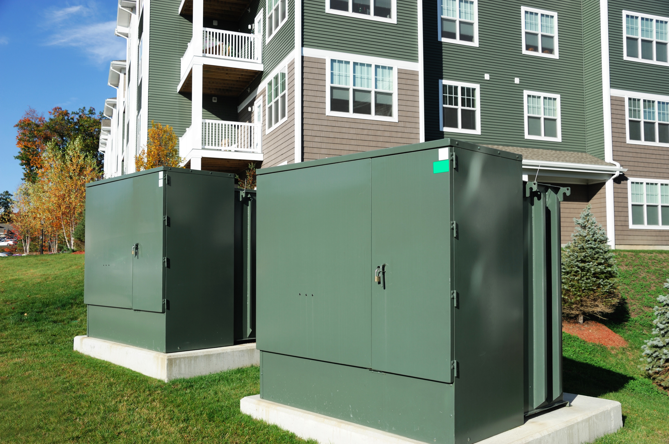
Play it safe outside.
electric meters
pad mount transformer
Stay away from electrical equipment like electric meters and transformers.
Notes:
Do not play around electric equipment such as meters or pad mount transformers.
Pad mount transformers are transformers for buried electrical lines. They change the voltages going into homes or business and are very powerful.

Slide 36
Time for
Play it Safe
LINGO

Slide 37
substation
Never climb the fence around a __________ for any reason because it is dangerous.
TM
Notes:
Never climb the fence around a ______ for any reason because it is dangerous.
substation

Slide 38
Pad mount _______ change the voltage of buried power lines and can be dangerous to play on.
transformers
TM
Notes:
Pad mount ___________ change the voltage of the buried power lines and can be dangerous to play on.
transformers

Slide 39
Keep electrical equipment like ____ ____ and ____ ____ ___ free of clutter and never play around them.
electric meters
circuit breaker box
TM
Notes:
Keep electrical equipment like _____ _____ and ______ _____ _____ free of clutter and never play around them.
electric meters, circuit breaker box

Slide 40
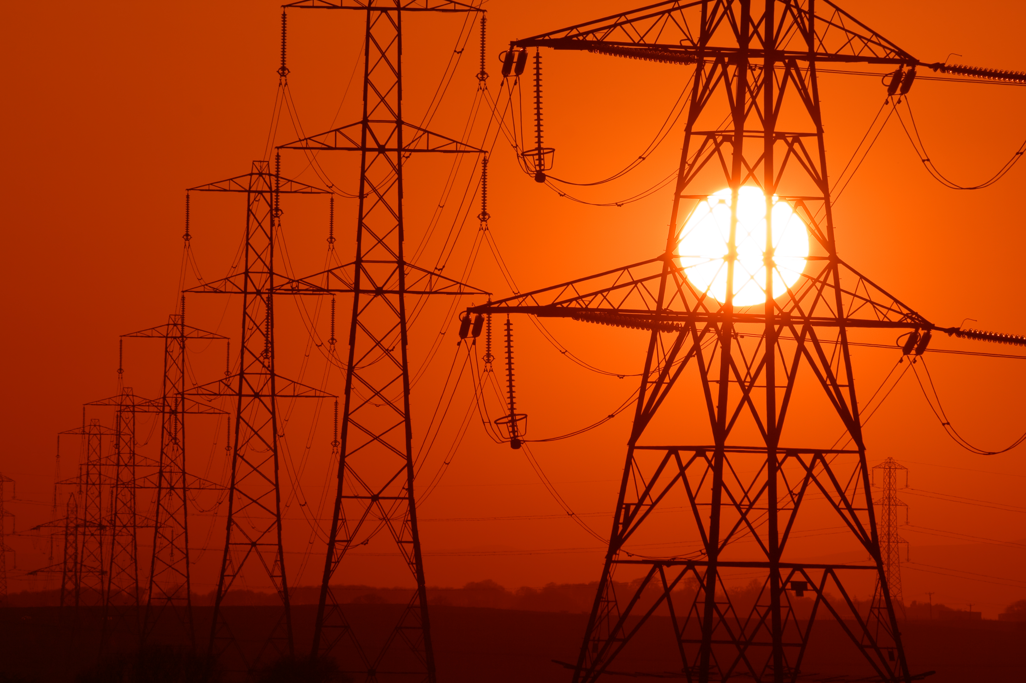
Electricity is powerful and we
must use it safely.
Notes:
Electricity is a powerful energy source and we must be safe when using it.

Slide 41










Electrical Safety Sense
Are you ready?
Notes:
Tell students how to play the review game:
They must remember many points of knowledge that were mentioned in the presentation.
Students can be called upon individually or as a class (if you have several) or to the group as a whole.
THUMBS UP for YES, THUMBS DOWN for NO!
They complete the Electrical Safety Sense circle or pie chart by answering 10 questions. The goal is to be 100 percent correct.
With each correctly answered question, students are 10 percent closer to completing the circle.
Are you READY?

Slide 42
Do you need to be careful around electricity?
TM
Notes:
Do you need to be careful around electricity?

Slide 43
10%
yes
TM
Notes:
yes

Slide 44
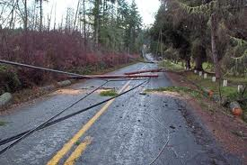
If you see a downed power line, do you TELL an adult right away?
TM
Notes:
If you see a downed power line, do you tell an adult right away?

Slide 45
20%
yes
TM
Notes:
yes

Slide 46
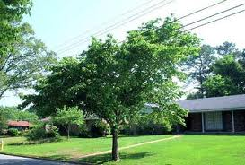
Should you play around power poles or trees that have overhead wires nearby?
TM
Notes:
Should you play around power poles or trees that have overhead wires nearby?

Slide 47
30%
no
TM
Notes:
no

Slide 48

Overloading electrical _______ is dangerous.
Notes:
Overloading electrical _________ is dangerous.

Slide 49
40%
outlets
TM
Notes:
outlets

Slide 50

You should NOT play ________ during a storm.
TM
Notes:
You should not play _________ during a storm.

Slide 51
50%
outside
TM
Notes:
outside

Slide 52
  Your family should keep the area around your _____ ______ box clean.
TM
Notes:
Your family should keep the area around your circuit breaker box clean.

Slide 53
60%
circuit breaker
TM
Notes:
circuit breaker

Slide 54
You should NOT unplug appliances by the _____.
TM
Notes:
You should not unplug appliances or electronics by the _____.

Slide 55
70%
cord
TM
Notes:
cord

Slide 56
You should not play around electric equipment like ____.
TM
Notes:
You should not play around electric equipment like _______.

Slide 57
80%
meters
TM
Notes:
meters

Slide 58

You should call _____ to mark the location of buried power lines.
Notes:
You should call ______ to mark the location of buried power lines.

Slide 59
90%
811
TM
Notes:
811

Slide 60
You should never climb fences around ___________.
TM
Notes:
You should never climb fences around __________.

Slide 61
100%
substations
TM
Notes:
substations

Slide 62
TM
ELECTRICAL SAFETY SENSE
Completed = 100% Safe
Notes:
Congratulate the students on being smart ENERGY SAFE KIDS. They have completed Electrical Safety Sense.

Slide 63

You can be an
Energy Safe Kid!
Brought to you by:
TM
© National Energy Foundation
Notes:
Thank participants for letting us visit and encourage students to BE SAFE and be Energy Safe Kids.
Teachers, if you have any questions or would like additional resources to help you teach about electrical safety, please email u at energysafety@nef1.org.

