Slide 1



Brought to you by:
™
Notes:
Welcome to the Energy Safe Kids presentation, sponsored by your local natural gas utility in partnership with the National Energy Foundation.

Slide 2


Think!
Talk!
Take Action!
about energy and
natural gas safety!
™
Notes:
We are going to Think!, Talk! and Take Action about energy and natural gas safety.

Slide 3
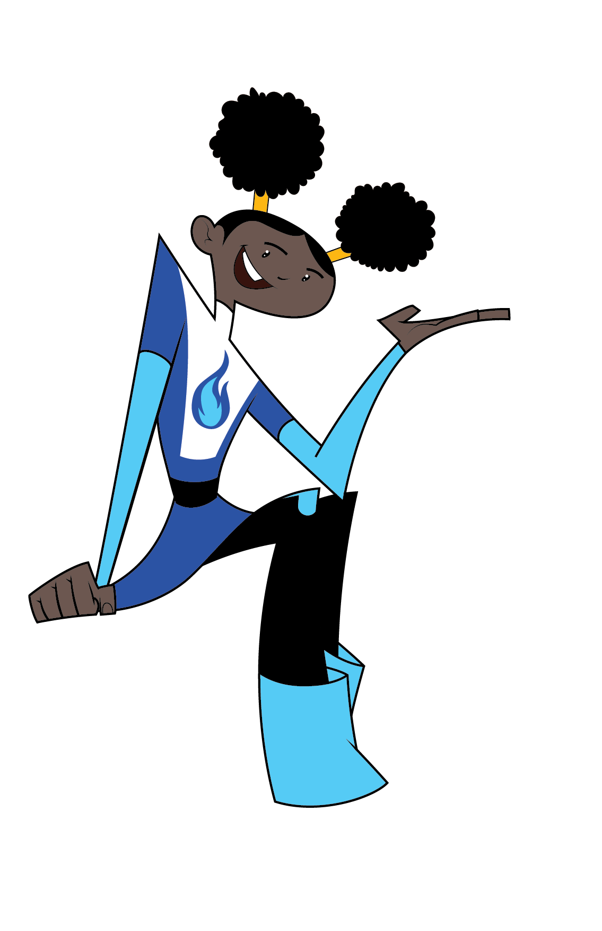
In this presentation, we will
Learn about energy and the properties of natural gas.
Learn about natural gas safety,
inside and outside.
Play Damage Prevention Lingo
™
Notes:
Playing Damage Prevention Lingo will help you learn to be safe around natural gas.
A question will appear on the slide. If you have the answer on your Lingo card, cross it off.

Slide 4

ENERGY
is the ability to do WORK
Notes:
OK – time to Talk! about energy.
How do you use energy?
Get a few ideas from students.

Slide 5
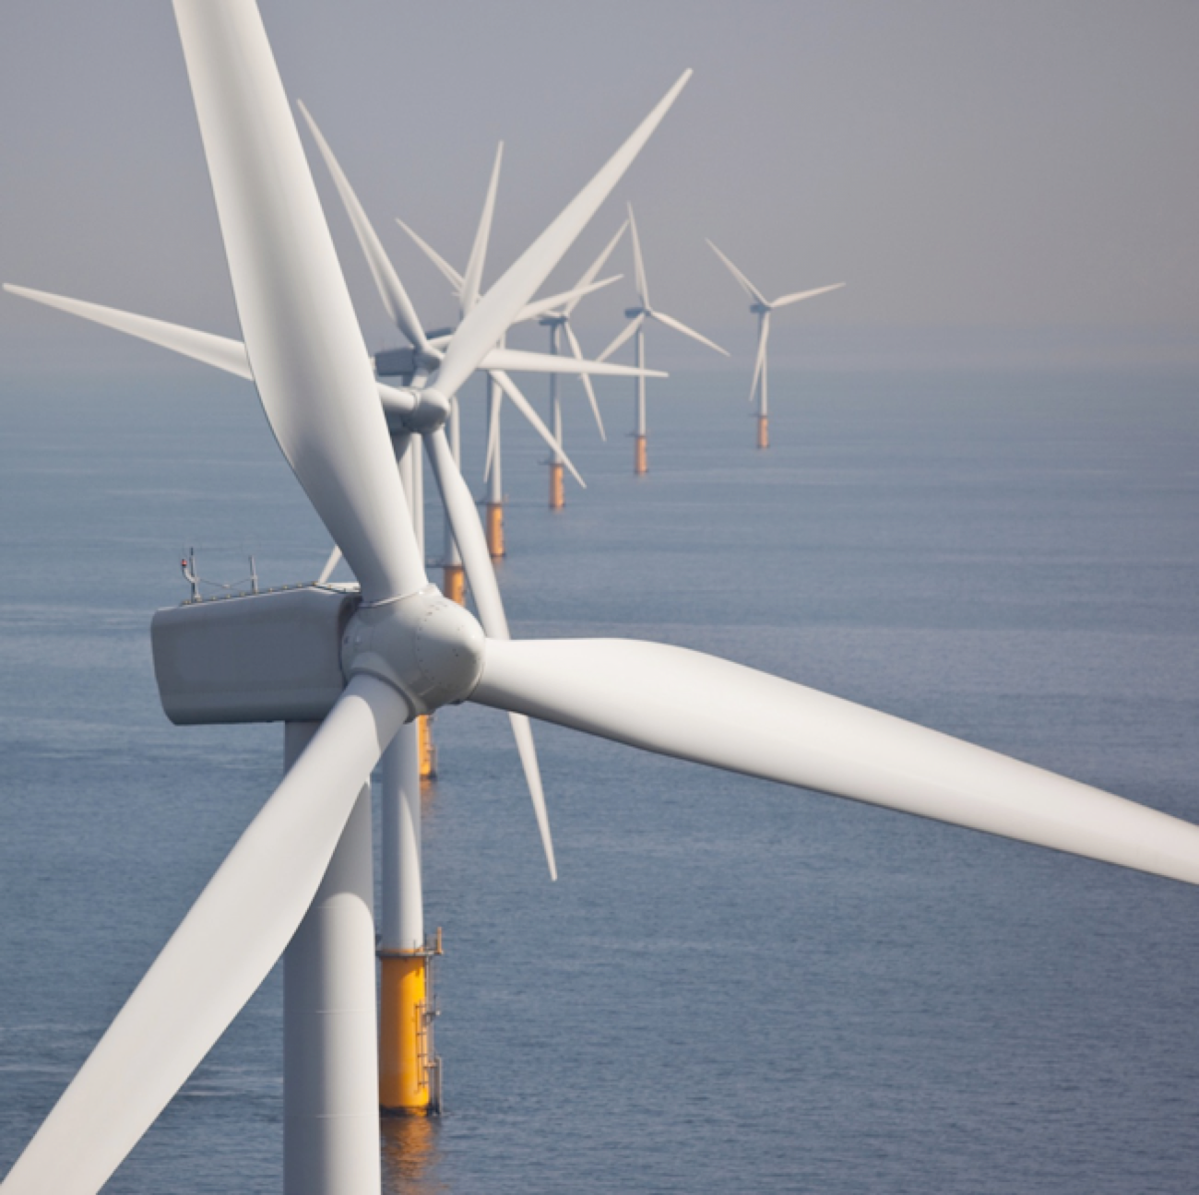
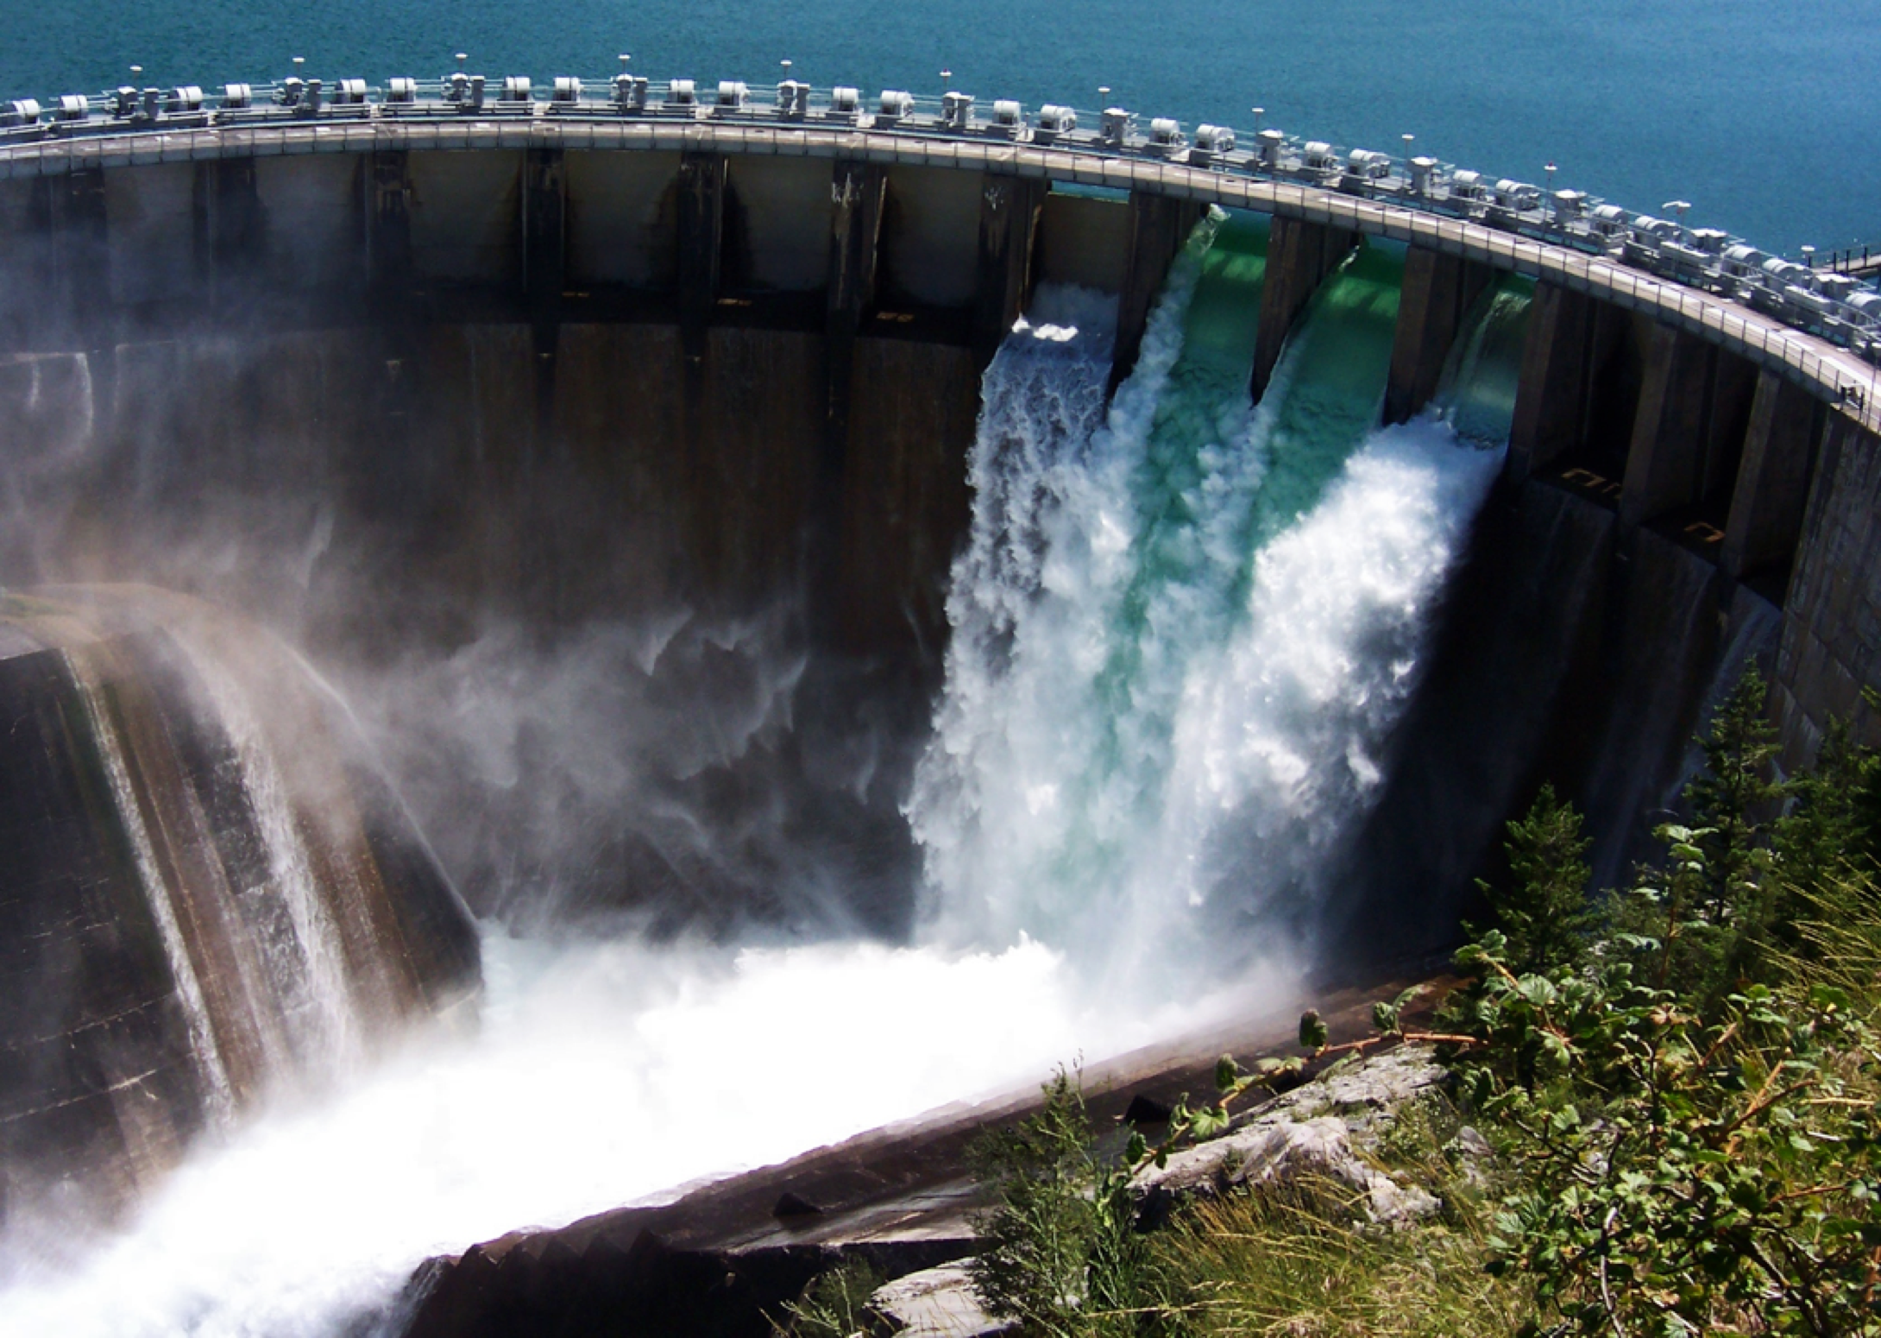

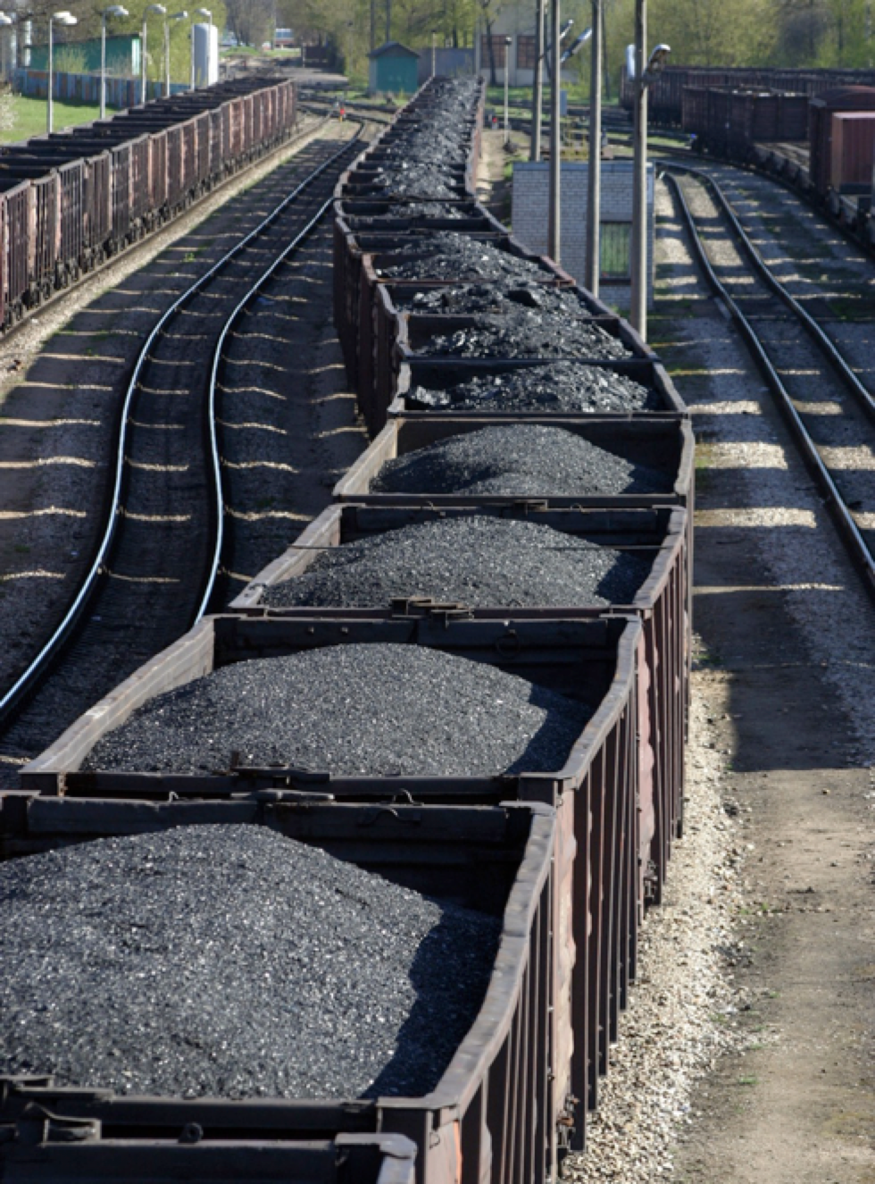
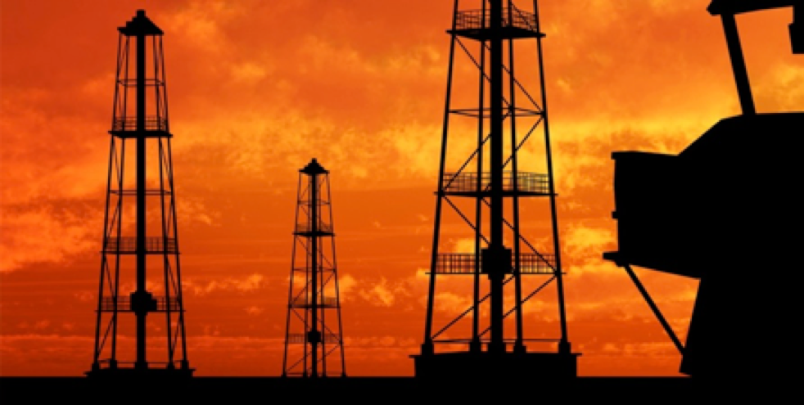
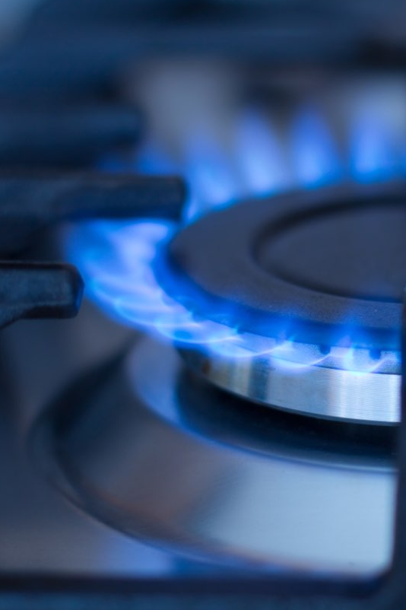
Renewable and Nonrenewable Energy Sources
Notes:
We use energy to do almost everything, so it is important to understand where our energy comes from.
We get all of our energy from natural resources.
Renewable resources are naturally replaced; like wind, water and solar.
Nonrenewable resources take a long time to form such as our fossil fuels: coal, oil and natural gas.

Slide 6
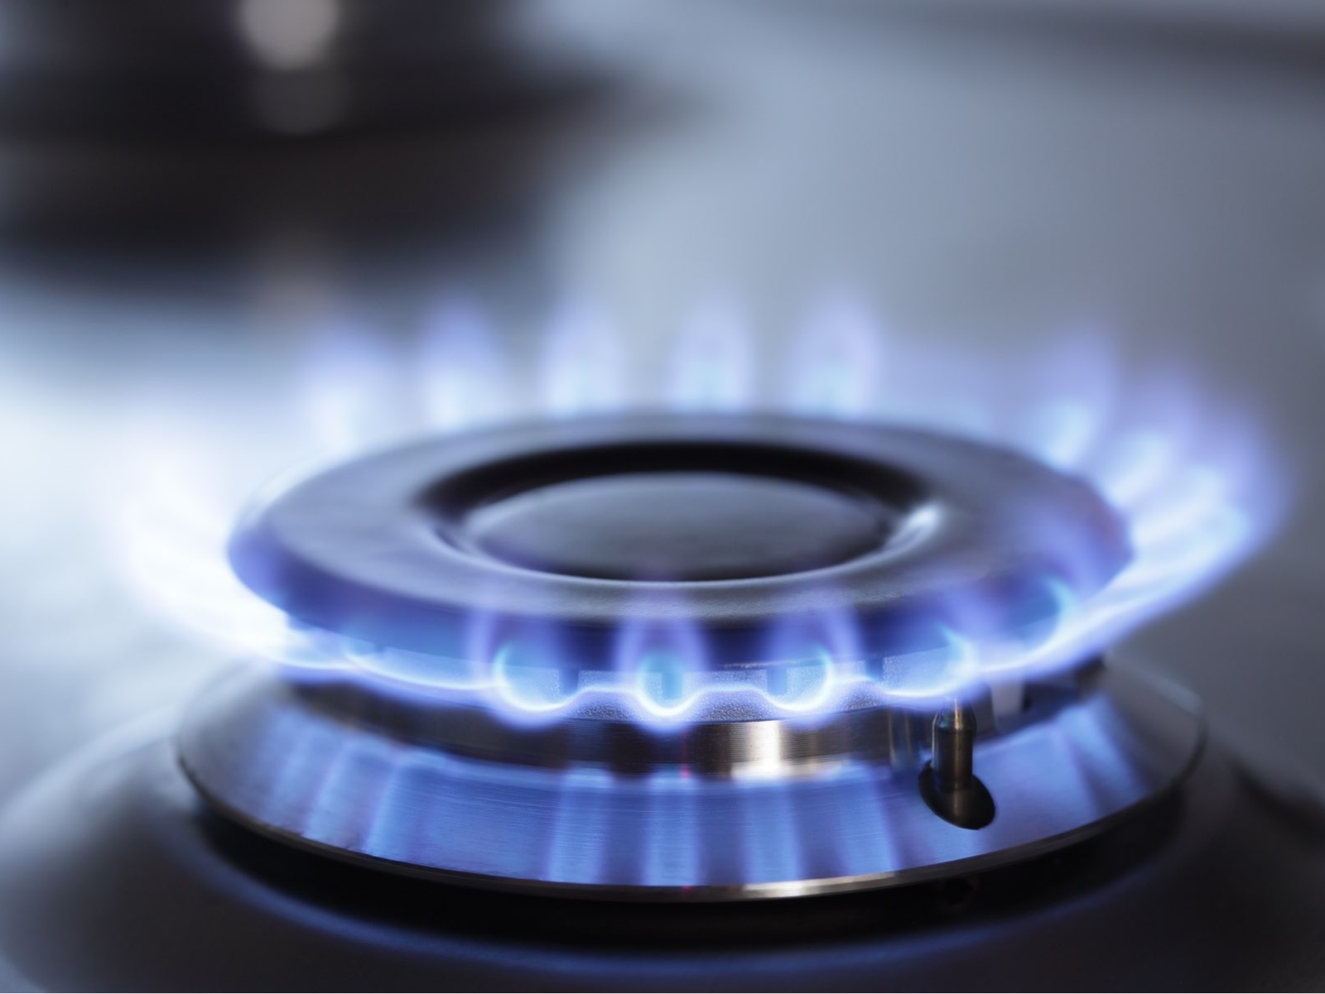
Natural Gas Safety
Notes:
SAY/DO:
We are here today to talk with you about natural gas safety.
How do we use natural gas? Raise your hand if you have any of these appliances in your home
Natural gas burns:
Cleaner than other forms of nonrenewable energy (no smoke)
Natural gas is reliable.
Because natural gas travels through pipes, which are buried underground, it’s less likely that stormy weather will disrupt the natural gas coming into your home.
Natural gas is a safe and reliable energy source. Like other types of energy, natural gas has the potential to be dangerous when it is used improperly.
e.

Slide 7

What is natural gas?
Notes:
Your natural gas company supplies the natural gas for homes, schools and businesses.
What is natural gas?
The video clip will give you an idea of how natural gas was formed many years ago.
After the clip, recap for students:
The plankton died and went to the bottom of the ocean and were covered by sand, silt and water. The weight of those layers caused the plankton to change into natural gas.
Let’s do an activity to simulate the heat and pressure.
For student engagement have students hold their hands up.
One hand is HEAT and the other hand is PRESSURE. Let’s put heat and pressure together and press your palms together holding for five seconds. (Count backwards from 5. 5- 4- 3- 2- 1.)
Are your hands cold or warm? They are warm. This is how heat and pressure change plankton into natural gas.

Slide 8



  Experiment Time
  States of Matter
Notes:
SAY/DO:
Have the bottle experiment set up ahead of time.
Pour a small amount (1/3 cup) of vinegar in a clear plastic bottle.
Using a funnel placed into the neck of a balloon, put two spoonfuls of baking soda into a balloon.
With the round part of the balloon with the baking soda in it hanging down the side of the bottle, stretch the neck of the balloon and place over the opening of the bottle.
Wear your safety glasses.
Teacher: Hold tight to the balloon and the bottle neck in case it was not secured over the opening.
Three common states of matter are solid, liquid and gas.
(Ask a student or the class at large.)
In my experiment, what are the solids? The bottle and the balloon.
Is there a solid inside the balloon? (Squish the balloon.)
Does everyone see the liquid? (Point to the liquid.)
When we mix these two compounds, we will make a gas.
Hold the tip of the balloon and bring it up and over the bottle so that all of the stuff inside the balloon drops down in to the bottle.
Wow, look - the chemical reaction is making a gas and is expanding the balloon.
The chemical reaction will make carbon dioxide gas which will inflate the balloon.

Slide 9
Properties of
Natural Gas
Notes:
Like the gas in the bottle, natural gas is typically a gas, but can be liquefied.
It is sometimes called “gas” for short, but shouldn’t be confused with gasoline that runs in your car.
Gasoline is a liquid and natural gas is a gas.

Slide 10

An odorant called mercaptan is
added to natural gas for safety.
Properties of
Natural Gas
It is colorless.
It is odorless.
Notes:
Mercaptan text box animates automatically after 3 seconds.
Natural gas is colorless.
The gas inside the bottle is colorless too.
When it burns, it creates a blue flame.
Natural gas is odorless.
Natural gas is combustible and that can be dangerous. Your local natural gas utility adds an odorant called mercaptan, which smells like rotten eggs, is added so you know if there is a natural gas leak in your home.
You will get your own mercaptan sticker to share with your family.
Do not scratch until everyone in your family is together!

Slide 11
Properties of
Natural Gas
It is lighter than air.
Notes:
Natural gas is lighter than air.
Just like the gas inside the bottle moved and filled up the balloon, natural gas can move around your house.
If there is a natural gas leak, you may smell the mercaptan upstairs and not downstairs, even if the leak is downstairs.

Slide 12
Properties of
Natural Gas
It is combustible.
Notes:
Natural gas is a combustible gas.
Combustible means that it can burn.
Natural gas has a very limited range of flammability.
This means that it takes a precise combination of air, natural gas AND an igniter (match, lighter, grill igniter) before it can burn.

Slide 13

Natural Gas Safety
Play it safe inside.
Never inspect natural gas appliances without adult supervision.

Slide 14
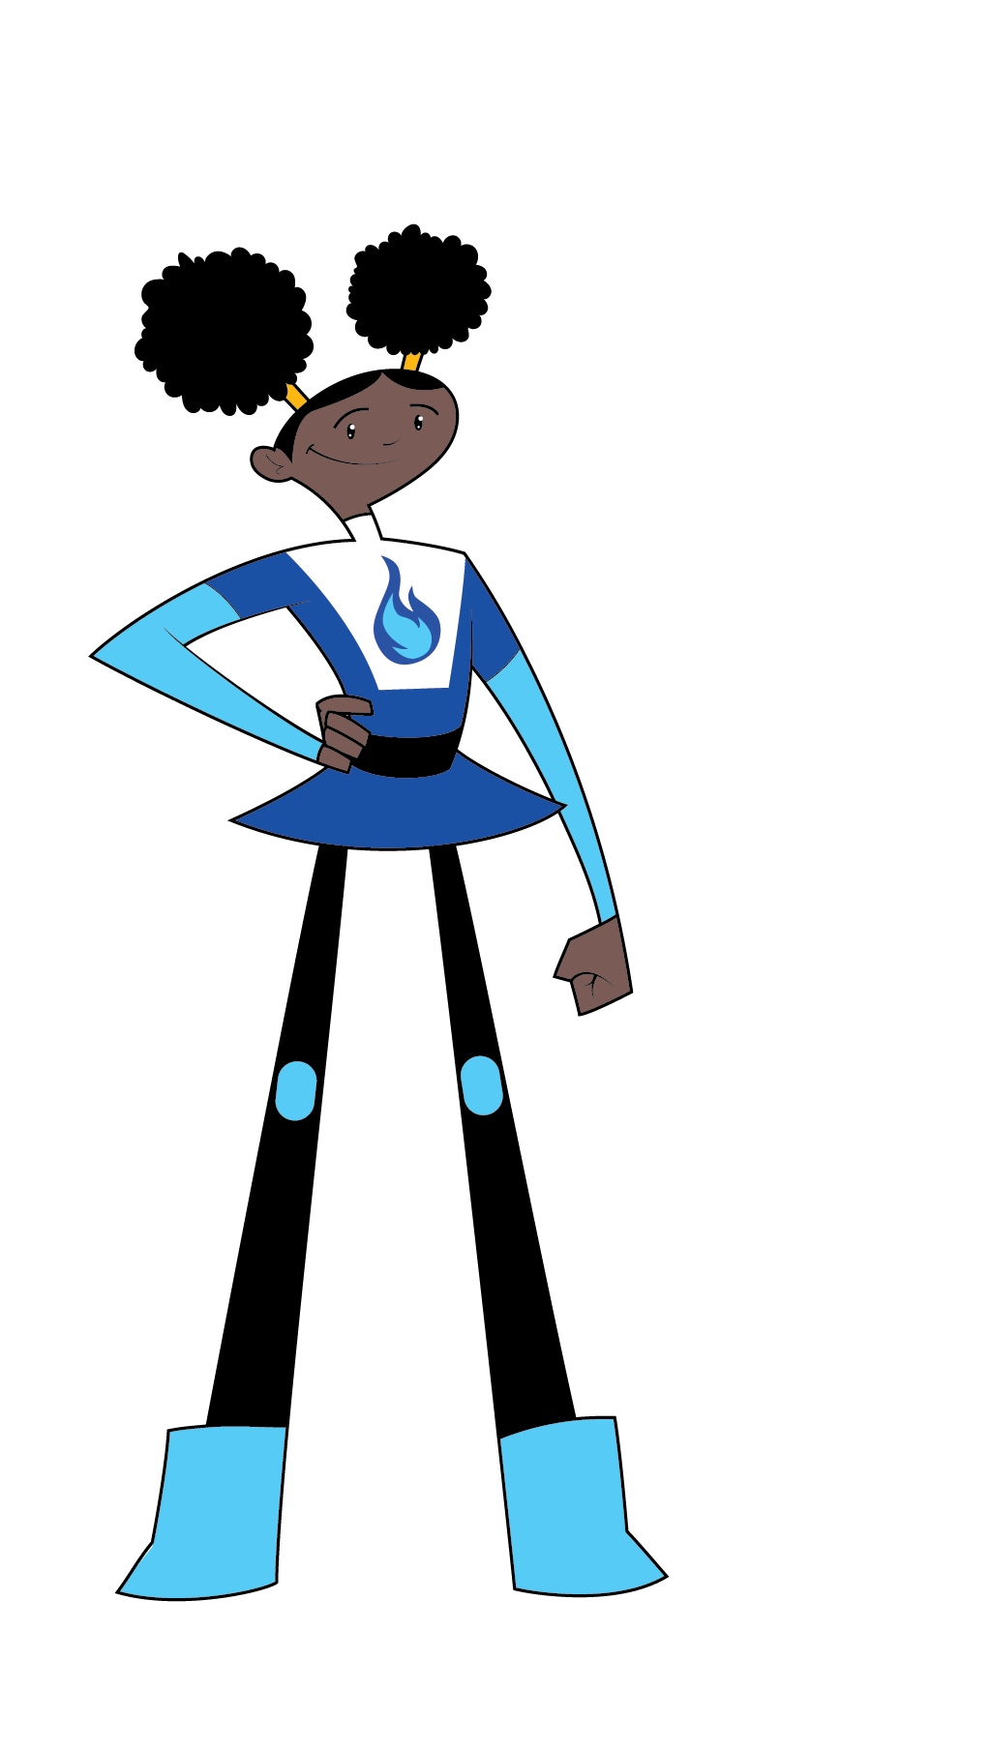
Have natural gas appliances maintained and inspected.
Keep areas around furnace and water heater clutter free.
Do not store flammable or combustible materials near any
gas appliances.
TM
Notes:
Remember that to be Energy Safe Kids, you should always have an adult with you when inspecting any natural gas appliances.
Natural gas appliances need to have good air flow.
Keep areas around natural gas appliances clean and clutter free.
Do not store flammable or combustible materials around natural gas appliances.
Never store cans of paint or aerosols near any natural gas appliance.
Do not play around or on natural gas appliances or hit the valves carrying the natural gas to them.
Have an adult make sure that the vents and flues are clean (from inside and outside of the house).

Slide 15
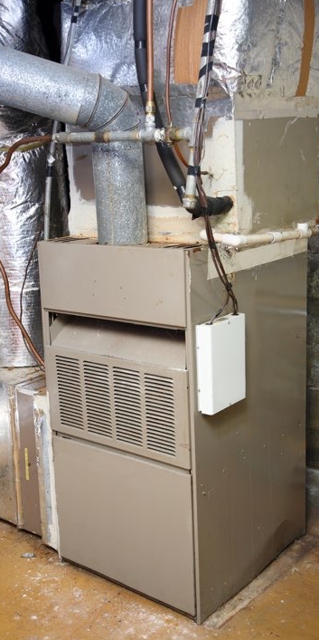
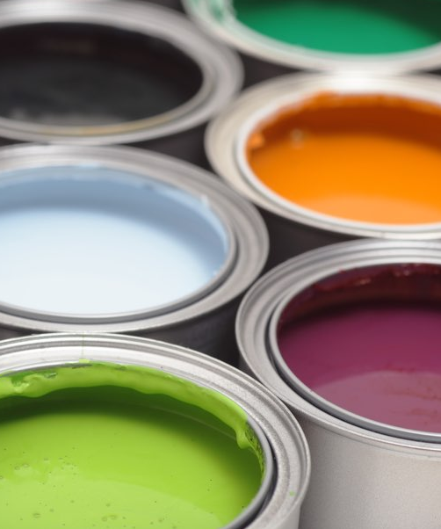

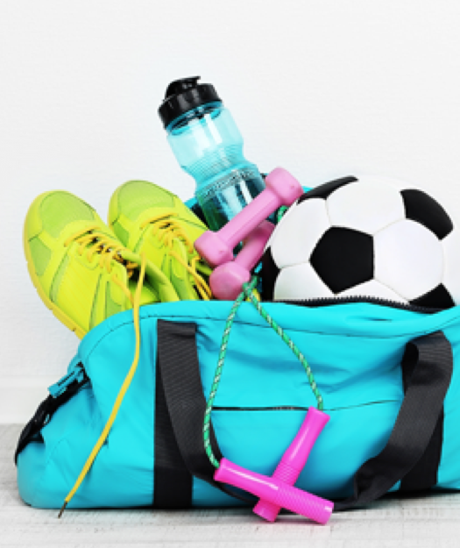
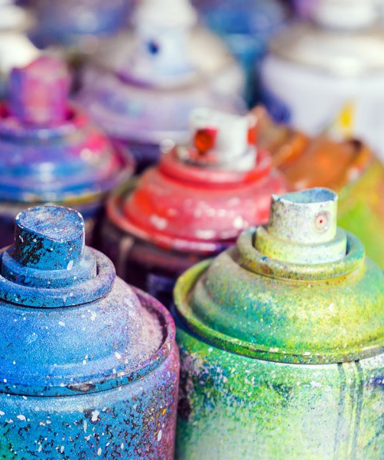
X
X
Keep the
area clean!
X
X
Notes:
SAY/DO:
I want you to tell me whether or not I can store the items in these photos near the furnace.
Give me “YES” by showing a “thumbs up” sign if you think it is OK to store them near the furnace.
Give me a “NO” by having your arms crossed in an X and move outward and away, saying “NO, keep the area clean.”
Ready?
Is it OK to store paint anywhere on or near the furnace?
NO, keep the area clean! Because it can catch fire or block the air flow.
Is it OK to store paper, boxes or trash near the furnace?
NO, keep the area clean! Because they can catch fire or block the air flow.
Is it OK to store aerosols or spray cans on or near the furnace?
NO, keep the area clean! Because they can catch fire or block the air flow.
Is it OK to store your clothes, sports or dance bag around the furnace?
NO, keep the area clean! Because it blocks the air flow.

Slide 16
It’s time for
Playing it Safe
Lingo
Notes:
It’s time for Damage Prevention Lingo!

Slide 17
Mercaptan
This chemical is added to natural gas to make it stinky.
™
Notes:
SAY/DO:
This chemical is added to natural gas to make it stinky.
Ask for an answer.
Mercaptan.

Slide 18
Combustible
Flammable
The furnace and water heater should never have co___________ or fl_____________ items stored nearby.
™
Notes:
SAY/DO:
The furnace and water heater should never have co_______ or fl_______ items stored nearby.
Ask for answers.
Combustible and Flammable.

Slide 19
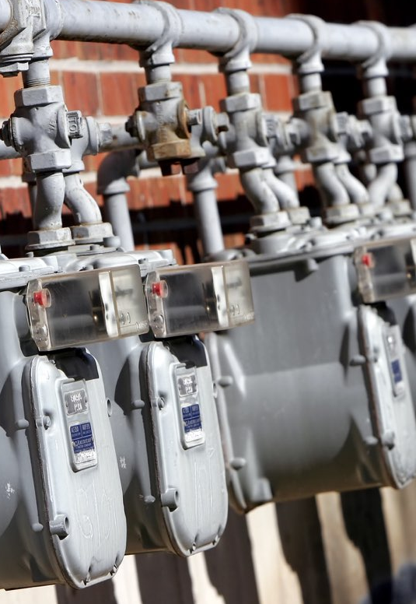
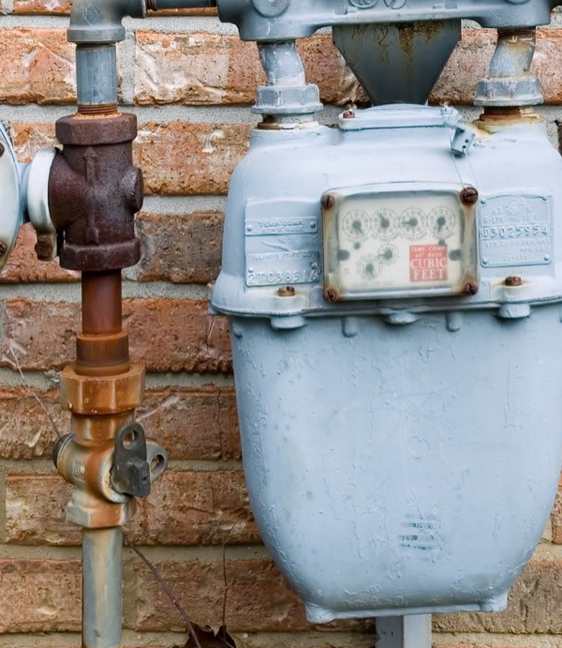
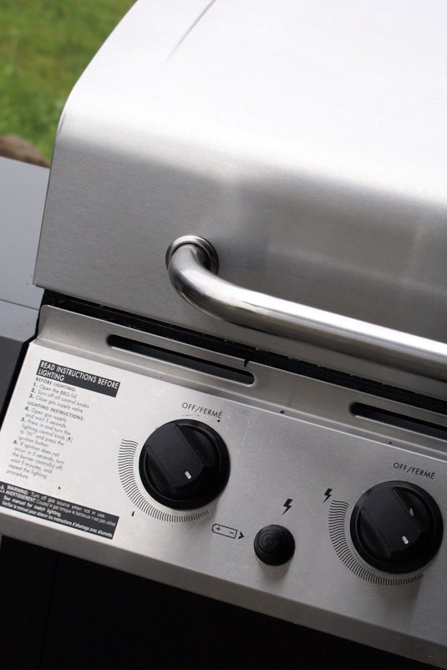
Play it safe outside.
Do not play around
natural gas equipment.
Be pipeline
aware.
Notes:
SAY/DO:
To be Energy Safe Kids, you should never play around natural gas equipment (such as gas meters, pipes, grills, pool heaters, etc).
Never hit equipment or meters with sticks or throw rocks at them.
Keep equipment or meters clear of clutter - Have adults CAREFULLY clear away snow, leaves, branches, etc.
Be pipeline aware.
Natural gas is delivered through underground pipelines.
Above ground markers indicate where these underground pipelines are buried.
Before any digging occurs at home or in a community, someone must call 811 so that underground pipeline locations are properly marked above ground.

Slide 20
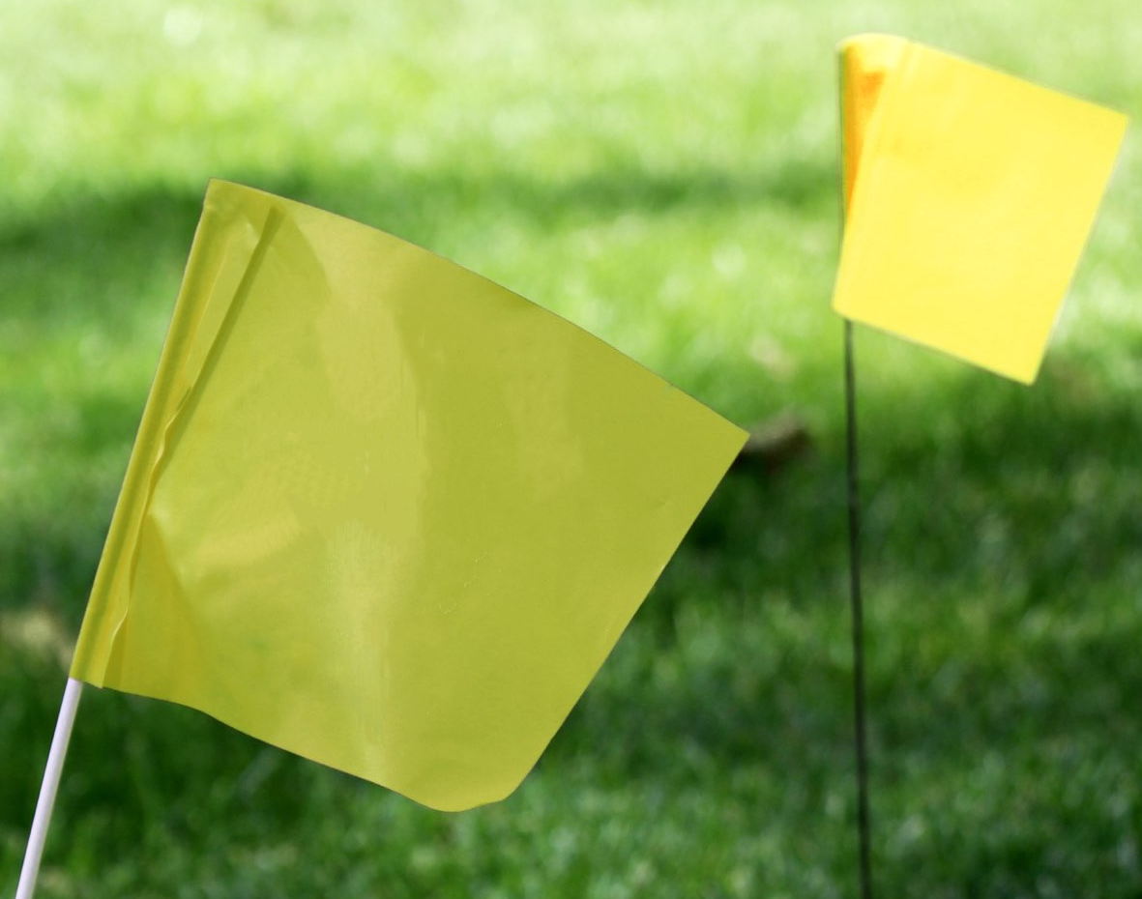
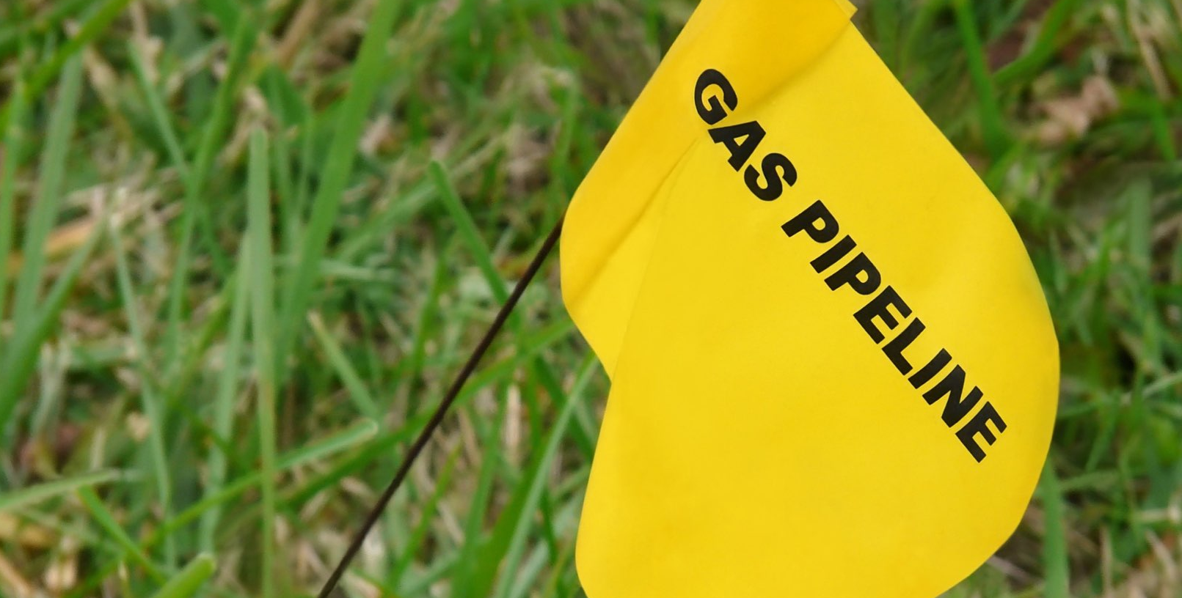


Do NOT move or pull out marker flags.
They show the location of underground utilities and pipelines.
Notes:
Marker flags show the location of underground pipelines for natural gas, water sewer and cables like electricity, TV, cable, telephone and internet.
NEVER move or pull out marker flags.
These markers are important because they help people know where NOT to dig.
Hitting pipelines can cause damage and serious incidents.
Different colored flags mean different utilities are buried underground.
White flags show where someone wants to dig.
Natural gas lines are marked with yellow flags, markers or paint.
Electricity lines are marked with red.
Water lines are marked with blue.
Temporary survey lines are marked with pink.
Reclaimed water lines are marked with purple.
Cable TV, communications and fiber optic lines are marked with orange.
Sanitary sewer lines are marked with green.

Slide 21
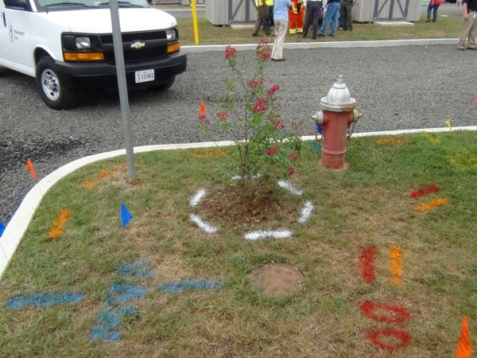
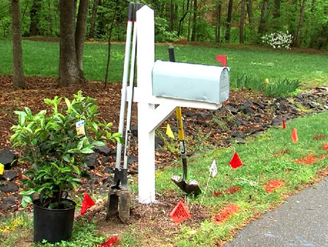
Someone
called 811.
Someone called 811.
Someone located
the underground
utilities and
marked them.
Notes:
All images and text animate automatically.
Look at these photos. There are quite a few colored flags and markings on the grass.
Someone called 811.
Someone located the underground utilities and marked them.

Slide 22

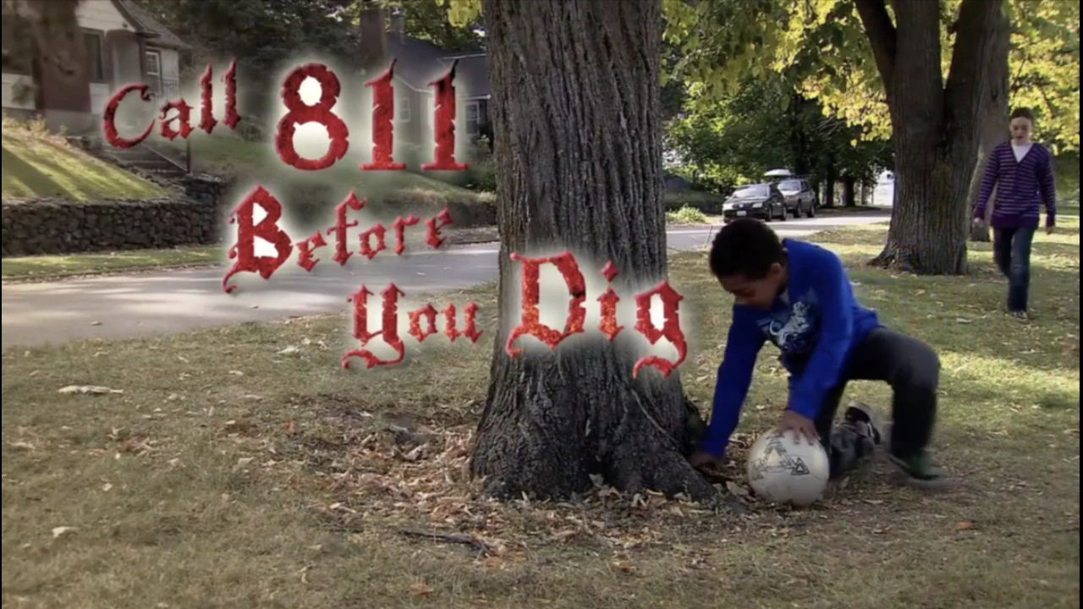
It’s fast. It’s free. It’s the LAW.
Notes:
SAY/DO:
Video clip will start automatically and will play in a loop.
Know what’s below. Call before you dig.
It is fast. It is free. It is the law.
There is a Call 811 Before You Dig video that is about pirates and two students, Jenny and Michael.
You can find the full video on the Energy Safe Kids website.
Once you have seen it - teachers - share it with others in the school, perhaps even sharing it during the announcements.

Slide 23
It’s time for
Playing it Safe
Lingo
Notes:
It’s time for Damage Prevention Lingo!

Slide 24
811
Call _____ to have underground pipes and cables located and marked.
™
Notes:
SAY/DO:
Call _____ to have underground pipes and cables located and marked.
Ask for an answer.
811

Slide 25
Marker Flags
“Be Pipeline Aware!” and pay attention to these colorful things.
™
Notes:
SAY/DO:
“Be Pipeline Aware!” and pay attention to these colorful things.
Ask for an answer.
Marker Flags

Slide 26
Underground
Pipelines
Call 811 to mark the location of utility cables and ___________ __________.
™
Notes:
SAY/DO:
Call 811 to mark the location of utility cables and ______ _______.
Ask for an answer.
Underground Pipelines

Slide 27

Notes:
https://vimeo.com/541753510

Slide 28

Signs of a Natural Gas Leak
Trust your senses!
See
Hear
Smell
Bubbling water,
blowing dirt
Hissing sound
Rotten egg -
MERCAPTAN
Notes:
SAY/DO:
See
If there is a dead area in the middle of a green area of plants or grass, it could be a natural gas leak.
If there are bubbles coming up in water there could be a natural gas leak.
If there is blowing dirt, and it is not windy, it could be a natural gas leak.
Hear
If you hear a “hissing” sound coming from the ground or a pipe, it could be a natural gas leak.
Smell
Mercaptan smells like rotten eggs.
Remember that natural gas is lighter than air so it can move around or can be smelled in one place but not another.

Slide 29
Leave the area immediately
with the door open.
Tell an adult
right away.
Go to a safe
area away
from the leak,
call 911
and your natural gas company.
LEAVE, Tell an adult and CALL 911 and your natural gas company if you notice any of these signs.
What to Do if You Suspect a
Natural Gas Leak
Notes:
SAY/DO:
Let’s talk about what to do if you suspect a natural gas leak.
Leave the area immediately with the door open.
Tell an adult right away.
Go to a safe area away from the leak, call 911 and your natural gas company.

Slide 30
Do NOT do anything that might create a spark.
Do NOT try to repair the pipe or stop the leak.
Do NOT return until the natural gas company employees say it is safe.
What Not to Do If You Suspect
a Natural Gas Leak
Notes:
Slide animations will begin automatically.
If you think there is a natural gas leak there are some things you should be sure NOT to do.
Do not do anything that might create a spark.
Do not use a light switch.
Do not use any phone or cell phone inside.
Do not use the garage door opener.
Do not let anyone smoke or light a flame of any kind.
Do not try to repair the pipe or stop the leak yourself.
Do not go back to the area until the natural gas company employees say it is safe.

Slide 31

Headache
Dizzy
What to do if
you suspect carbon monoxide
poisoning:
Signs of carbon monoxide
poisoning
Leave immediately,
tell an adult and call 911!
Carbon monoxide is a poisonous gas.
There is NO odor.
Drowsy, etc.
Notes:
SAY/DO:
Sometimes when natural gas does not have enough air, it does NOT burn right and it creates carbon monoxide.
Carbon monoxide is a colorless and odorless poisonous gas which can make you sick.
Carbon monoxide can build up in your home when the flue or vent is blocked by soot, nests or even snow.
This detector acts just like a smoke alarm but for carbon monoxide gas. It will make noise if it senses carbon monoxide gas.
This you don’t have a detector you can tell if there is carbon monoxide in your home by how your family is feeling.
Carbon monoxide poisoning can make people: have headaches, feel dizzy, feel nauseous and/or confused.
If you leave your home and go to school and you breathe fresh air, but then come back home and everyone feels sick again, you might have carbon monoxide in your home.
If you suspect carbon monoxide, LEAVE IMMEDIATELY, TELL AN ADULT and CALL 911!

Slide 32
It’s time for Playing it Safe
Lingo
Notes:
It’s time for Damage Prevention Lingo!

Slide 33
Name three senses you can use to detect a natural gas leak.
See
Hear
Smell
™
Notes:
SAY/DO:
Name three senses you can use to detect a natural gas leak.
Ask for an answer.
See, Hear, Smell

Slide 34
911,
Carbon Monoxide
You should call _____ if you think ____ ____ gas in a house is causing everyone to feel sick.
™
Notes:
SAY/DO:
You should call ____ if you think _____ _______ gas in a house is causing everyone to feel sick.
Ask for answers.
911 and carbon monoxide

Slide 35
If you hear the ________ _______ of a natural gas leak, you should leave immediately and ____ ___ ______.
Hissing Sound,
Tell an Adult
™
Notes:
SAY/DO:
Last slide of Damage Prevention Lingo!
If you hear the_____ ____ of a natural gas leak, you should leave immediately and _____ ___ _______!
Ask for answers.
Hissing Sound, Tell an Adult.

Slide 36


Students, you can be an Energy Safe Kid!
™
Notes:
SAY/DO:
Students, be an Energy Safe Kid!

