Slide 1
Brought to you by:
Notes:
Welcome to Energy Safe Kids, brought to you by the National Energy Foundation and DTE Energy.

Slide 2
What We Will Do Today
Learn about energy.
Learn about properties of electricity.
Learn about electrical safety - inside and outside.
Play Electrical Safety Sense.
Notes:
SAY:
Today we will learn about energy, specifically about electricity.
We will learn how to be safe with electricity both inside and outside of our homes.
We will also play a game called Electrical Safety Sense to review.

Slide 3
ENERGY
Notes:
SAY:
Let’s get started.
What do you think about when you hear the word energy? Take a minute to discuss with your class, then click when you’re ready to move on.
You may think about the energy to move your legs when you run or ride a bike.
Or perhaps you thought of electricity to power video games and lights.

Slide 4
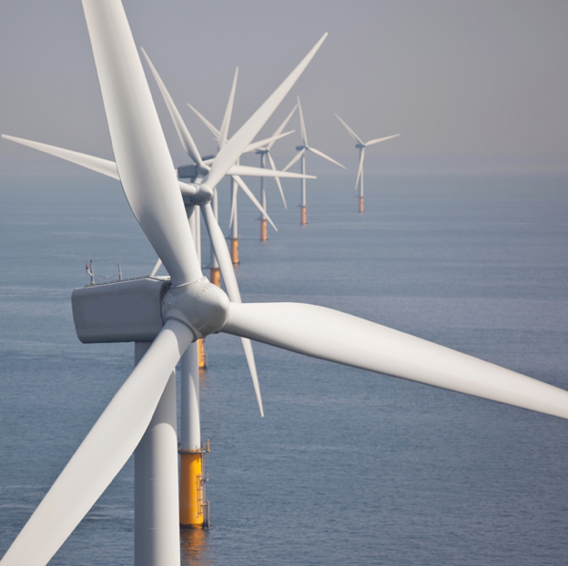
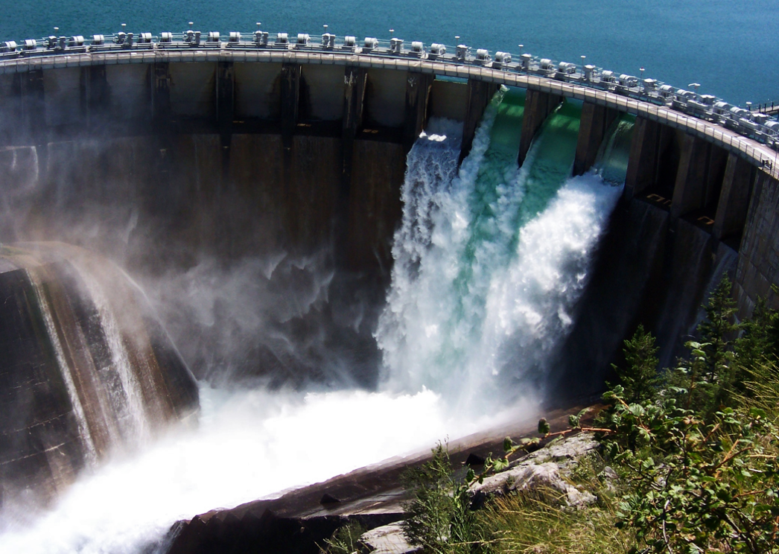
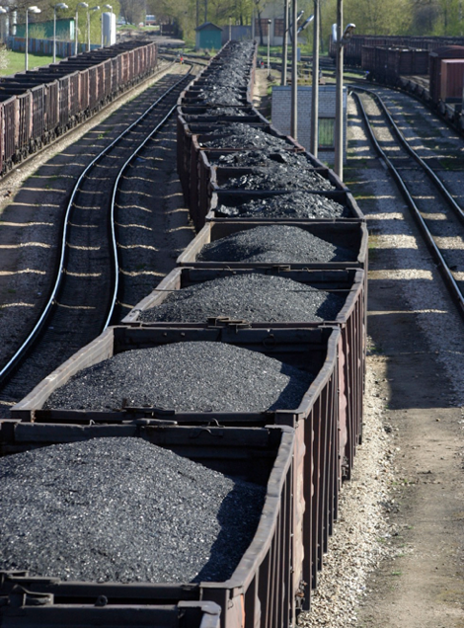
Renewable and Nonrenewable
Energy Sources
Notes:
FYI - Animation from Energy Sources to Renewable and Nonrenewable happens automatically and with a 2 second delay.
SAY:
Everything we do takes energy, so it is important to understand where our energy comes from.
Renewable resources are sources of energy that are naturally replaced; like wind, water and solar.
Nonrenewable resources like coal, uranium for nuclear power plants and natural gas are sources that take a long time to make and once they are gone, they’re gone.
All of these resources can be used to generate electricity. Let’s talk more about electricity.

Slide 5
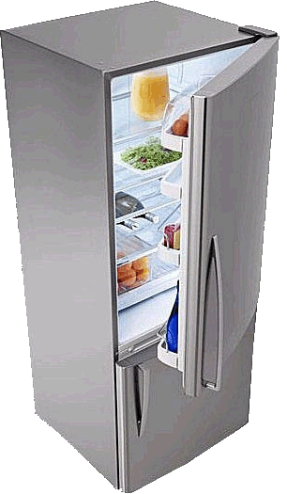
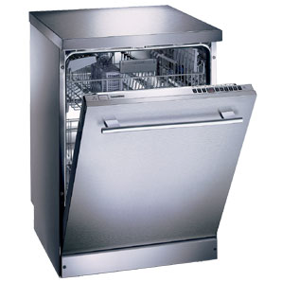
We use electricity for virtually everything
at home and at school.
Notes:
SAY:
Electricity is an energy source that is used to heat buildings, cook food, dry clothes, heat water and give us light.
Look at all the ways we use electricity.

Slide 6
What is electricity?
Electricity is the flow of electric charge.
It needs a path to travel on - a circuit.
Notes:
SAY:
What is electricity?
Electricity is the flow of electric charge.
It needs a path to travel on. That path is called a circuit.

Slide 7
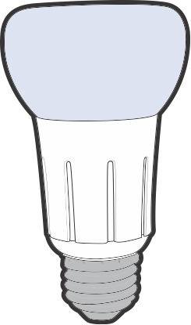
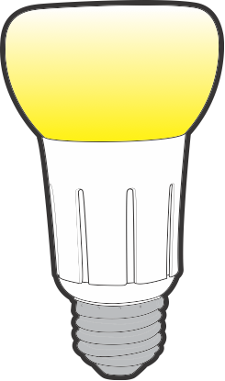
Circuits can be open or closed.
Open circuit: no electricity can flow.
Closed circuit: electricity can flow.
Notes:
SAY/DO:
An electrical circuit can be open or closed.
This is a diagram of an open circuit.
When the circuit is open, the path is broken and no electricity can flow.
Show me an open circuit with your arms.
This is how a light switch works, it opens and closes the circuit. When the switch is off, the electrical pathway is not complete, so no electricity can flow.
Here is a diagram of a closed circuit.
When you flip the light switch, you close the circuit and the light turns on.
Show me a closed circuit with your arms.
Now open, lights off! Closed, lights on!

Slide 8
Should YOU become part of these circuits?
Notes:
SAY:
Circuits bring electricity to your home and deliver it around inside, from your plugs to lamps, the fridge and everything else that uses electricity.
Do you think you would want to become part of the circuit bringing electricity to a building or moving it around your house?
No! You could be seriously hurt or even killed.
So let’s look at how to be safe with electricity.

Slide 9
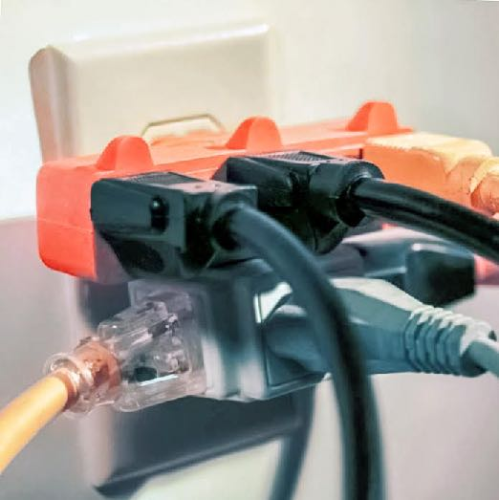
Play it safe inside.
Never stick anything into an outlet
except a plug.
Never
overload outlets.
This can be a fire hazard.
Notes:
SAY:
Play it safe inside.
Do not stick anything in outlets except plugs.
Do not use too many plugs in one outlet, like in this picture. This can be a fire hazard.

Slide 10
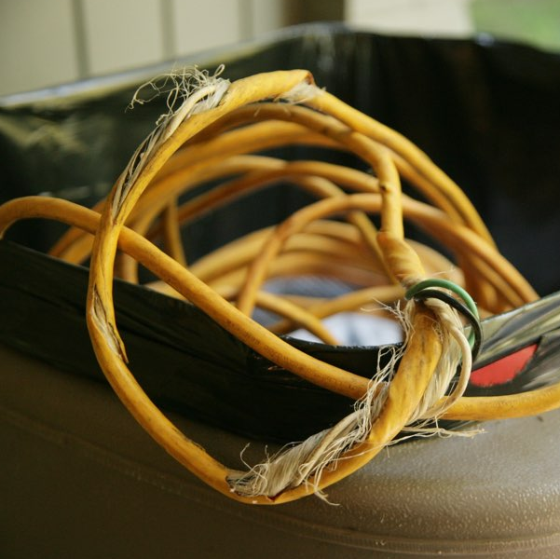
Play it safe inside.
Never mix water and electricity.
Never touch or use frayed cords.
Notes:
SAY:
Do not mix water and electricity. Keep things like music players and hair dryers away from sinks and tubs.
Do not touch frayed cords. You could get shocked.

Slide 11
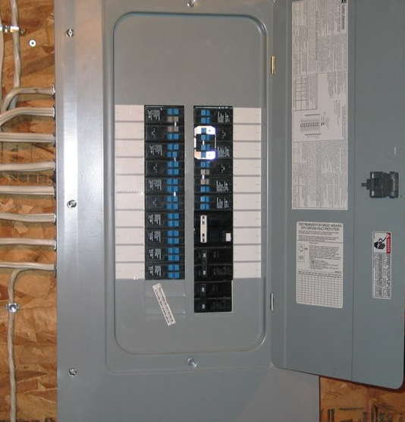
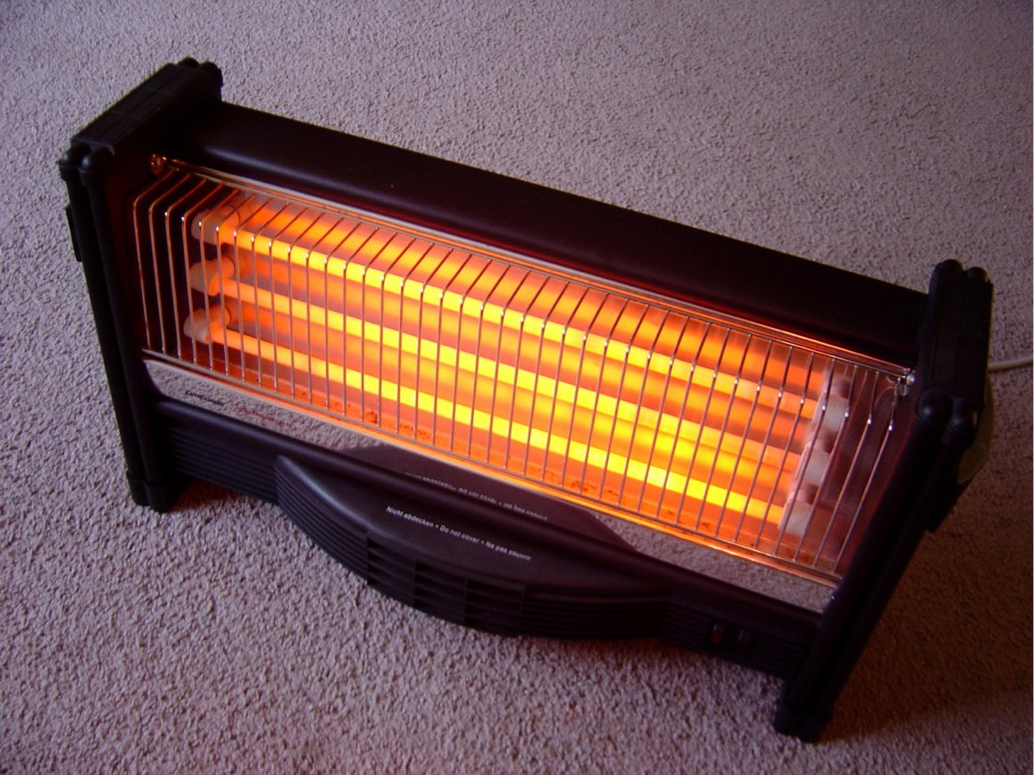
Play
it
safe inside.
Notes:
SAY:
Stay away from electrical equipment in your home like this breaker box.
Things that use electricity often get hot, like light bulbs and this space heater. So keep the area around them clear to avoid a fire.
Never use electrical appliances or space heaters to dry clothes or bedding.

Slide 12
Play
it
safe
outside.
Notes:
SAY:
Now let’s see how to be energy safe outside!

Slide 13
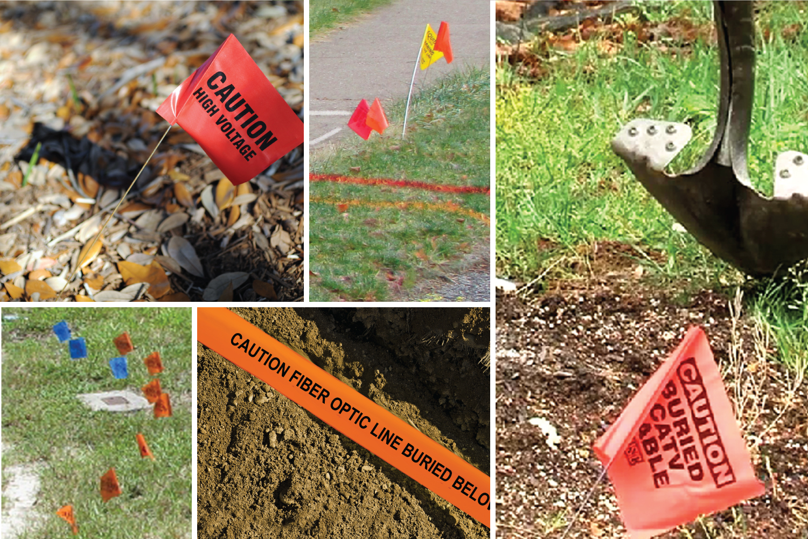
Call 811 before you dig.
Notes:
SAY/DO:
Before any digging occurs at home or in the community, someone must call 811 so that underground wires and pipeline locations are properly marked above ground.
These markers are important because they help people know where not to dig.
Hitting buried electric power lines, natural gas lines or communication lines can cause damage, power outages and serious injuries, even death.

Slide 14
Do NOT touch marker flags.
They show where pipes, cables and power lines are buried.
Notes:
SAY/DO:
NEVER move or pull out marker flags.
Electric power lines are marked with red flags, markers or paint.
Natural gas lines are marked with yellow flags, markers or paint.
Other things have other colors.

Slide 15
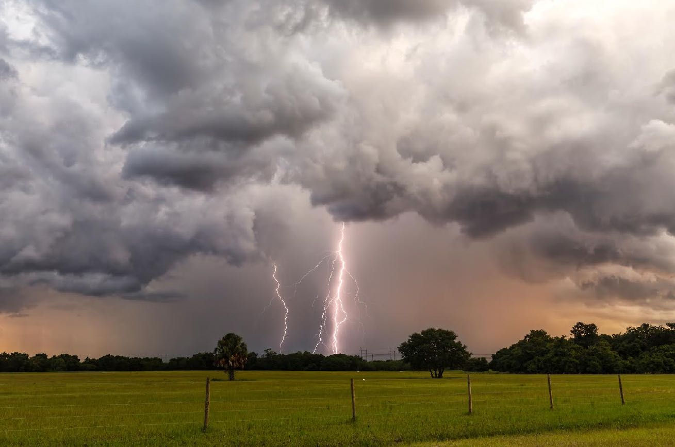
Play it safe outside.
Go inside when there is a storm.
Notes:
SAY:
Go inside when there is a storm coming.

Slide 16
Look up to know what’s down.
Stop, turn around and go the other way.
Stay away from downed power lines and anything they may be touching.
Notes:
SAY:
After a storm, it is very important to be careful. Power lines may have come down in the storm.
Look up to know what’s down. Downed lines may be wrapped around or hiding behind a tree, touching a fence or lying in a puddle.
If you see poles with wires hanging down, stop, turn around and go the other way.
Stay away from downed power lines and anything they may be touching.

Slide 17
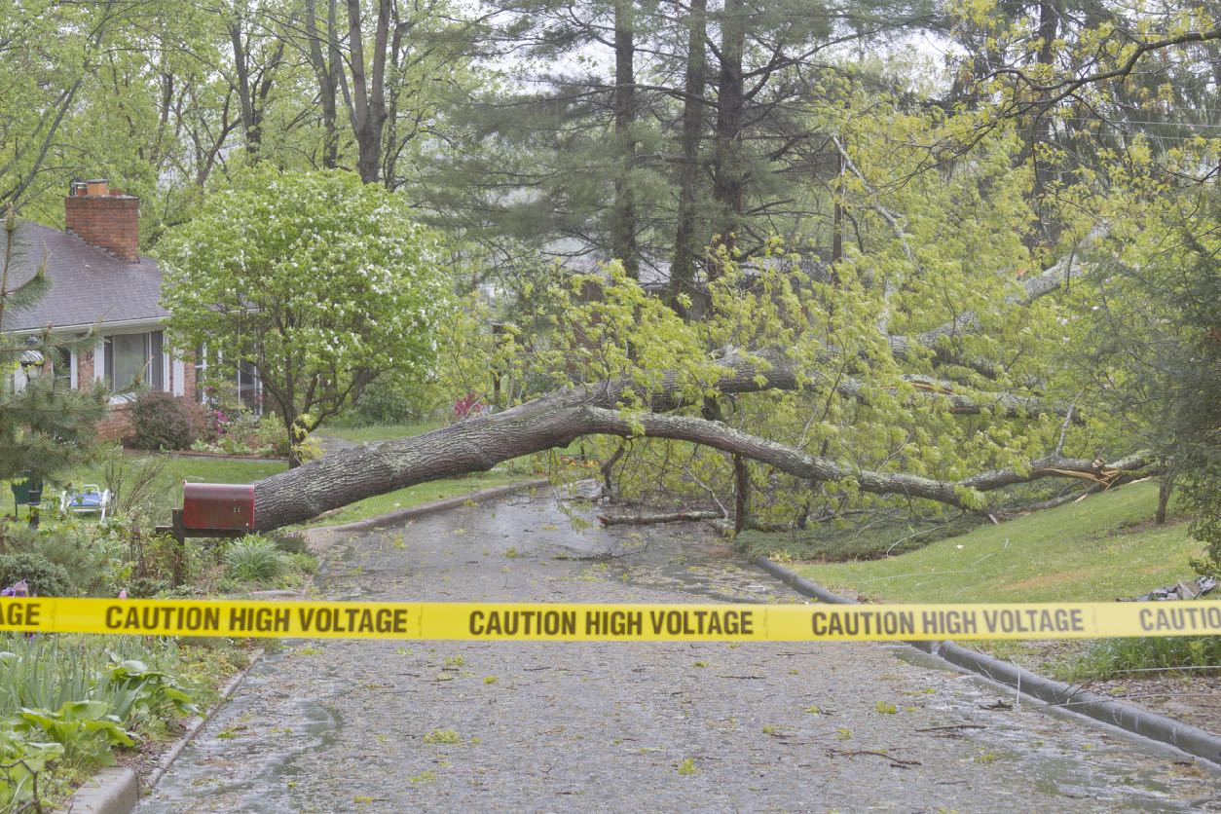
Look up to know what’s down.
Stop, turn around and go the other way.
This is dangerous, even if there is no movement, sparking or buzzing.
Notes:
SAY/DO:
This fallen tree is hiding downed power lines.
Be careful around fallen trees, look up to see if power lines could be hiding.
The electricity can travel through trees, water and fences touching a power line for a long distance, so if you touch any of these things you will get shocked just as if you touched the power line!
Assume any downed wire is dangerous, even if it is not moving, sparking or buzzing.
Stop, turn around and go the other way.
Remember: stay away from downed power lines and anything they may be touching.
Never cross ANY yellow caution tape, it is there to keep you safe.

Slide 18
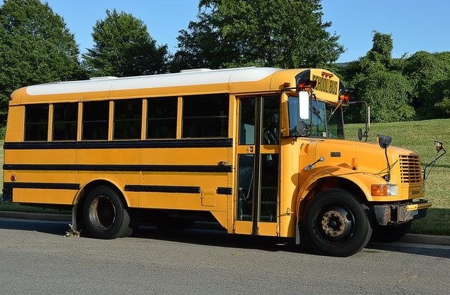
Stay the length of a
school bus away.
Tell an adult if you see downed lines, so they can call DTE or 911.
Notes:
SAY:
How far away from a downed power line should you stay?
At least 20 feet, which is about the length of a school bus.
Tell an adult if you see downed lines, so they can call DTE or 911.

Slide 19
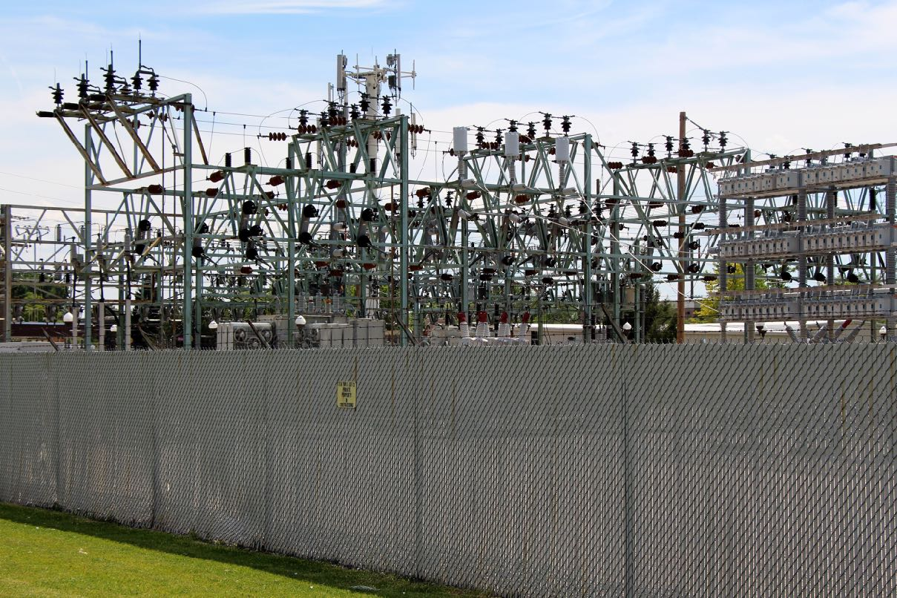
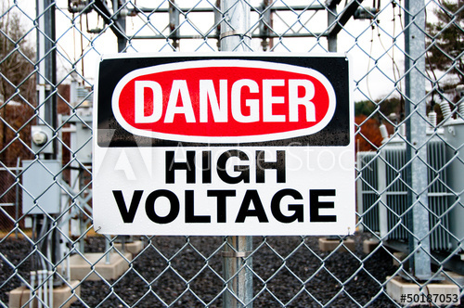
Stay away from electrical equipment.
DO NOT climb substation fences.
Play it safe outside.
Notes:
SAY:
Play it safe outside by staying away from electrical equipment.
DO NOT climb substation fences for any reason. If something goes over the fence like a ball, it is gone. Do NOT try to get it back.

Slide 20
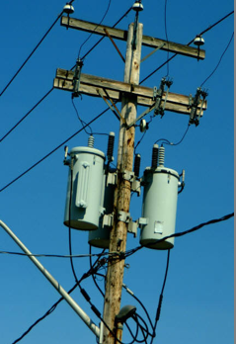
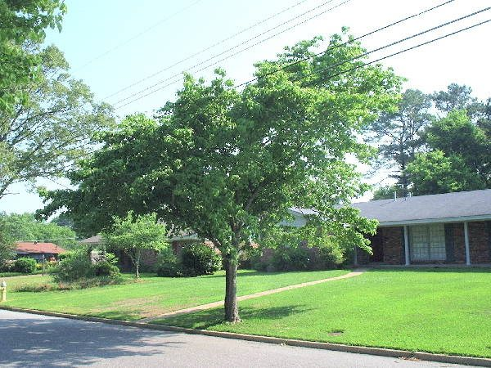
Play it safe outside.
electric poles
power lines through tree top
Do not climb electric poles or
trees near power lines.
Notes:
SAY:
Do not climb electric poles.
Do not climb trees near power lines.
Do not fly kites around power lines. Let go immediately if the kite gets near wires.

Slide 21
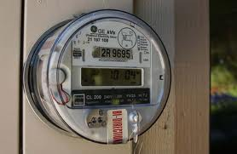
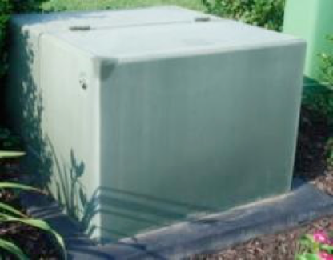
Play it safe outside.
electric meter
pad mount transformer
Stay away from electrical equipment like meters and transformers.
Notes:
SAY:
Do not play around electric equipment such as meters or pad mount transformers.
Pad mount transformers are used where there are buried electrical lines. They change the voltages going into homes or business and are very powerful. Don’t sit on them or try to open them.

Slide 22
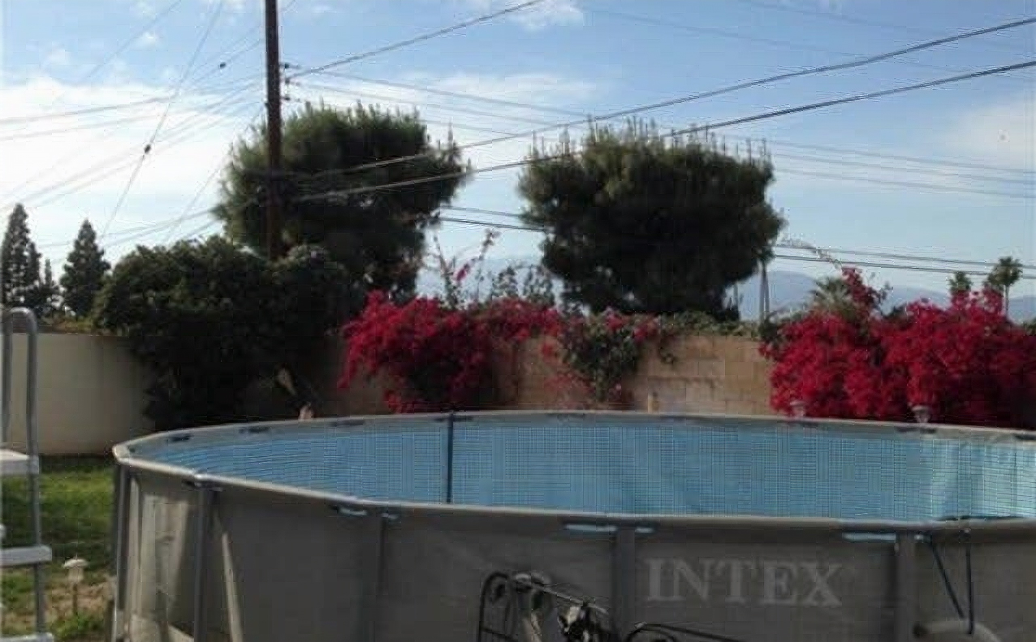
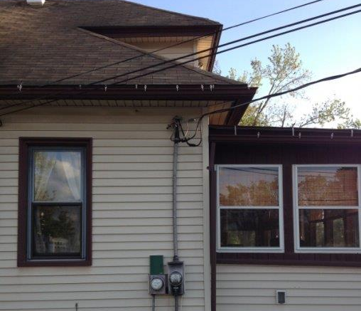
Play it safe outside.
Stay away from low-hanging lines.
Notes:
SAY/DO:
Stay away from low-hanging power lines, including the smaller line that connects to your house.
This is called a service line and it is your home's connection to the energy grid. It is also extremely dangerous.
Tell your family to keep pools away from the power line that comes into your home.
Look at this picture. Do you see anything dangerous here?
You may notice the pool under the wires and that the wires are very low on the right. In this case, special care needs to be taken not to hit the power line when cleaning the pool, using ladders or any other objects long enough to reach it.

Slide 23
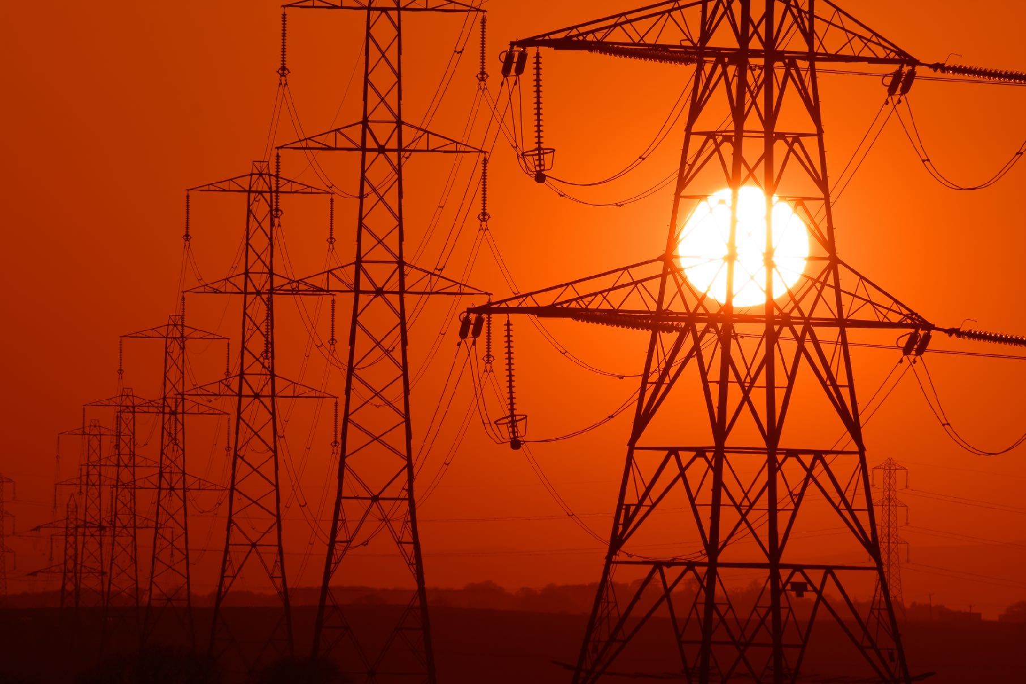
Electricity is powerful and we must use it safely.
Notes:
SAY:
Electricity is a powerful energy source and we must be safe when using it.

Slide 24
Electrical Safety Sense
Are you ready?
Notes:
SAY:
It’s time to play our review game, Electric Safety Sense.
For each question, everyone will answer. THUMBS UP for YES, THUMBS DOWN for NO. If it isn’t a YES or NO question, everyone answer in a whisper when I say go.
We will complete a pie chart by answering 10 questions. The goal is to be 100 percent correct.
With each correctly answered question, the class is 10 percent closer to completing the circle. Your teacher will keep score, or let you do it.
Are you READY? Click to the next slide to begin.

Slide 25
Do you need to be careful around electricity?
Notes:
SAY:
Here’s your first question. This should be an easy one.
Do you need to be careful around electricity? Thumbs up or down.

Slide 26
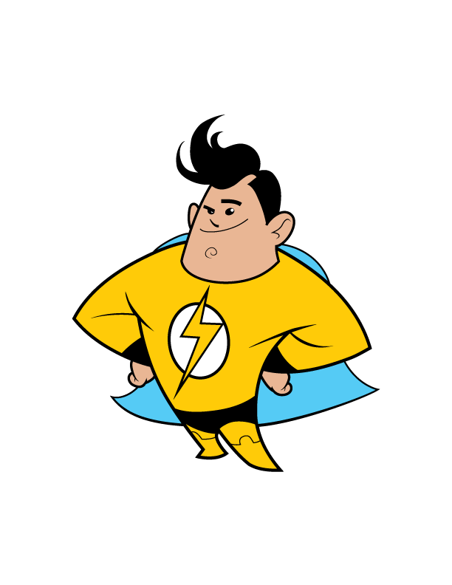
10%
Yes
Notes:
Yes

Slide 27
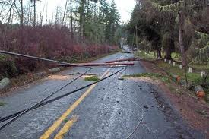
If you see a downed power line, do you TELL an adult right away?
Notes:
SAY:
If you see a downed power line, do you tell an adult right away? Thumbs up or down.

Slide 28
20%
Yes
Notes:
I hope your thumbs were up.
The correct answer is yes, so they can call DTE or 911.

Slide 29
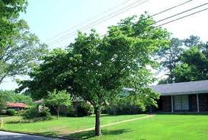
Should you play around electric poles or climb trees that have overhead wires nearby?
Notes:
SAY:
Should you play around electric poles or climb trees that have overhead wires nearby? Thumbs up or down.

Slide 30
30%
No
Notes:
Nope, you don’t want to do those things.
Hopefully you had all three questions correct and now have 30 percent.

Slide 31
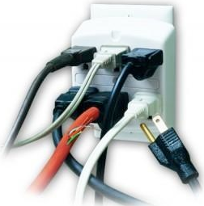
Overloading electrical _______ is dangerous.
Notes:
SAY:
For this one, whisper your answer when I say go.
Overloading electrical _________ is dangerous.
Ready, GO!

Slide 32
40%
outlets
Notes:
If you said outlets, you’re right.
Give yourself another 10 percent.

Slide 33
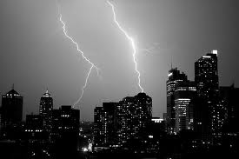
You should NOT play ________ during a storm.
Notes:
SAY:
You should not play _________ during a storm.
Whisper your answer. Ready, GO!

Slide 34
50%
outside
Notes:
Outside is the correct answer
We’re halfway there!

Slide 35
Keep things away from space heaters because it can cause a ______.
Notes:
SAY:
Keep things away from space heaters because it can cause a _______.
Ready, GO!

Slide 36
60%
fire
Notes:
If you said fire, you’re right.
Let’s try harder questions.

Slide 37
Stay the length of a ______ ____ away from a downed power line.
Notes:
SAY:
Stay the length of a ______ ____ away from a downed power line, or anything it’s touching.
Whisper your answer if you remember. GO!

Slide 38
70%
school bus
Notes:
Stay at least 20 feet away, which is the length of a school bus.

Slide 39
You should not play around electric equipment like ____.
Notes:
SAY:
You should not play around electric equipment like _______. Hint: look at the picture.
Ready to whisper? GO!

Slide 40
80%
meters
Notes:
Meters is correct.
Just two questions to go!

Slide 41
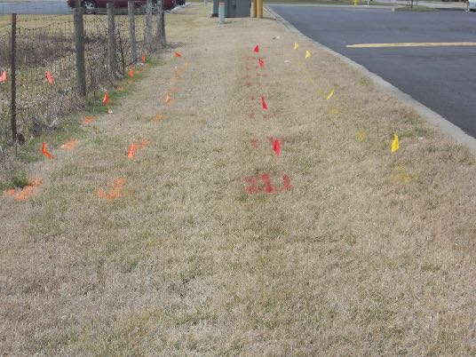
Call _____ before digging to mark the location of buried power lines.
Notes:
SAY:
Call ______ before digging to mark the location of buried power lines.
Ready, GO!

Slide 42
90%
811
Notes:
The correct number is 811.
Are you ready for your final question?

Slide 43
If you see a downed power line you should ____, ____ _____ and __ ___ ______ ___.
Notes:
SAY:
Everyone read this one with me and say the answers as we go.
If you see a downed power line you should ____, ____ _____and __ ___ ______ ___.

Slide 44
100%
Stop, turn around, and go the other way!
Notes:
Stop, turn around, and go the other way!

Slide 45
ELECTRICAL SAFETY SENSE Completed = 100% Safe
Notes:
SAY:
Congratulations on being ENERGY SAFE KIDS. You have completed Electrical Safety Sense.

Slide 46
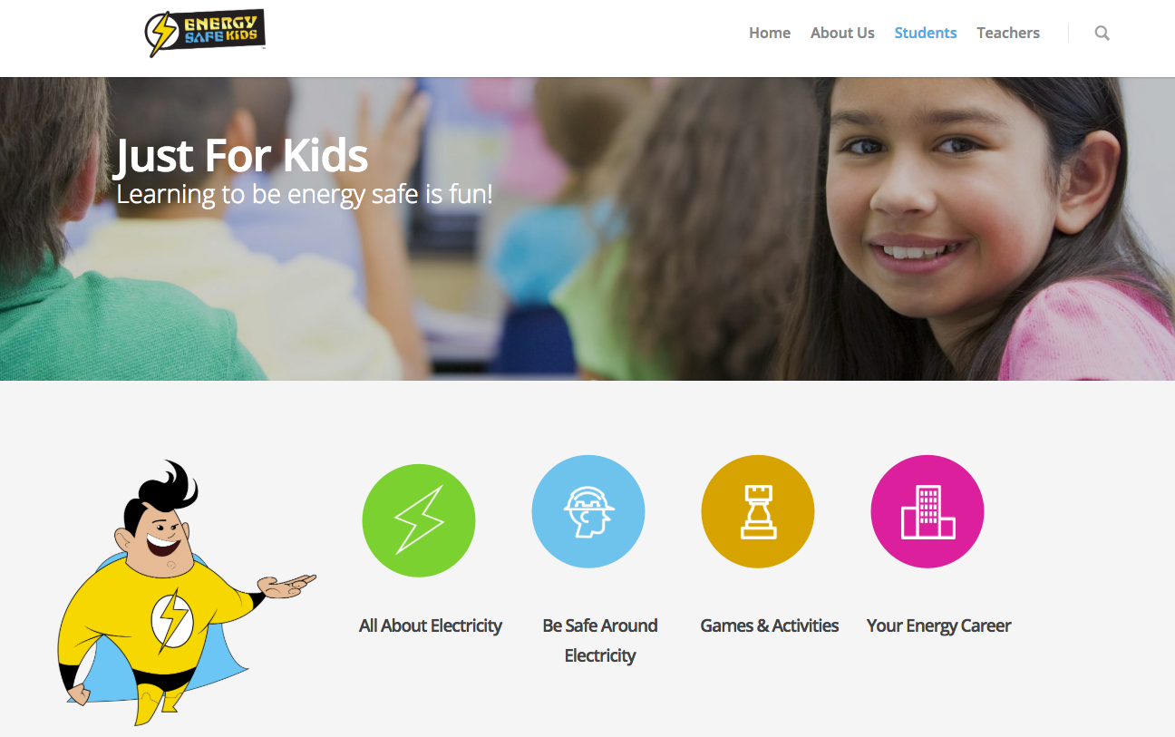
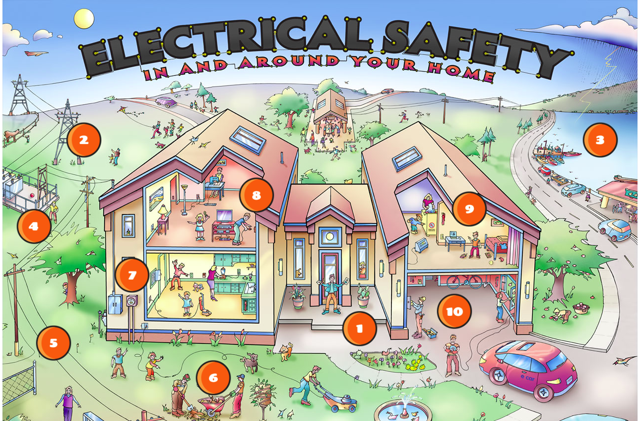
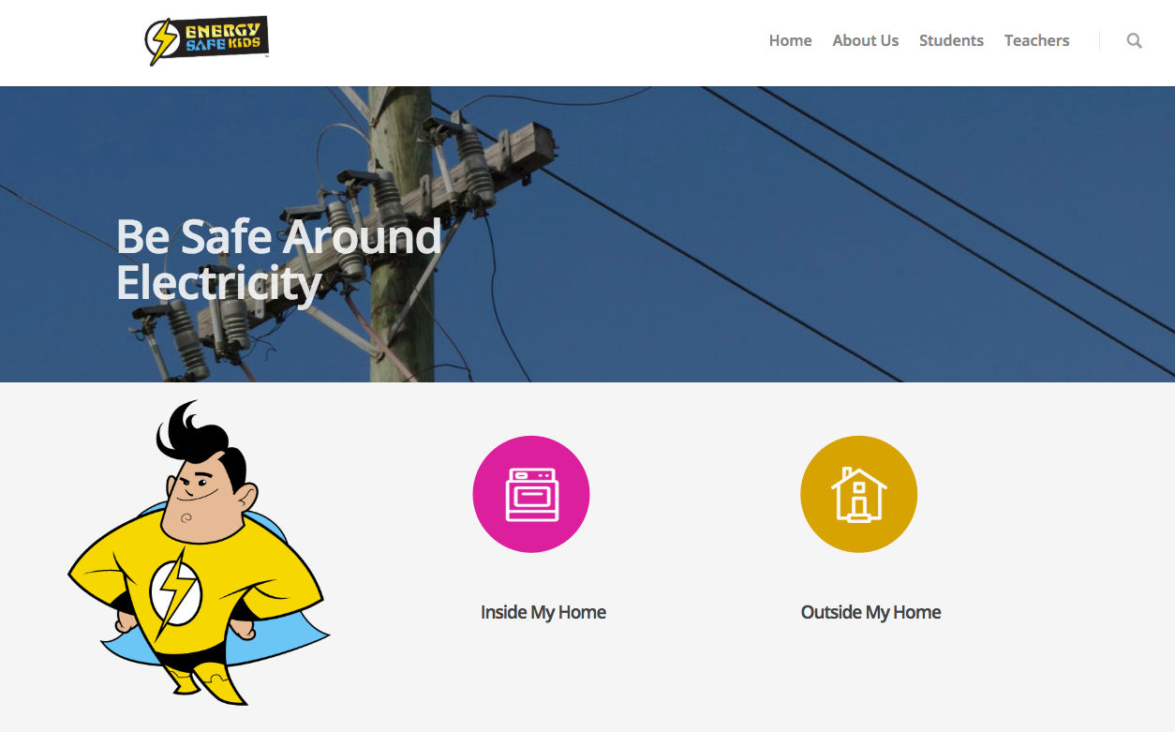
Learn more at energysafekids.org/dte
Notes:
SAY:
The Energy Safe Kids website has so much information for you, your family and teachers.
Teachers will find resources for classroom use: lesson plans, activities and facts about electrical safety in the United States.
You and your family can learn about electricity basics, safety and careers and test your safety IQ against “The Interactive Electrical Safety Poster.”
The interactive poster is a fun way to review electrical safety and test your knowledge.
The words in the title of the poster light up with each correct answer.

Slide 47
Remember these tips to be an Energy Safe Kid.
Look up to know what’s down.
If you see a downed power line, stop, turn around and go the other way.
Notes:
SAY:
Let’s recap the most important things to teach your family when you get home.
Look up to know if there are power lines that have been knocked down near you after a storm, since they could be hidden.
If you see a downed line, yellow tape marking off an area or notice that a line could be down where you can’t see it, stop, turn around, and go the other way.

Slide 48
Remember these tips to be an Energy Safe Kid.
Stay a school bus length away from downed power lines and anything they are touching.
Tell an adult to call DTE or 911.
Notes:
SAY:
Stay a school bus length away from downed power lines, anything they are touching or anything they may eventually touch because the wire is moving.
Tell an adult to call DTE or 911.

Slide 49
Help your family be Energy Safe.
Take home your booklet and scan form.
Discuss them with your family.
Fill out the form and bring it back to class.
Notes:
SAY/DO:
Now it is up to you, as the safety expert, to share what you have learned.
Your teachers are going to give each of you two things to take home, a short survey on a scan form and a booklet.
Show your family the booklet, and talk through the scan form questions with them.
Answer the questions on the survey form and bring it back to your teacher.
If enough of you return the survey, your class will earn $50 your teacher can use to support your learning.
Teachers, mail your forms back in the envelope provided.

Slide 50
You can be an
Energy Safe Kid!
Brought to you by:
Notes:
SAY:
Thank you all for listening and please use what you learned today to BE SAFE and be an Energy Safe Kid.

