Slide 1
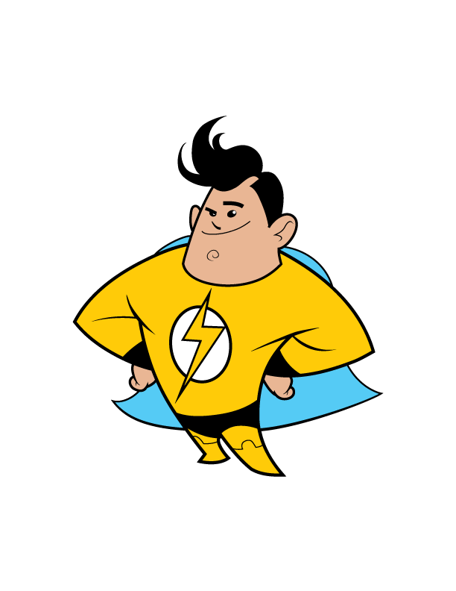
™
Notes:
Welcome to Energy Safe Kids presentation.

Slide 2
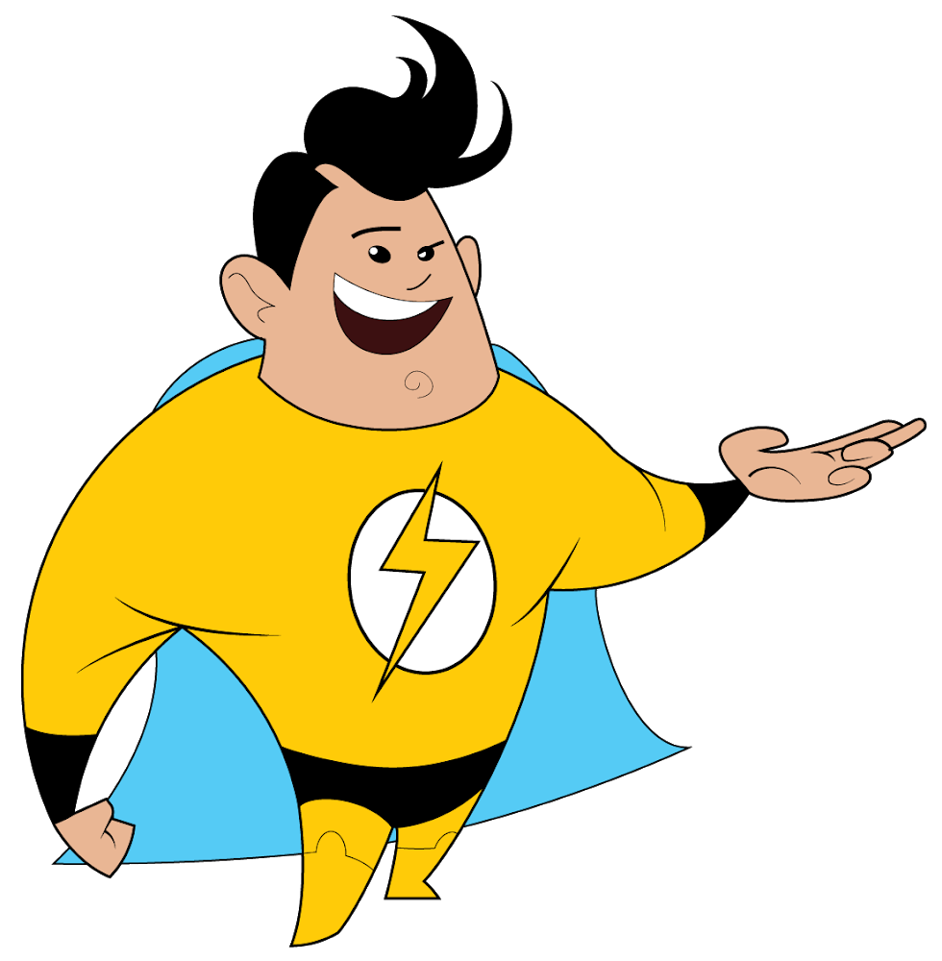
Think!
Talk!
Take Action!
about energy
and electrical safety!
™
Notes:
As part of our presentation, we are going to Think!, Talk! and Take Action! about electrical safety.
We will see our super hero, when it is time to play the Damage Prevention Lingo game.
Damage and prevention are two big words. Damage means to break something and prevention means to keep it from happening.
Playing Damage Prevention Lingo will help you learn to be safe around electricity.
You can be a Damage Prevention Hero and teach others about safety.

Slide 3
Learn about energy.
Learn about properties of electricity.
Learn about electrical safety - inside and outside.
™
Play Damage Prevention Lingo.
Notes:
Today we will learn about energy.
We will learn about the properties of electricity.
Learn about electrical safety, inside and outside.
We will play Damage Prevention Lingo.

Slide 4
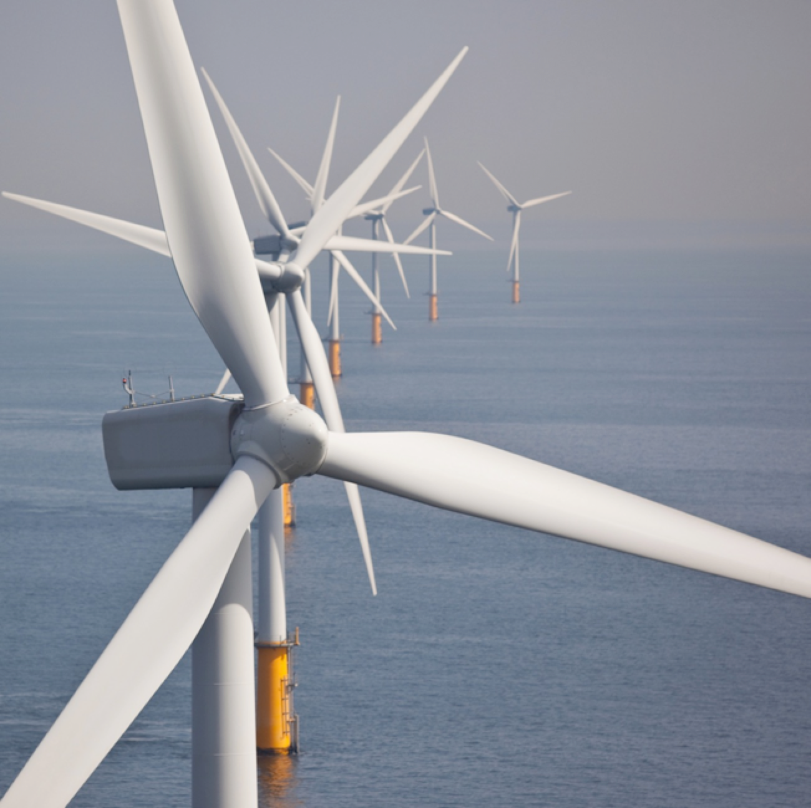
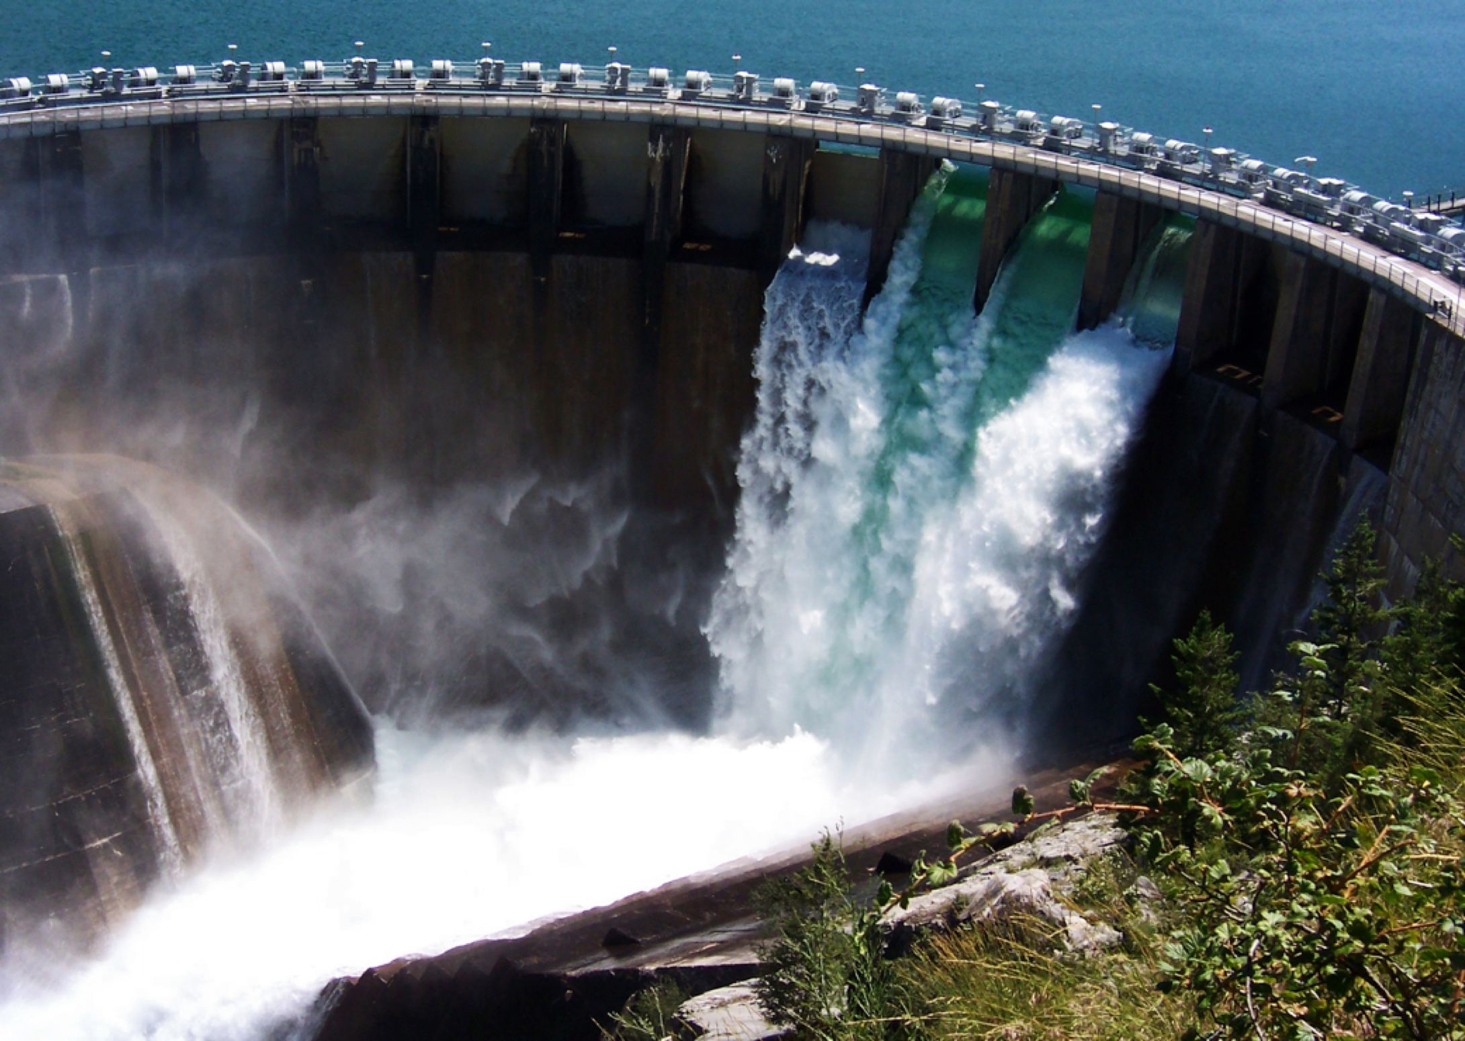
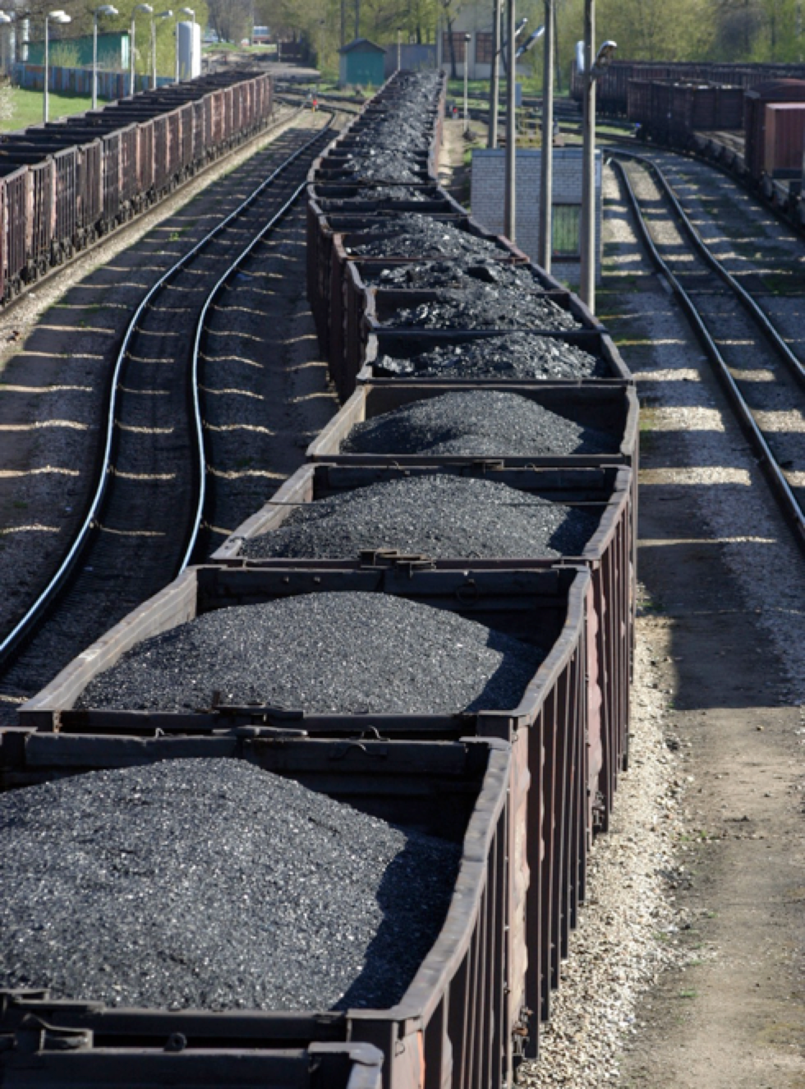
Renewable and Nonrenewable Energy Sources
Notes:
We use energy to do almost everything, so it is important to understand where our energy comes from.
Renewable resources are sources of energy that are naturally replaced; like wind, water and solar.
Nonrenewable resources are sources that take a long time to make and once they are gone, they are gone: like our fossil fuels, coal, oil and natural gas.

Slide 5
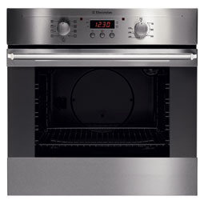
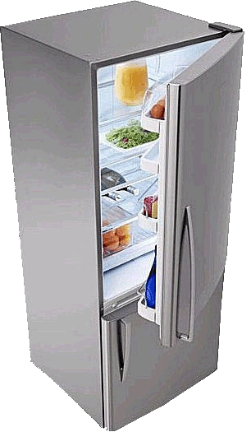
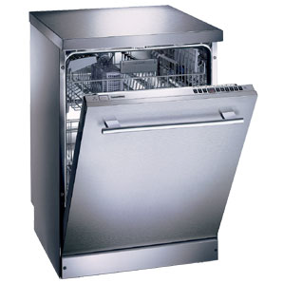
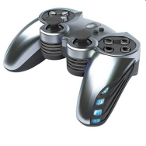
We use electricity for virtually everything
at home and at school.
Notes:
Electricity is an energy source that is used to heat buildings, cook food, dry clothes, heat water and give us light.
Look at all the ways we use electricity.
Let’s talk about electricity.

Slide 6
What is electricity?
Electricity is the flow of electric charge.
It needs a path to travel on - a circuit.
Notes:
What is electricity?
Electricity is the flow of electrons.
It needs to travel on a path. A complete path is called a circuit.

Slide 7
What do we need for electricity to flow?
An energy source
A conductor to carry electrical energy
A load to use the energy
example:
battery
example:
wire
example:
light bulb
Notes:
For electricity to work, it needs to travel on a circuit, like cars travel on a race track.
Click once for all 3 boxes to come in.
An electrical circuit allows energy to be changed from one form to another.
Batteries contain chemical energy that changes into electrical energy.
The electrical energy moves through the wire but some of it is changed into heat energy due to resistance in the wire.
The light bulb changes the energy again, from electrical energy into light and more heat energy.

Slide 8
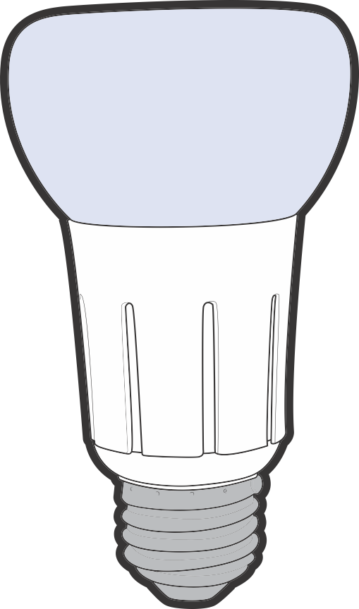
Circuits can be open or closed.
Open circuit: no electricity can flow.
Notes:
An electrical circuit can be open or closed. Click to show a diagram of an open circuit.
When the circuit is open, the path is broken and no electricity can flow. Click to show a diagram of a closed circuit.
This is how a light switch works, it opens and closes the circuit. When the switch is off, the electrical pathway is not complete, so no electricity can flow.
When you flip the switch, you close the circuit and the light turns on.

Slide 9
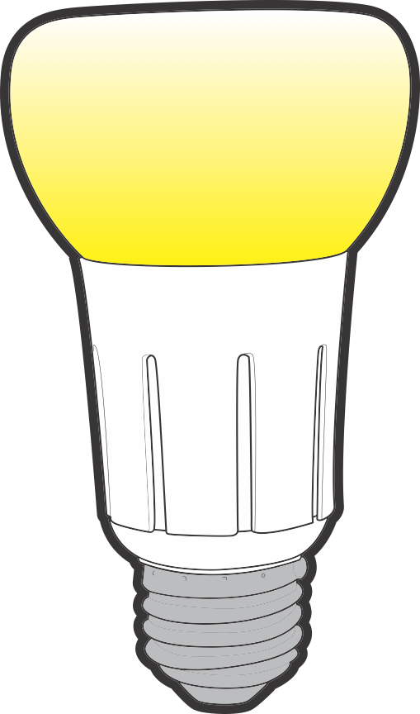
Closed circuit: electricity can flow.
Notes:
An electrical circuit can be open or closed. Click to show a diagram of an open circuit.
When the circuit is open, the path is broken and no electricity can flow. Click to show a diagram of a closed circuit.
This is how a light switch works, it opens and closes the circuit. When the switch is off, the electrical pathway is not complete, so no electricity can flow.
When you flip the switch, you close the circuit and the light turns on.

Slide 10
Insulator
does not allow electricity to flow easily
Notes:
An insulator does not let electricity flow through easily. In our experiment, what did we find out was a good insulator?
Insulators are materials such as paper, plastic and rubber.
This energy stick is made of plastic which is an insulator. However, the ends are metal which is a conductor. You act as a conductor when you touch the metal ends.

Slide 11
Conductor
material that allows electricity to pass through easily
Notes:
We just made a circuit and saw that electricity needs a path. The path of a circuit is made using a conductor, like wire.
A conductor allows electricity to flow through it easily, like metal wires do.
This energy stick is made of plastic which is an insulator. However, the ends are metal which is a conductor. You act as a conductor when you touch the metal ends.
Which one was a conductor? (aluminum foil) wires and people are also conductors
Which was an insulator? (paper) rubber and plastic are also insulators

Slide 12
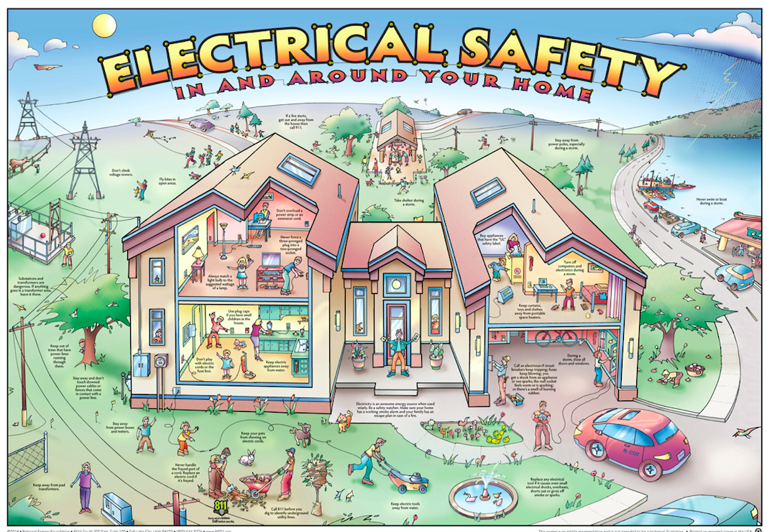
Notes:
Now let’s explore electrical safety - inside.

Slide 13
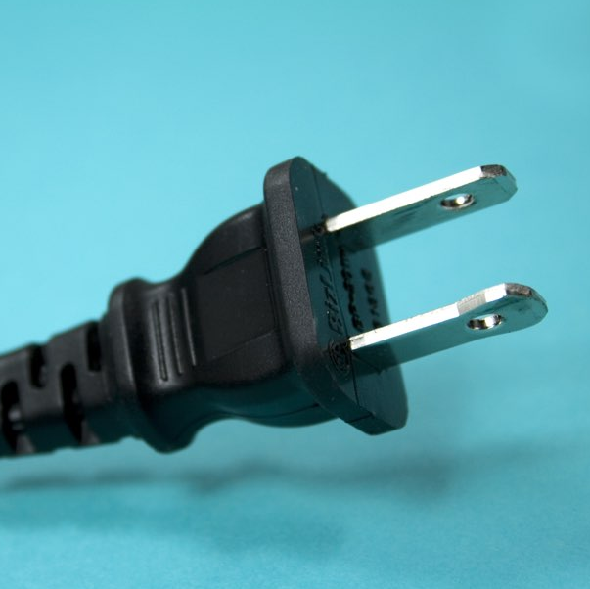
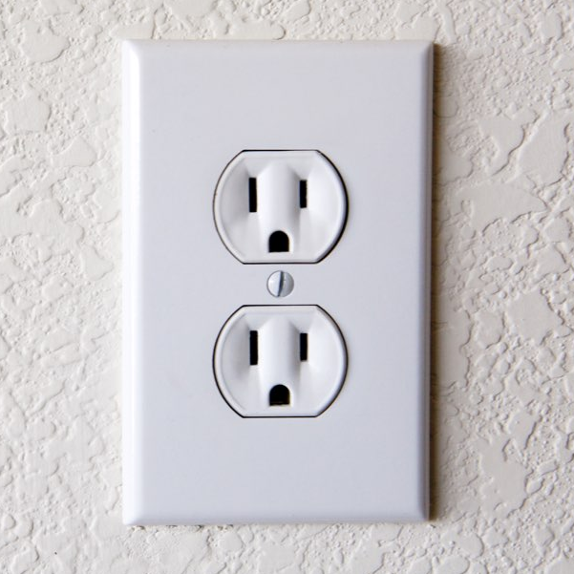
Electrical Safety
Play it safe inside. Always:
Unplug appliances by the plug, NOT the cord.
Use outlet caps.
Unplug appliances using the plug, NOT the cord.
Never stick anything into an outlet except a plug.
Notes:
Teachers, you have a copy of this poster that the students can look at and review ways to be safe.
Now let’s explore electrical safety - inside.
Animation happens automatically.
Play it safe inside. Always:
Unplug appliances using the rubber plug – not the cord.
Never stick anything into an outlet except a plug.
Remember, that wires connected to an outlet are not safe to touch, you can get shocked or burned.

Slide 14
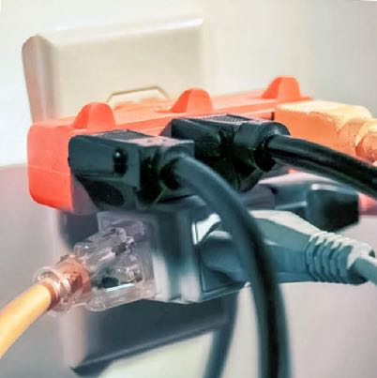
Play it safe inside.
Never overload outlets.
This can be a fire hazard.
Use outlet caps. Protect others from harm.
X
Notes:
Do not overload outlets. This can be a fire hazard.
Use outlet caps – they can protect small children from shock and burns.

Slide 15
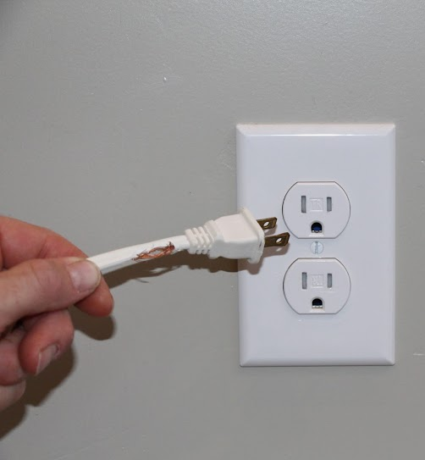
Play it safe inside.
Never mix water and electricity.
Do not mix water and electricity.
Do not touch or use frayed cords.
Notes:
Do not mix water and electricity.
Do not touch frayed cords.

Slide 16
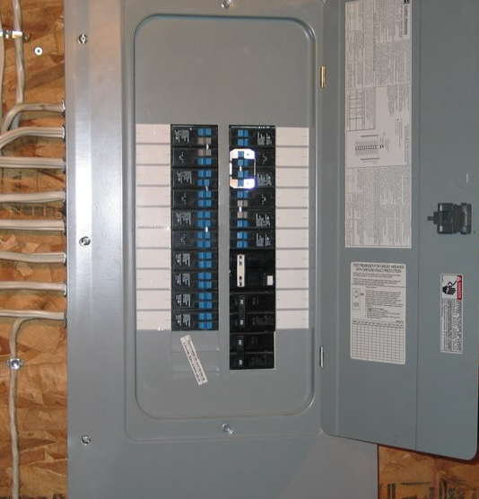
Play it
safe
inside.
Notes:
Do not touch electric equipment, like the circuit breaker box.
Never put utensils in the toaster while it is still plugged in.
Never use electric appliances or space heaters to dry clothes or bedding.
Click to make the “NO TOUCH” symbol to come in as you mention each photo.
Is it OK to touch the circuit breaker box? Click
Is it OK to put a fork or knife in a toaster while it is still plugged in? Click
Is it OK to dry wet clothes or bedding on a space heater? Click

Slide 17
It’s time for Damage Prevention Lingo.
™
Notes:
It’s time for Damage Prevention Lingo.

Slide 18
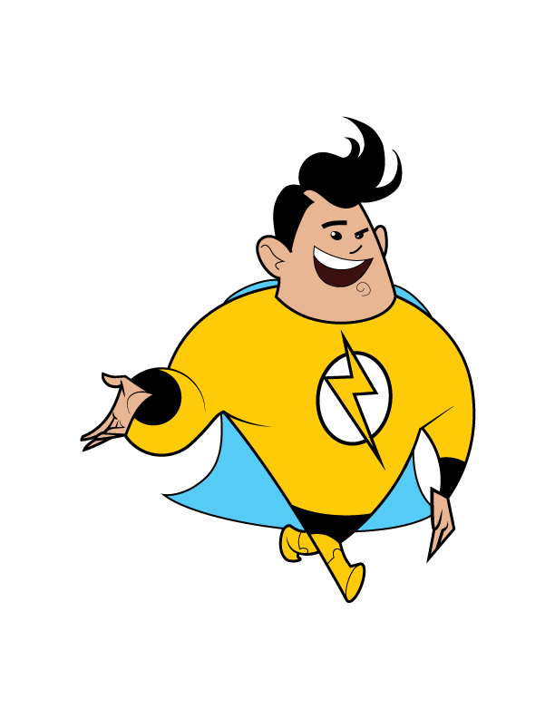
Overloaded Outlets
When too many appliances are plugged in, o___________
o______ can be a fire hazard.
™
Notes:
When too many appliances are plugged in, o____________ o__________ can be a fire hazard.
Overloaded Outlets

Slide 19
Frayed Cord
Do not touch or use a broken or
f________ c_____.
It can be
dangerous.
™
Notes:
Do not touch or use a broken or f_____ c____. It can be dangerous.
Frayed Cord

Slide 20
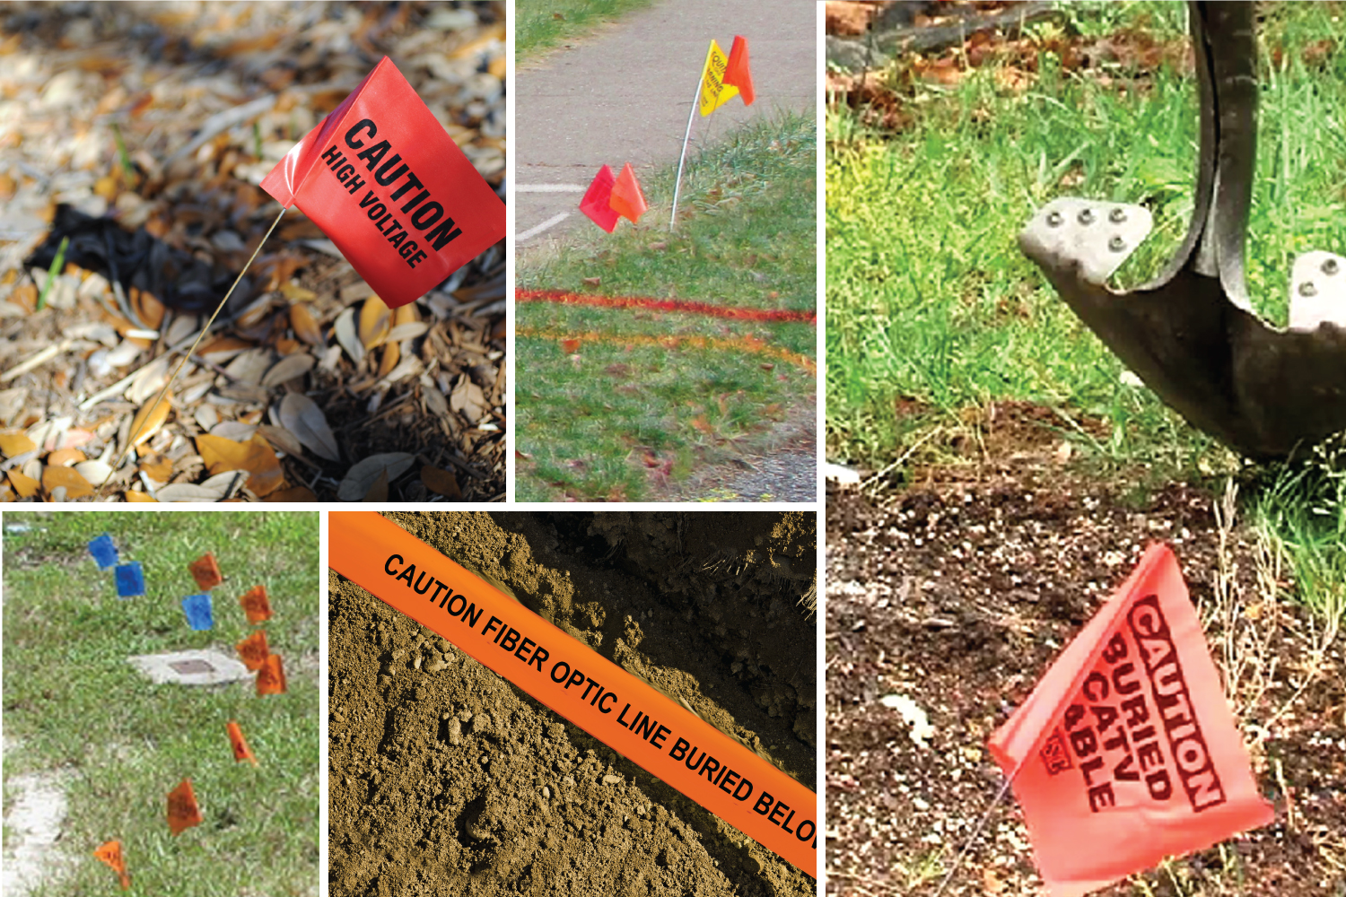
Notes:
Before any digging occurs at home or in a community, someone must call 811 so that electric power line locations are properly marked above ground.
These markers are important because they help people know where not to dig.
Hitting buried electric power lines or communication lines can cause damage and serious incidents.

Slide 21
Do NOT move or pull out marker flags. They show the location of buried utility lines.
Notes:
Different colored flags mean different utilities are buried underground.
White flags or paint show where the someone wants to dig.
Electricity lines are marked with red.
Natural gas lines are marked with yellow flags, markers or paint.
Water lines are marked with blue.
Other colors mark things like cable (orange) and sewer lines (green).
NEVER move or pull out marker flags.
If you see flags that are laying around, you should leave them alone, never put thumbtack in the ground.

Slide 22
It is fast. It is the LAW.
Notes:
Before any digging occurs at home or in a community, someone must call 811 so that the location of buried power lines and utility cables are properly marked above ground.
It is fast. It is free. It is the law.
There is a Call 811 Before You Dig video that is about a pirate and two students, Jenny and Michael. It is on the Energy Safe Kids website which we will show you later.
Once you have seen it - teachers - share it with others in the school, perhaps even sharing it during the announcements.

Slide 23
It’s time for Damage Prevention Lingo.
™
Notes:
It’s time for Damage Prevention Lingo.

Slide 24
811
Call _____ to have buried power lines and utility cables located and marked.
™
Notes:
Call ____ to have buried power lines and utility cables located and marked.
811

Slide 25
Pay attention to these colorful things that can tell you what is below.
Marker Flags
™
Notes:
Pay attention to these colorful things that can tell you what is below.
Marker Flags

Slide 26
Power Lines
Call 811 to mark the location of utility cables and buried p_______ l_____.
™
Notes:
Call 811 to mark the location of utility cables and buried P_____ L____.
Power Lines

Slide 27
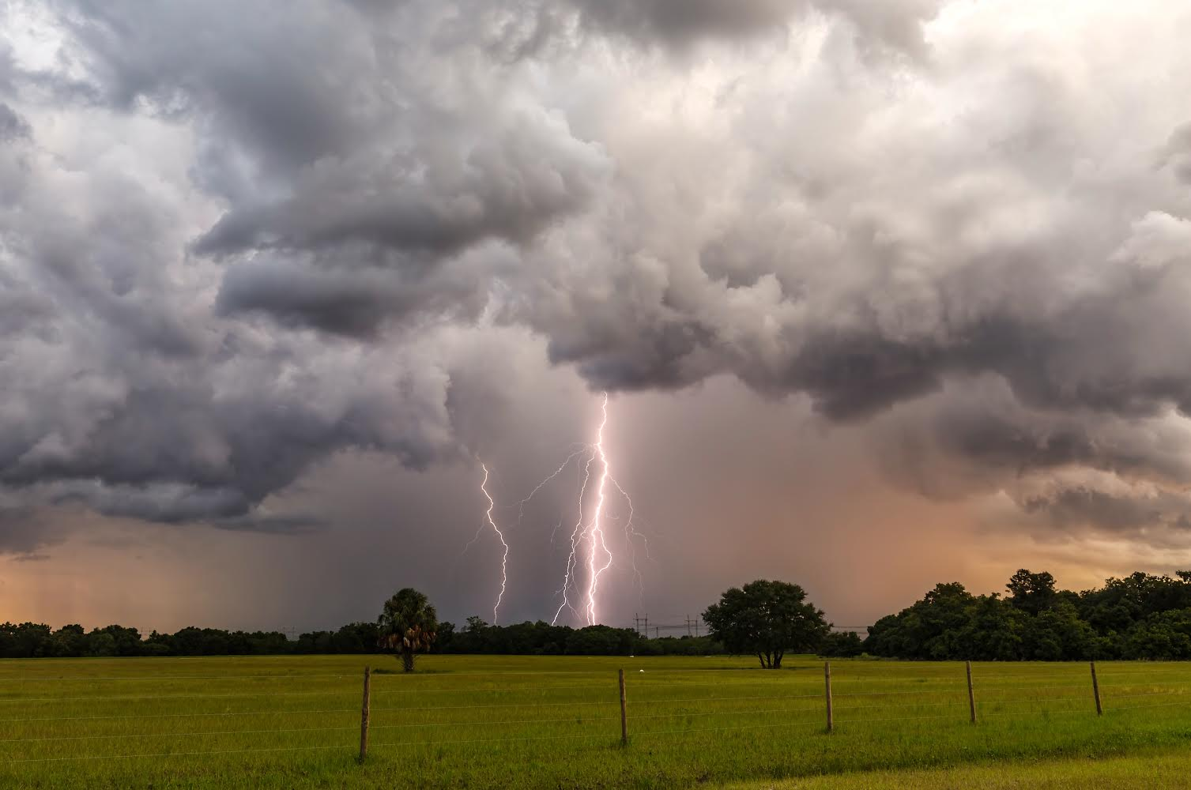
Electrical Safety Outside
When thunder roars, go indoors.
Notes:
Electrical safety outside.
Go inside when there is a storm.

Slide 28
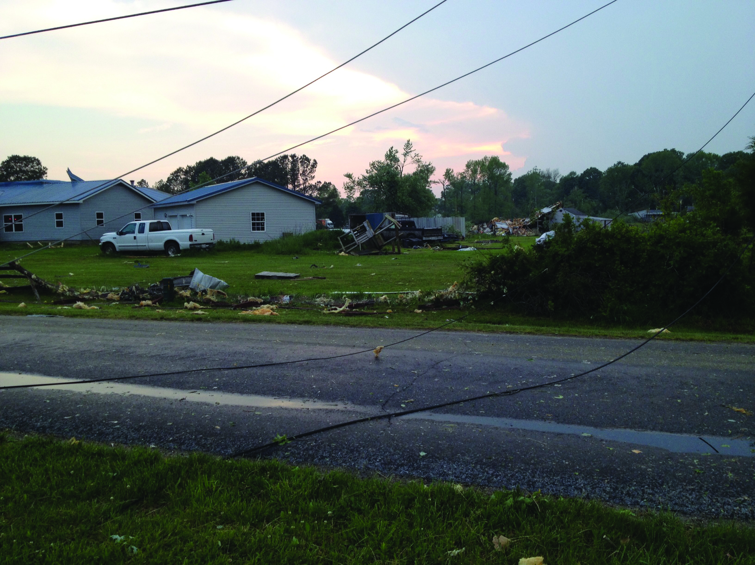
Electrical Safety Outside
Stop, turn around and go the other way.
Notes:
Play it safe outside.
Do we know if the power lines still have electricity going through them?
We should always expect electricity to be going through the wires even if you don’t see sparks.
Stop, turn around and go the other way.
Stay away from downed power lines.
Have an adult call 911 if you see downed power lines.

Slide 29
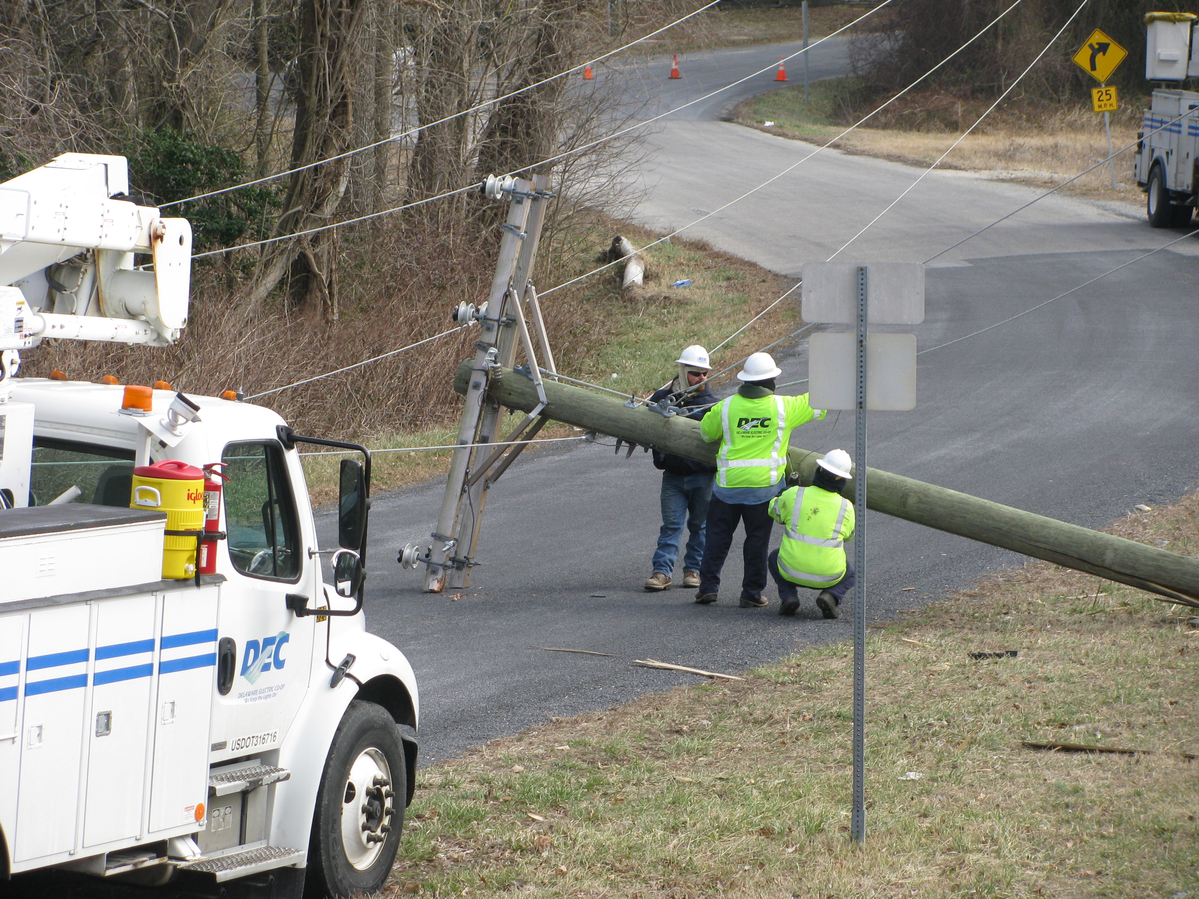
Electrical Safety Outside
Stop, turn around and go the other way.
Notes:
Can you see the orange cones in the road at the top of the photo? Why are they there?
Stop, turn around and go the other way.
Stay away from downed power lines.
Have an adult call 911 if you see downed power lines.

Slide 30
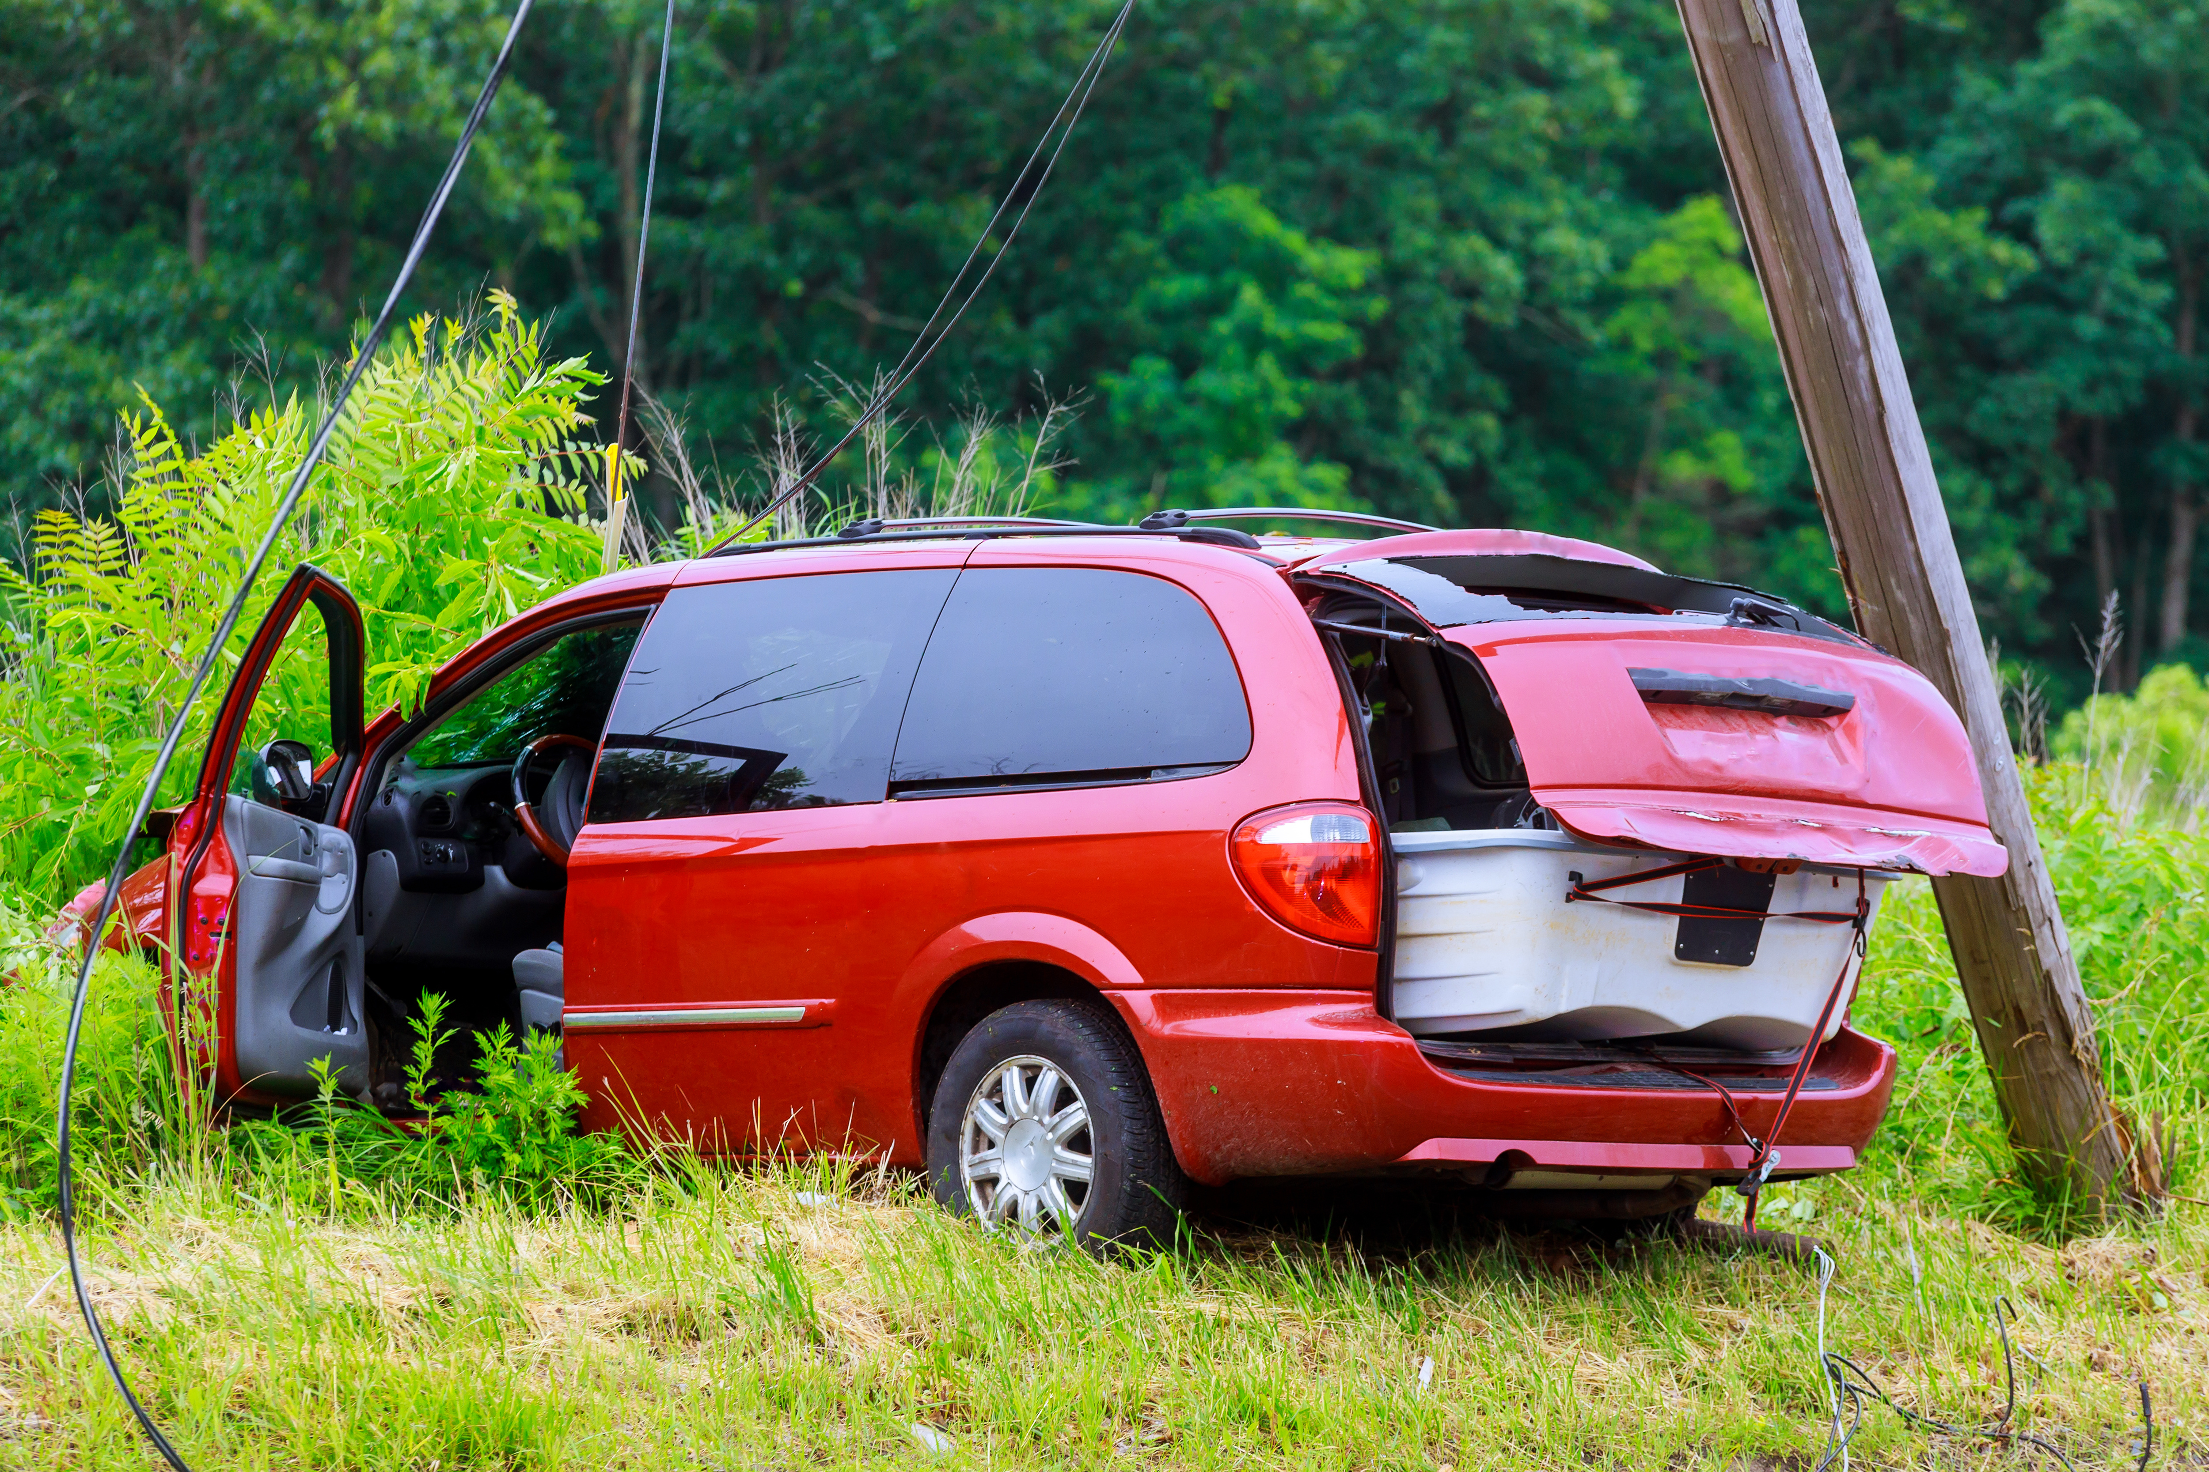
Electrical Safety Outside
Stay inside the car and call 911.
If you must get out:
1. Open the door
2. Stand on the edge
of the doorframe
3. Jump out with
your feet together
4. away to
a safe location.
HOP
Notes:
If power lines fall on your car, stay inside the car and call 911.
Do not touch anything metal on the vehicle.
Do NOT leave the vehicle until you are instructed by emergency personnel.
Click for steps to follow.
If you must get out of your car, do these four things:
open the door, but do NOT step out
stand on the edge of the doorframe, remember NOT to touch anything metal
jump out with your feet together
THEN hop away to a safe location. Keep your feet together the entire time you hop. Do NOT walk.
Does everyone see these 3 red lines in the picture?
See how the lines get thinner the further away from the door.
The energy in the downed power lines are more powerful CLOSER to the car. As you hop away from the car, there is less energy.

Slide 31
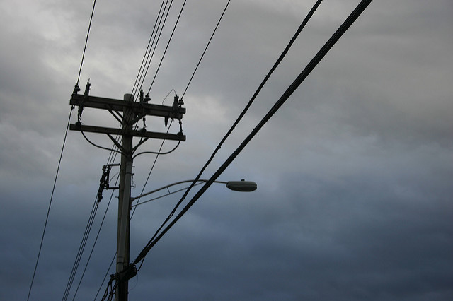
Power lines carry electricity.
Stay at least 25 feet away
(length of a ),
Stay 100 feet from downed power lines.
Notes:
Electricity is transported from where it is generated to your community through power lines.
Be sure to stay away from power lines. Stay at least 25 feet away from power lines (about the length of a school bus), 100 feet away from downed power lines.
Click for buses will move in.

Slide 32
It’s time for Damage Prevention Lingo.
™
Notes:
It’s time for Damage Prevention Lingo.

Slide 33
Downed Power Lines
For electrical safety outside, stay 100 feet away from d_________ p______ l_____.
™
Notes:
For electrical safety outside, stay 100 feet away from d_____ p____ l_____.
Downed Power Lines

Slide 34
Stop, turn around and go the
other way.
Have an adult call _____ if you see a downed power line.
911
™
Notes:
Stop, turn around and go the other way. Have an adult call ____ if you see a downed power line.
911

Slide 35
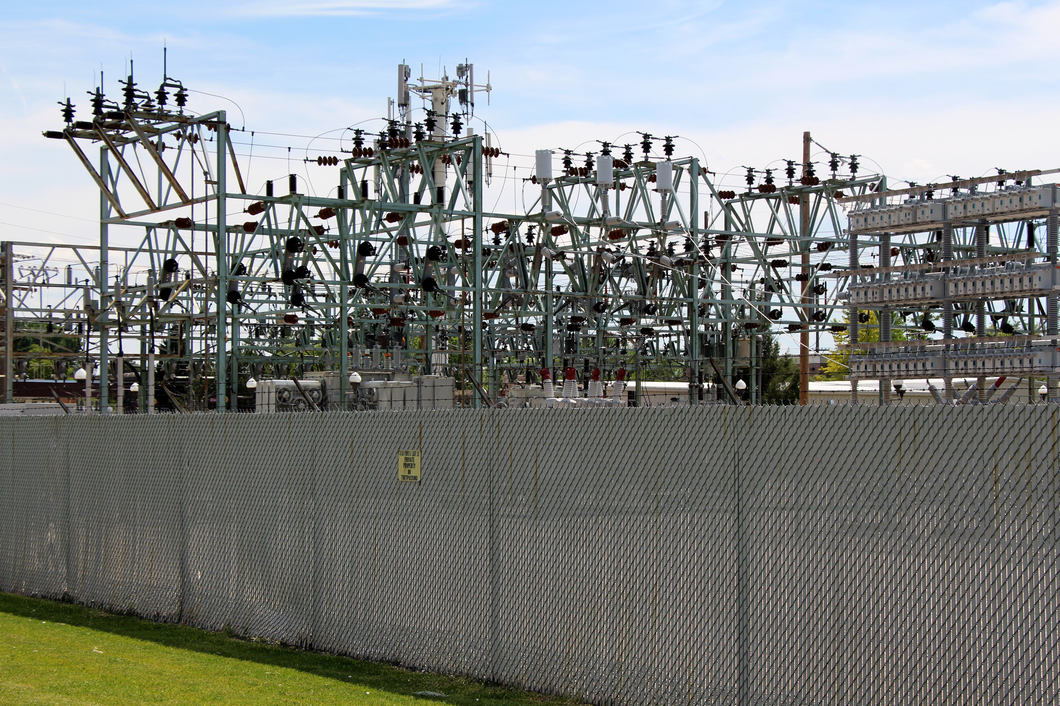
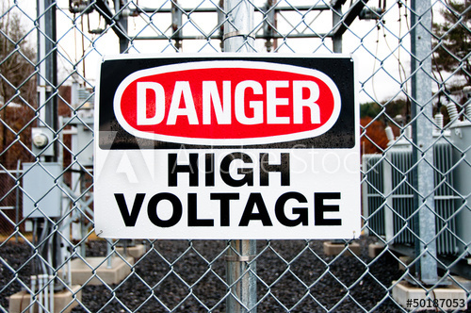
Stay away from electrical equipment.
DO NOT climb substation fences.
Play it safe outside.
Notes:
Stay away from electrical equipment, like the one in this picture.
DO NOT climb substation fences for any reason. If something goes over the fence like a ball or toy, it is gone.

Slide 36
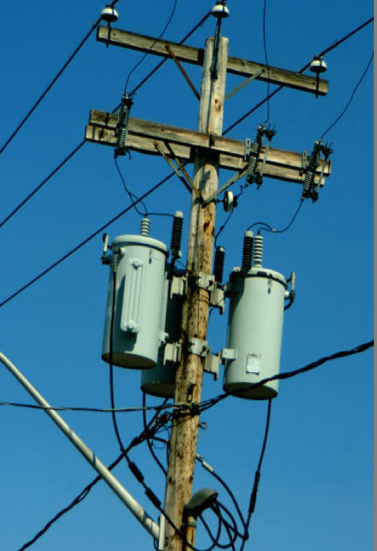
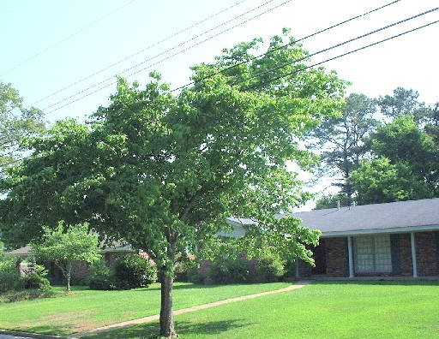
Play it safe outside.
power poles
power lines through tree top
Do not climb power poles or
trees near power lines.
Notes:
Do not climb power poles.
Do not climb trees near power lines.
Do not fly kites or drones around power lines. Let go of the kite immediately if it gets near wires.

Slide 37
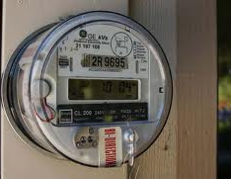
Play it safe outside.
electric meters
pad mount transformer
Stay away from electrical equipment like electric meters and transformers.
Notes:
Do not play around electric equipment such as electric meters or pad mount transformers.
Pad mount transformers are transformers for buried electrical lines.
They change the voltages going into homes or business and are very powerful.

Slide 38
It’s time for Damage Prevention Lingo.
™
Notes:
It’s time for Damage Prevention Lingo.

Slide 39
Substation
Never climb the fence around a s_________ for any reason.
It is dangerous.
™
Notes:
Never climb the fence around a s______ for any reason. It is dangerous.
Substation

Slide 40
Pad mount _______ change the voltage of buried power lines and can be dangerous to play on.
Transformers
™
Notes:
Pad mount ___________ change the voltage of the buried power lines and can be dangerous to play on.
Transformers

Slide 41
Never play
around electrical equipment like e____ m____
and the c____
b____ b___.
It is dangerous.
Electric Meters
Circuit Breaker Box
™
Notes:
Never play around electrical equipment like e____ m____ and the c____ b____ b___. It is dangerous.
Electric Meters, Circuit Breaker Box

Slide 42
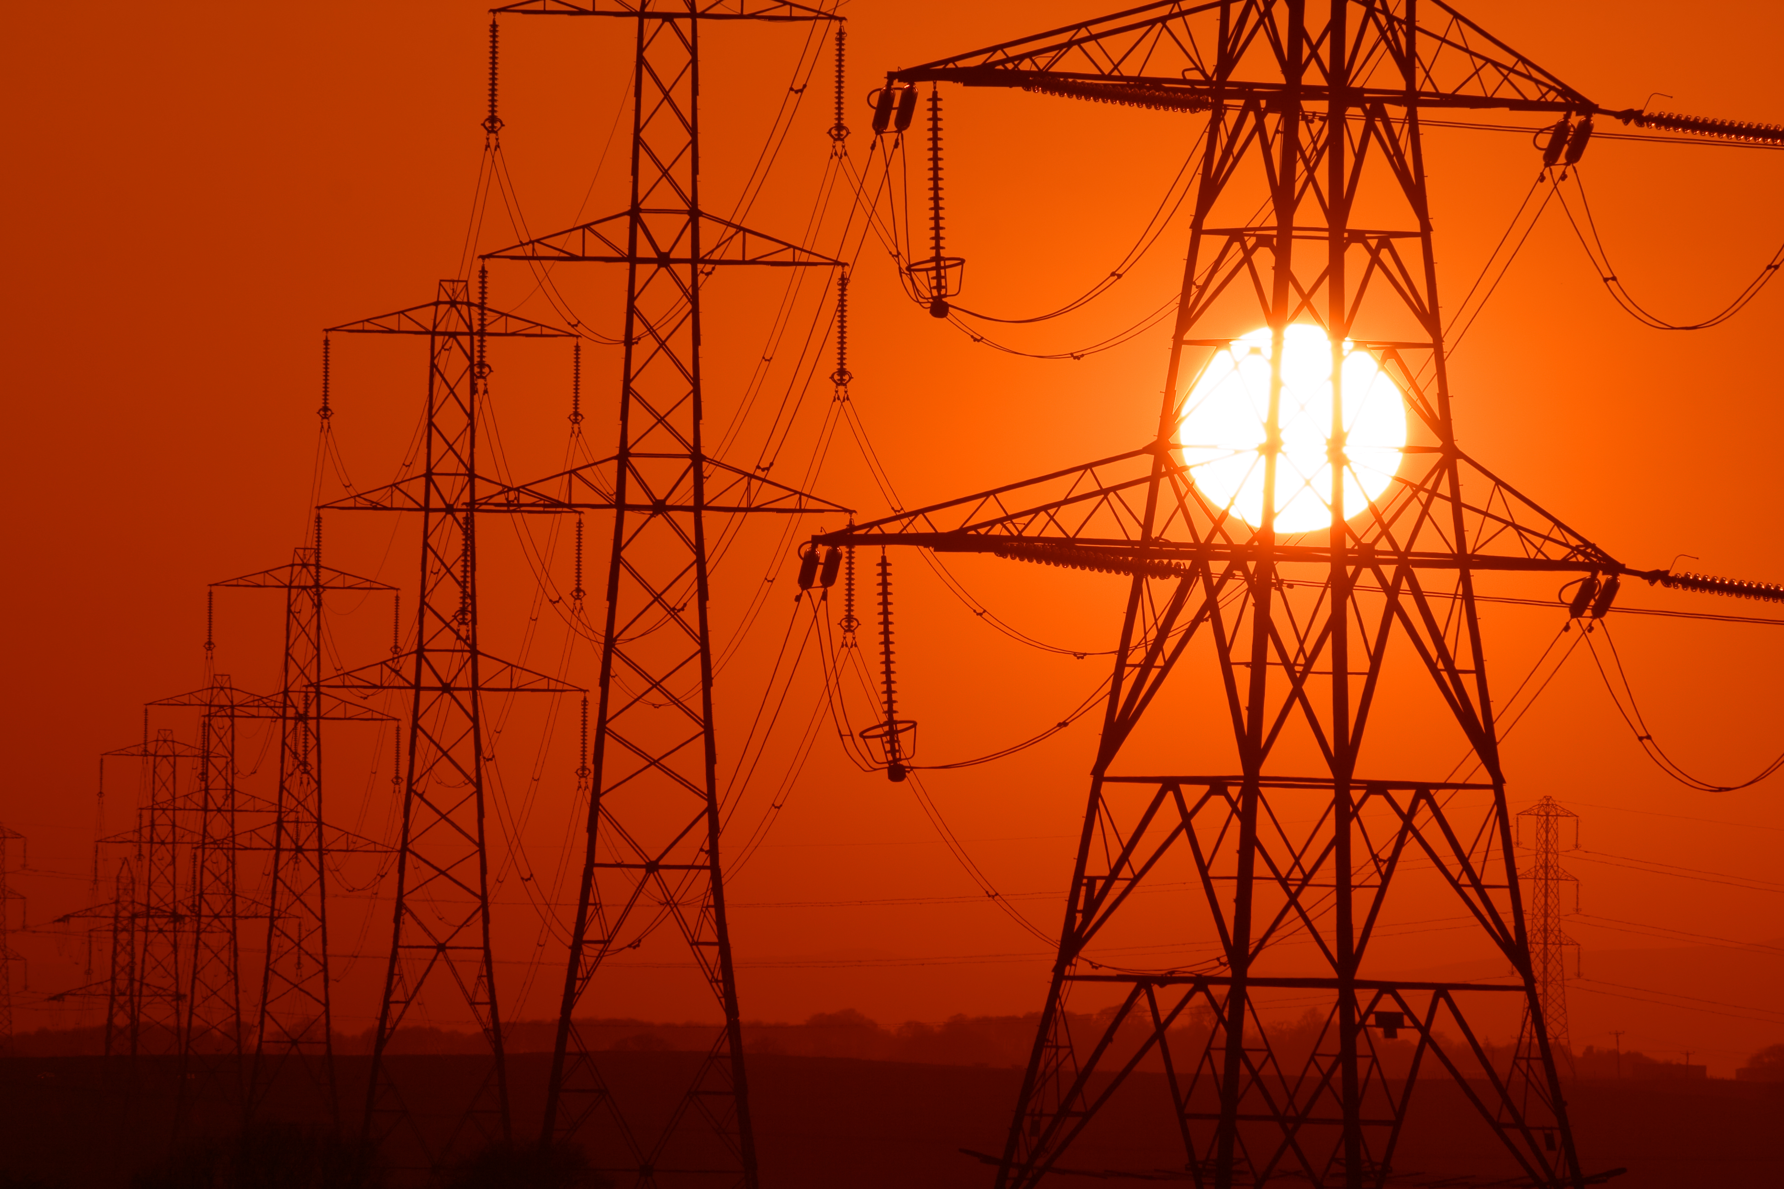
Electricity is powerful and we must use it safely.
Notes:
Electricity is a powerful energy source and we must be safe when using it.

Slide 43
Students, be an Energy Safe Kid!
™
Notes:
Students, be an Energy Safe Kid!

Slide 44
You can be an
Energy Safe Kid!
™
Notes:
You can be an Energy Safe Kid.

