Slide 1

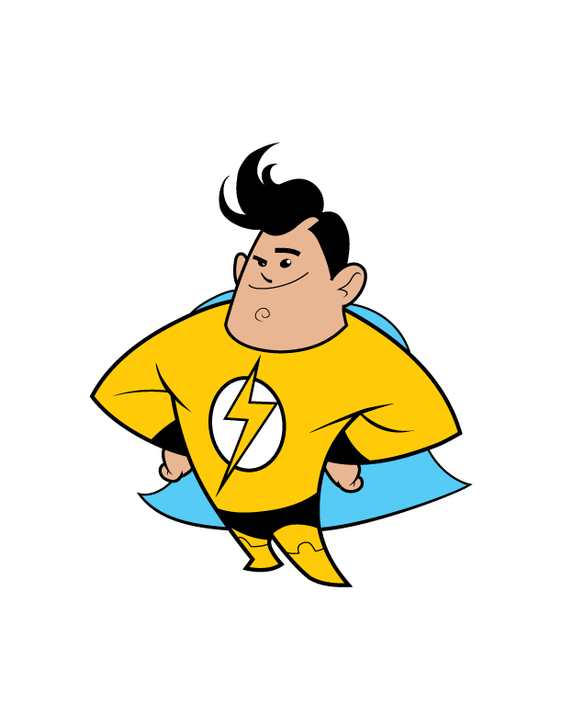

TM
Notes:
Hello everyone and welcome to Energy Safe Kids, brought to you by the National Energy Foundation.

Slide 2


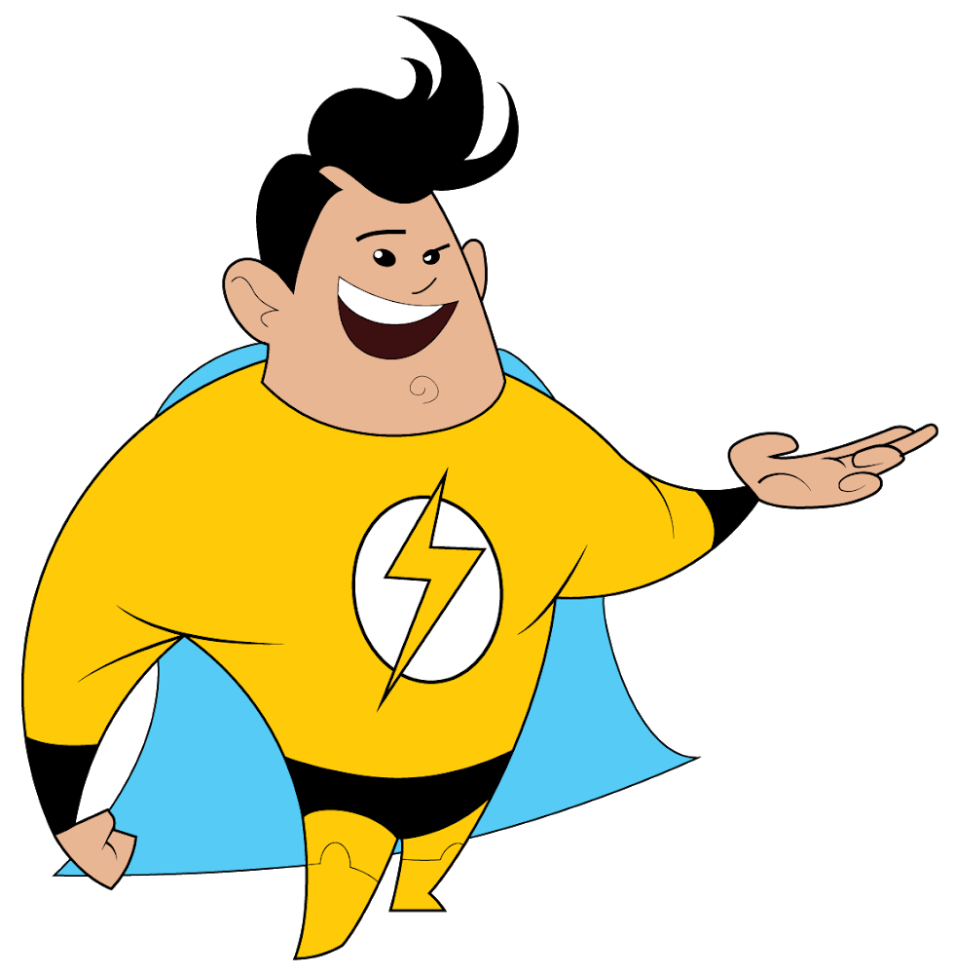
Think!
Talk!
Take Action!
about electrical safety!
TM
Notes:
As part of the presentation, tell the group that we are going to Think!, Talk! and Take Action! about electrical safety.

Slide 3
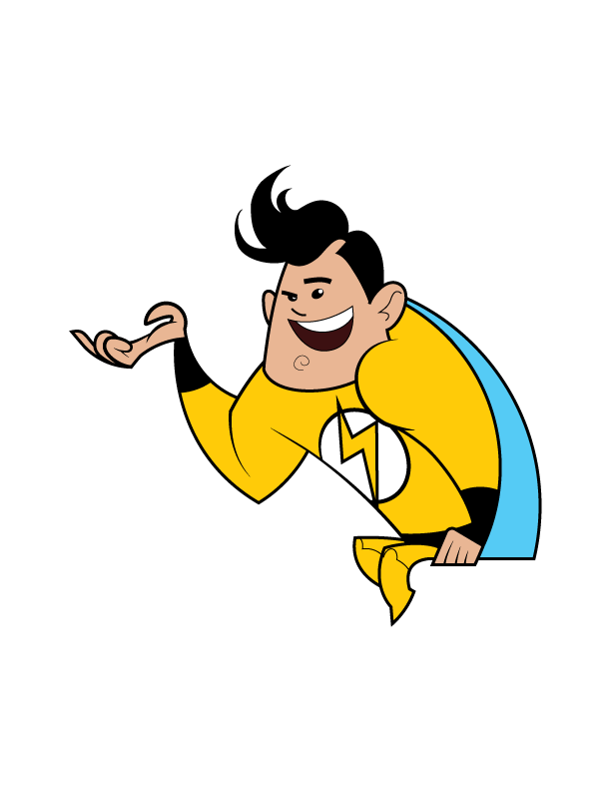
What We Will Do Today
  Learn about energy.
Learn about properties of electricity.
Learn about electrical safety -
inside and outside.
TM
Play Damage Prevention Lingo and
Electrical Safety Sense - literacy review games.
Notes:
For the Damage Prevention LINGO review game, let the students know that a slide will appear when it is time to play the game.
Damage and prevention are two big words. Damage means to break something and prevention means to keep it from happening.
Playing Damage Prevention Lingo will helps you learn to be safe around electricity.
The review activity at the end of the presentation is called Electrical Safety Sense.

Slide 4

ENERGY
is the ability to do WORK.
Notes:
Let’s Talk! about energy now.
What is energy?
BRIEFLY allow students to answer.
Energy is the ability to do work.

Slide 5
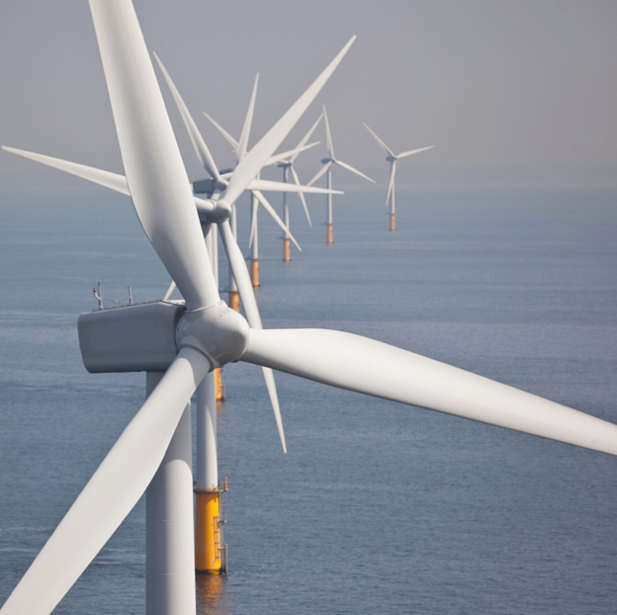
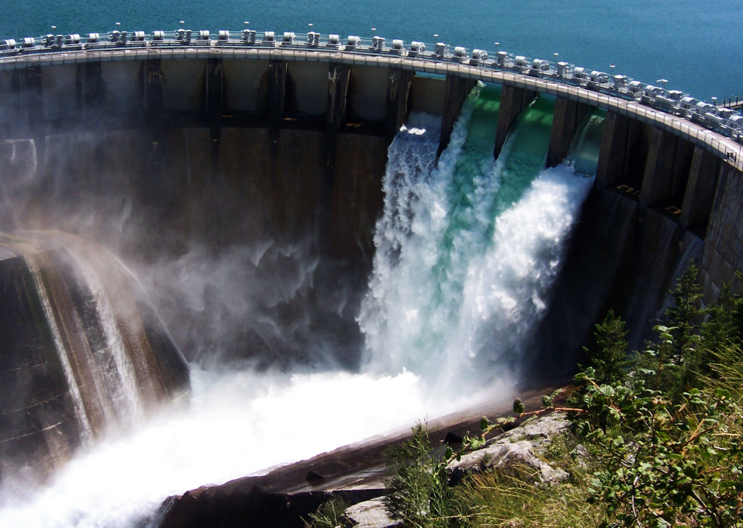


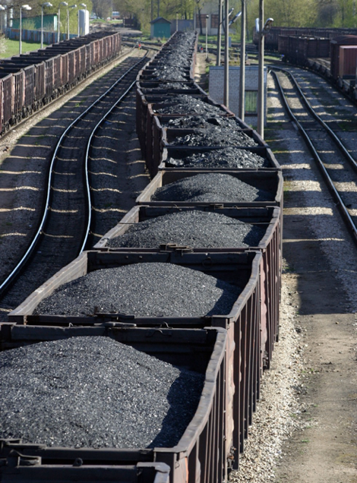

Renewable and Nonrenewable
Energy Sources
Notes:
Animation from Energy Sources to Renewable and Nonrenewable happens automatically and with a 2 second delay.
We use energy to do almost everything, so it is important to understand where our energy comes from.
Renewable resources are sources of energy that are naturally replaced; like wind, water and solar.
Nonrenewable resources are source that take a long time to make and once they are gone, they are gone like our fossil fuels, coal, oil and natural gas.
Let’s talk about electrical safety.

Slide 6
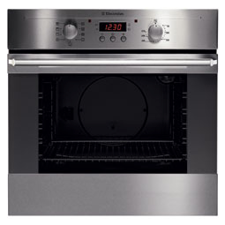


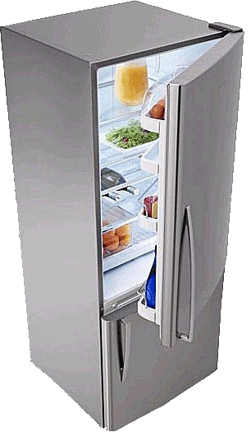
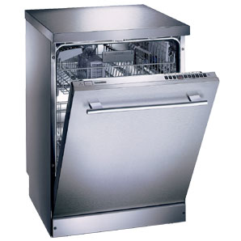


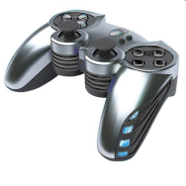
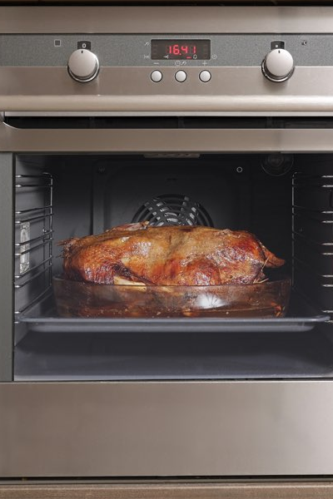
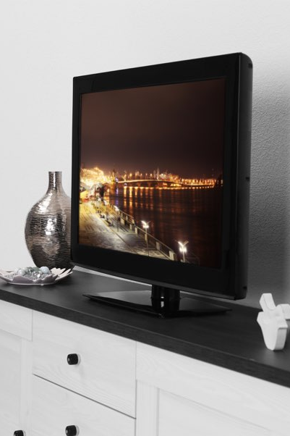


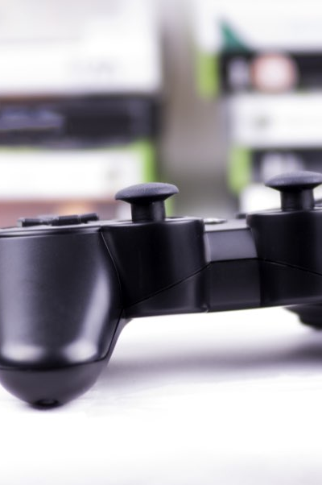
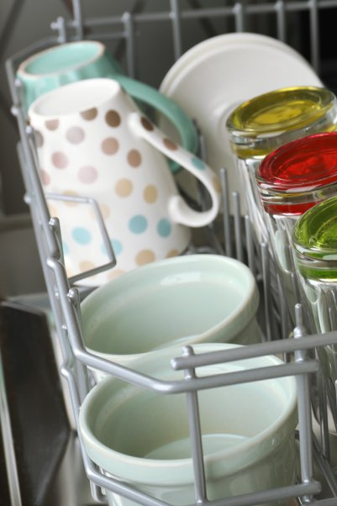
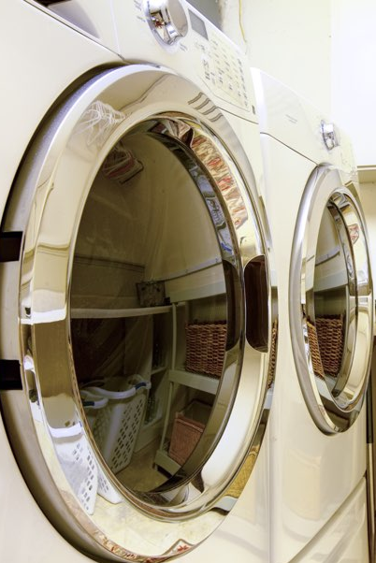
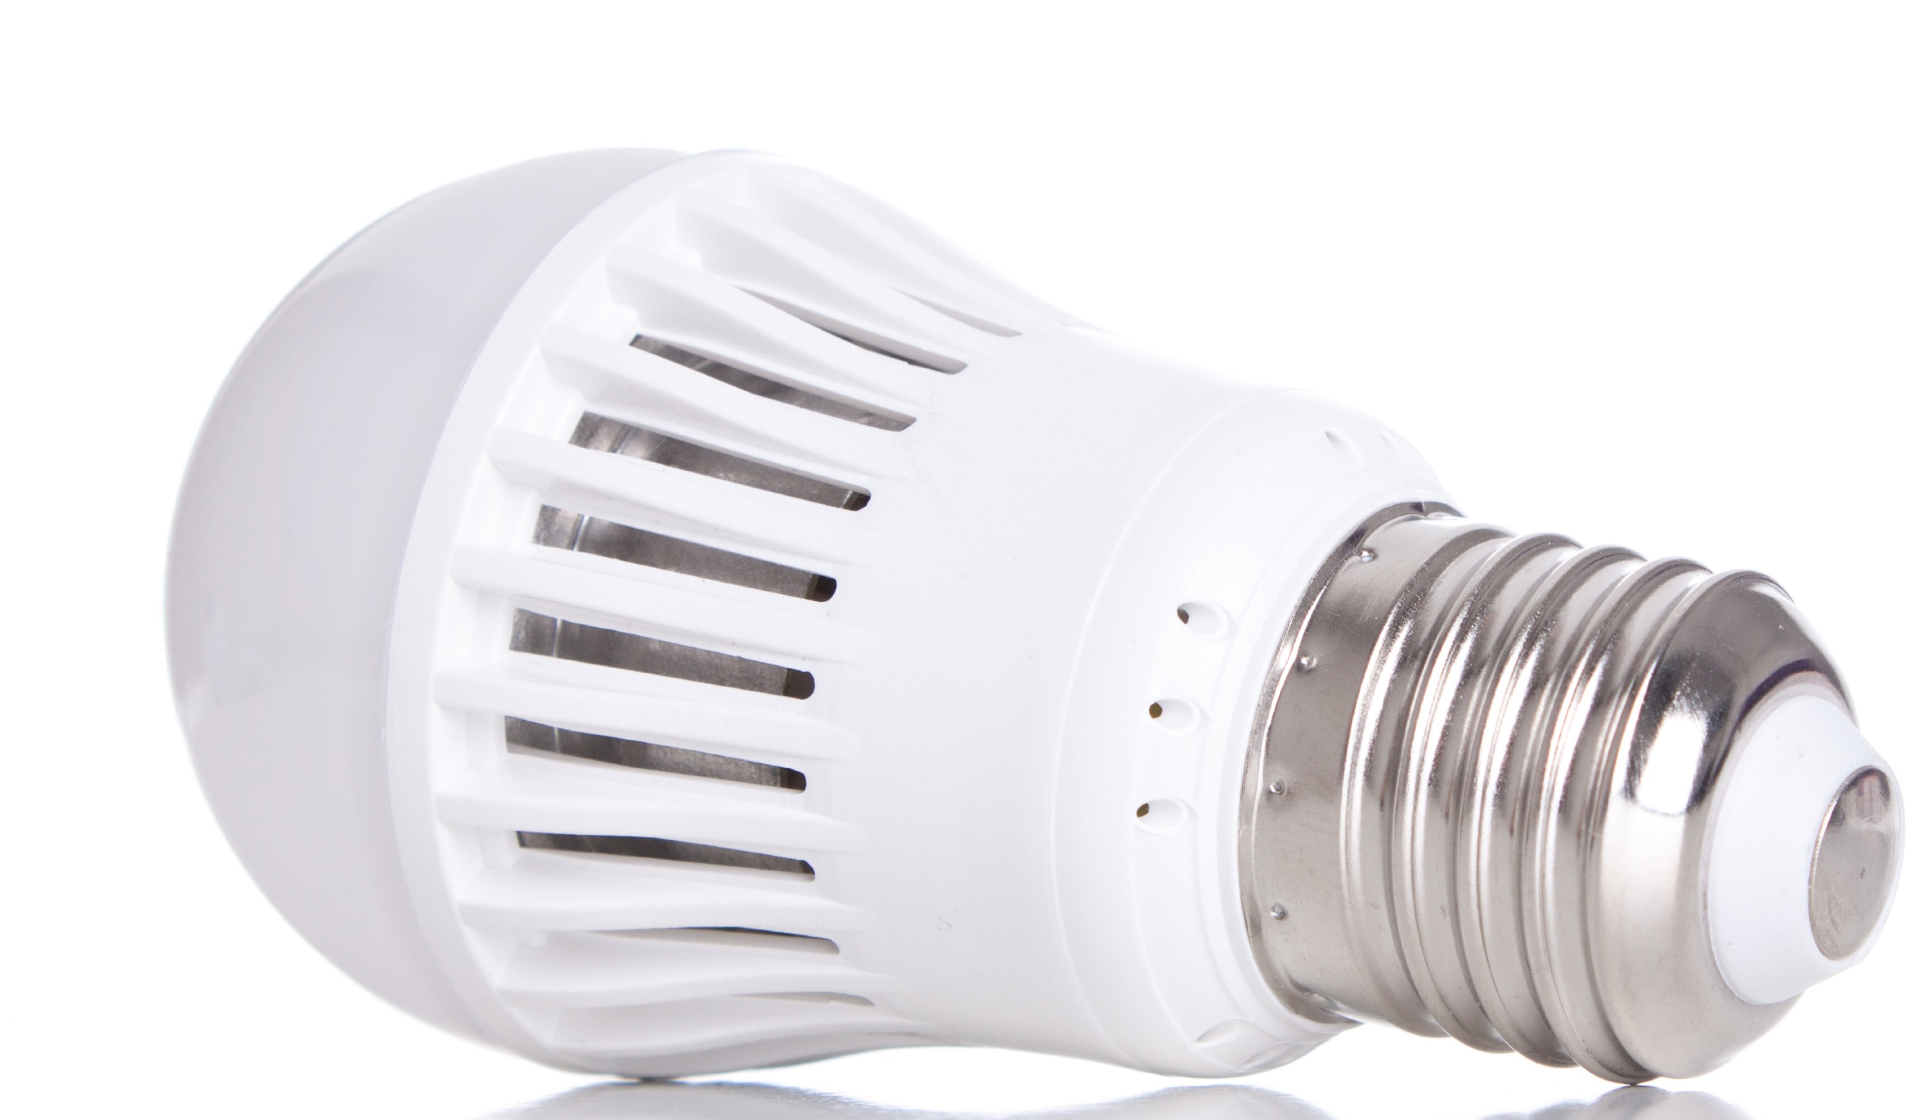
We use electricity for virtually everything
at home and at school.
Notes:
Electricity is an energy source that is used to heat buildings, cook food, dry clothes, heat water and give us light.
Look at all the ways we use electricity.
Let’s talk about electricity.

Slide 7
What is electricity?
Electricity is the flow of electric charge.
It needs a path to travel on - a circuit.
Notes:
What is electricity?
Electricity is the flow of electrons.
It needs to travel on a path. A complete path is called a circuit.

Slide 8
What do we need for electricity to flow?
An energy source
A conductor to carry electrical energy
A load to use the energy
example:
battery
example:
wire
example:
light bulb
Notes:
For electricity to work, it needs to travel on a circuit, like cars travel on a race track. Review three things needed to make a circuit from slide.
An electrical circuit allows energy to be changed from one form to another.
Batteries contain chemical energy that changes into electrical energy.
The electrical energy moves through the wire but some of it is changed into heat energy due to resistance in the wire.
The light bulb changes the energy again, from electrical energy into light and more heat energy.

Slide 9


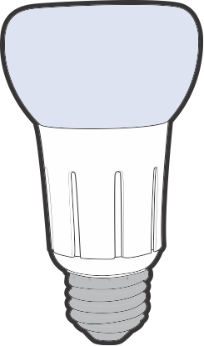
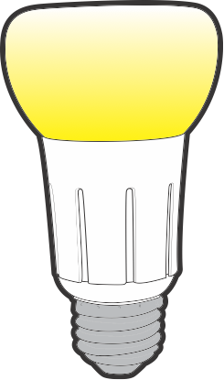
Circuits can be open or closed.
Open circuit:
no electricity can flow.
Closed circuit: electricity can flow.
Notes:
An electrical circuit can be open or closed.
Click to show a diagram of an open circuit.
When the circuit is open, the path is broken and no electricity can flow.
Click to show a diagram of a closed circuit.
This is how a light switch works, it opens and closes the circuit. When the switch is off, the electrical pathway is not complete, so no electricity can flow.
When you flip the switch, you close the circuit and the light turns on.
Stay on the closed circuit diagram.
Demonstrate the energy stick and explain how it works.
Props- energy stick, paper, foil
The stick has a small battery, which converts chemical energy to electric energy. This is the energy source. It also has light bulbs inside to act as loads, and wires that end at the ends of the stick to conduct electricity.
If we touch both ends of the stick, we complete a circuit to let the electricity flow.
Have a volunteer hold one end of the stick. Touch the other end and then touch hands to complete the circuit. (The stick will send an electrical current around the human circuit, resulting in light and sound coming from the stick.)
Click to the next slide before doing the energy stick with the whole group.

Slide 10
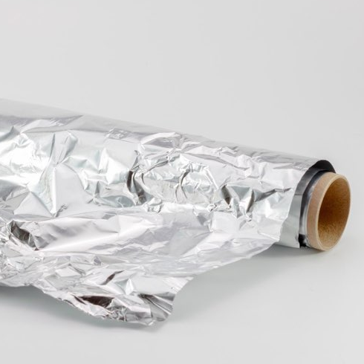
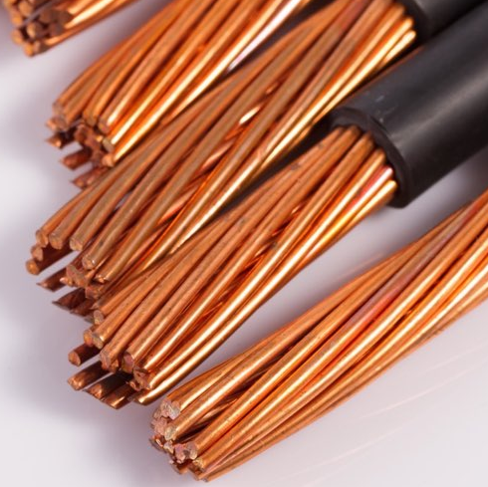

Conductor
material that allows electricity to
pass through easily
Notes:
We just made a circuit and saw that electricity needs a path. The path of a circuit is made using a conductor, like wire.
A conductor allows electricity to flow through it easily, like metal wires do.
Click to show three examples of conductors: aluminum foil, wire and people
Remember, that wires connected to an outlet are not safe to touch, you can get shocked or burned. (Remind kids that some of the electricity is converted to heat.)

Slide 11



Insulator
does not allow electricity to flow easily
Notes:
An insulator does not let electricity flow through easily.
Click to show three examples of insulators:
Insulators are materials such as paper, plastic and rubber.
This energy stick is made of plastic which is an insulator. However, the ends are metal which is a conductor. You act as a conductor when you touch the metal ends.
Recap results of conductor insulator experiment.
Which one was a conductor? (aluminum foil) wires and people are also conductors
Which was an insulator? (paper) rubber and plastic are also insulators

Slide 12
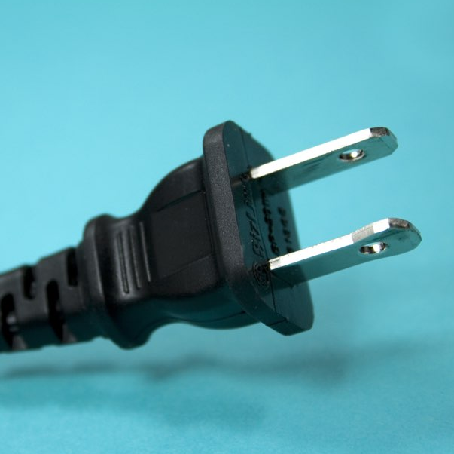
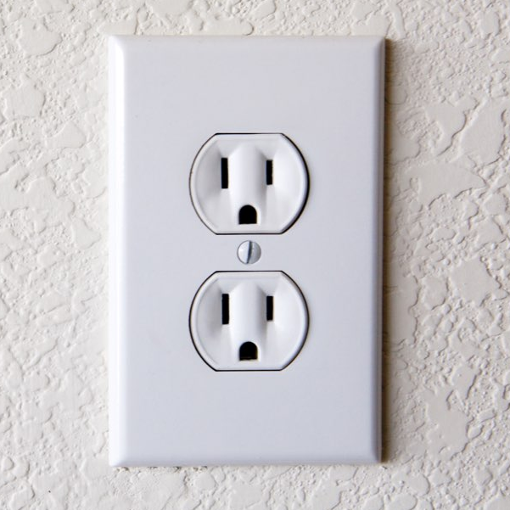
  Unplug appliances by the plug, NOT the cord.
  Use outlet caps.
Play it safe inside.
Always:
Electrical Safety
Notes:
Now let’s explore electrical safety - inside.
Play it safe inside. Always:
Unplug appliances using the rubber plug – not the cord.
Use outlet caps – they can protect small children from shock and burns.

Slide 13
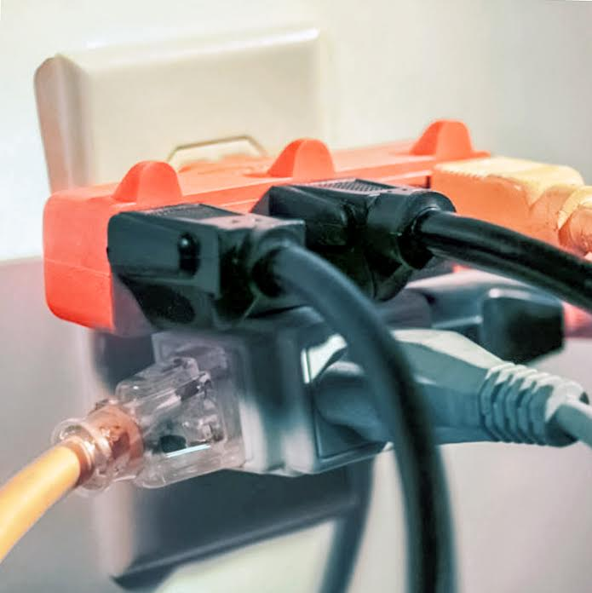
Play it safe inside.
Never stick anything into an outlet
except a plug.
Never
overload outlets.
This can be a fire hazard.
Notes:
More on electrical safety inside.
Do not overload outlets. This can be a fire hazard.
Do not stick anything in outlets except plugs.

Slide 14

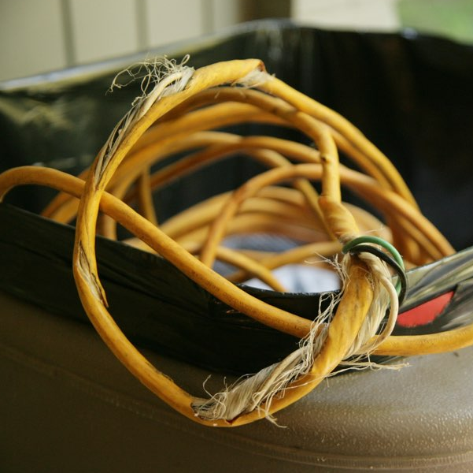
Play it safe inside.
Never mix water
and electricity.
Never touch or use frayed cords.
Notes:
More on electrical safety inside.
Do not mix water and electricity.
Do not touch frayed cords.

Slide 15
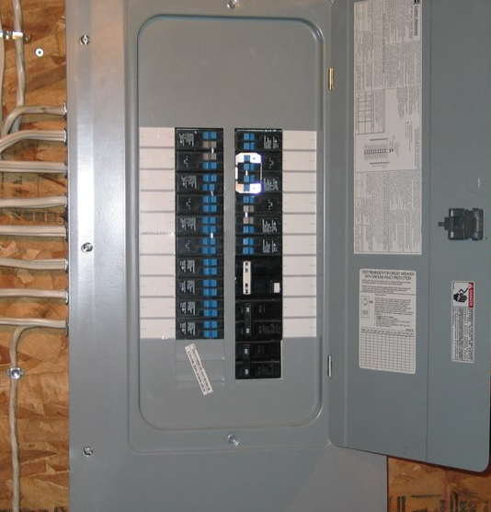
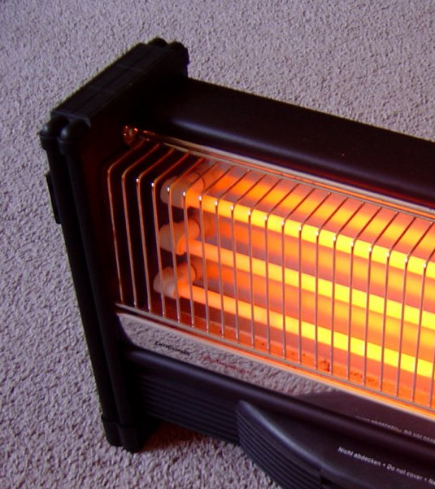
Play
it
safe
inside.
Notes:
More on electrical safety inside.
Stay away from electrical equipment in the garage or basement.
Keep the area around equipment, like the circuit breaker box, clean and dry.
Never use electrical appliances or space heaters to dry clothes or bedding.

Slide 16
Damage Prevention LINGO

Slide 17
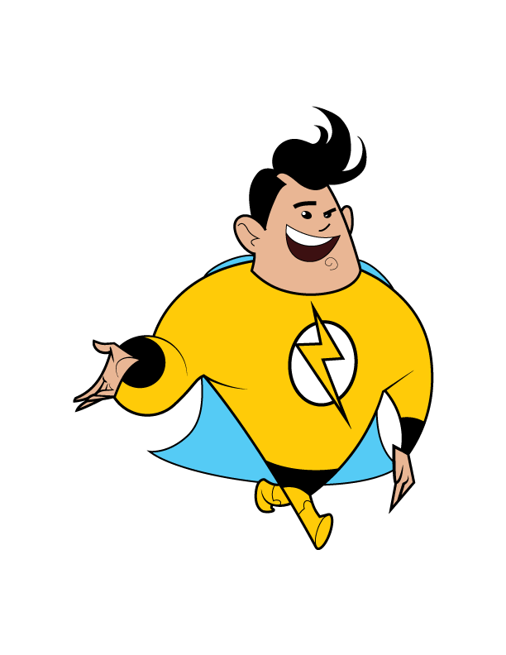
overloaded outlets
When too many appliances are plugged in, ______________
_____________ can be a fire hazard.
TM

Slide 18
frayed cord
Appliances with a broken or ________ _________
can be dangerous.
TM

Slide 19
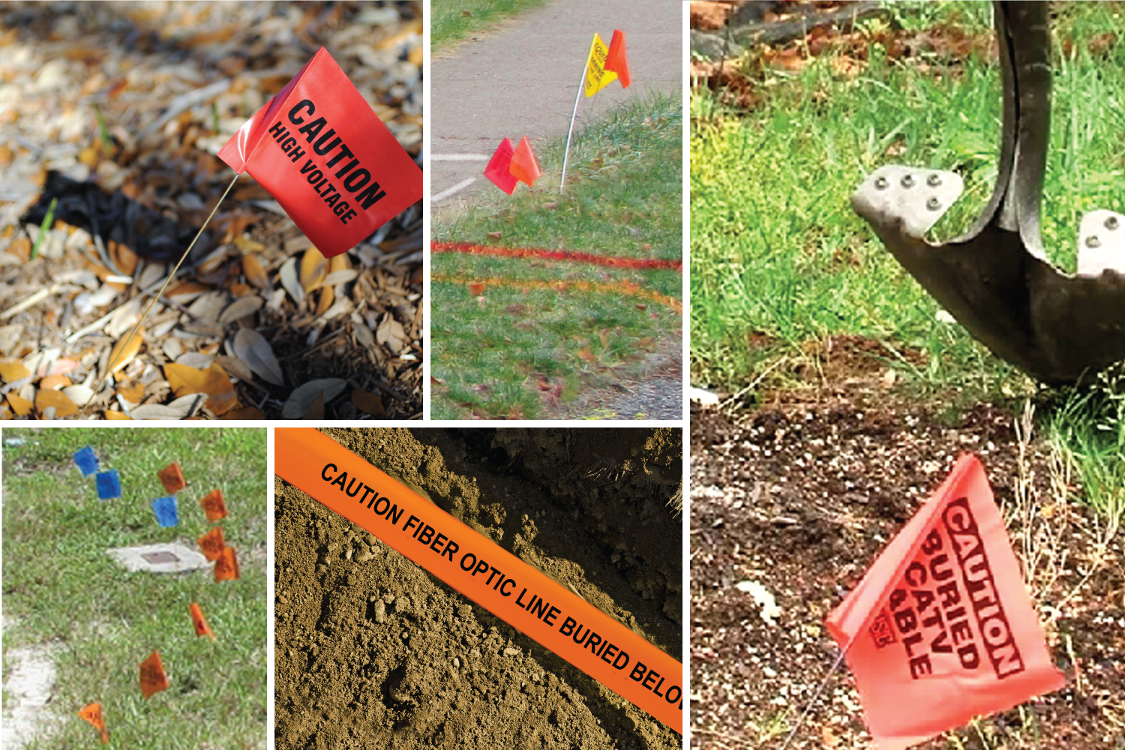
Notes:
Explain to students that before any digging occurs at home or in a community, someone must call 811 so that underground pipeline locations are properly marked above ground.
These markers are important because they help people know where not to dig.
Hitting buried electric power lines or communication lines can cause damage and serious incidents.

Slide 20
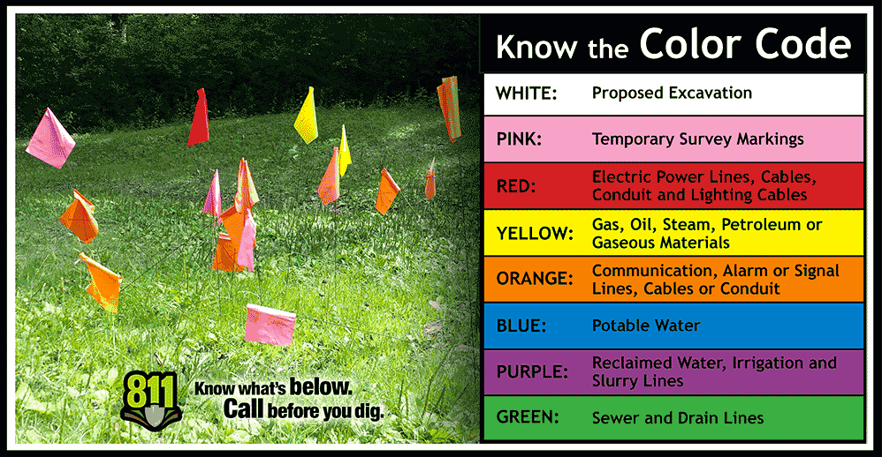

Do NOT move or pull out marker flags. They show the location of buried utility lines.
Notes:
NEVER move or pull out marker flags.
Electric power lines are marked with red.
Water lines are marked with blue.
Natural gas lines are marked with yellow flags, markers or paint.
Other colors mark things like cable (orange) and sewer lines (green).

Slide 21

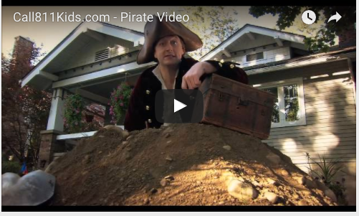
Call 811 before you dig.
Notes:
Teachers: Call 811 before you dig- Pirate Video is found on the Energy Safe Kids website: energysafekids.org/student or on YouTube at https://youtu.be/ipUdekpev0I.
The image of the pirate video is hyperlinked to the video. Click anywhere on the image and it will bring up the video if the internet is available.
Encourage teachers to share it with others in the school, perhaps even sharing it during the announcements.

Slide 22
Damage Prevention LINGO

Slide 23
811
Call _____ to have buried power lines and cables located and marked.
TM
Notes:
Call ____ to have buried power lines and cables located and marked.
811

Slide 24
Pay attention to these colorful things that can tell you what is below.
Marker Flags
TM
Notes:
Pay attention to these colorful things that can tell you what is below.
Marker Flags

Slide 25
power lines
Call 811 to mark the location of utility cables and buried ___________ __________.
TM
Notes:
Call 811 to mark the location of utility cables and buried _____ _______.
power lines

Slide 26
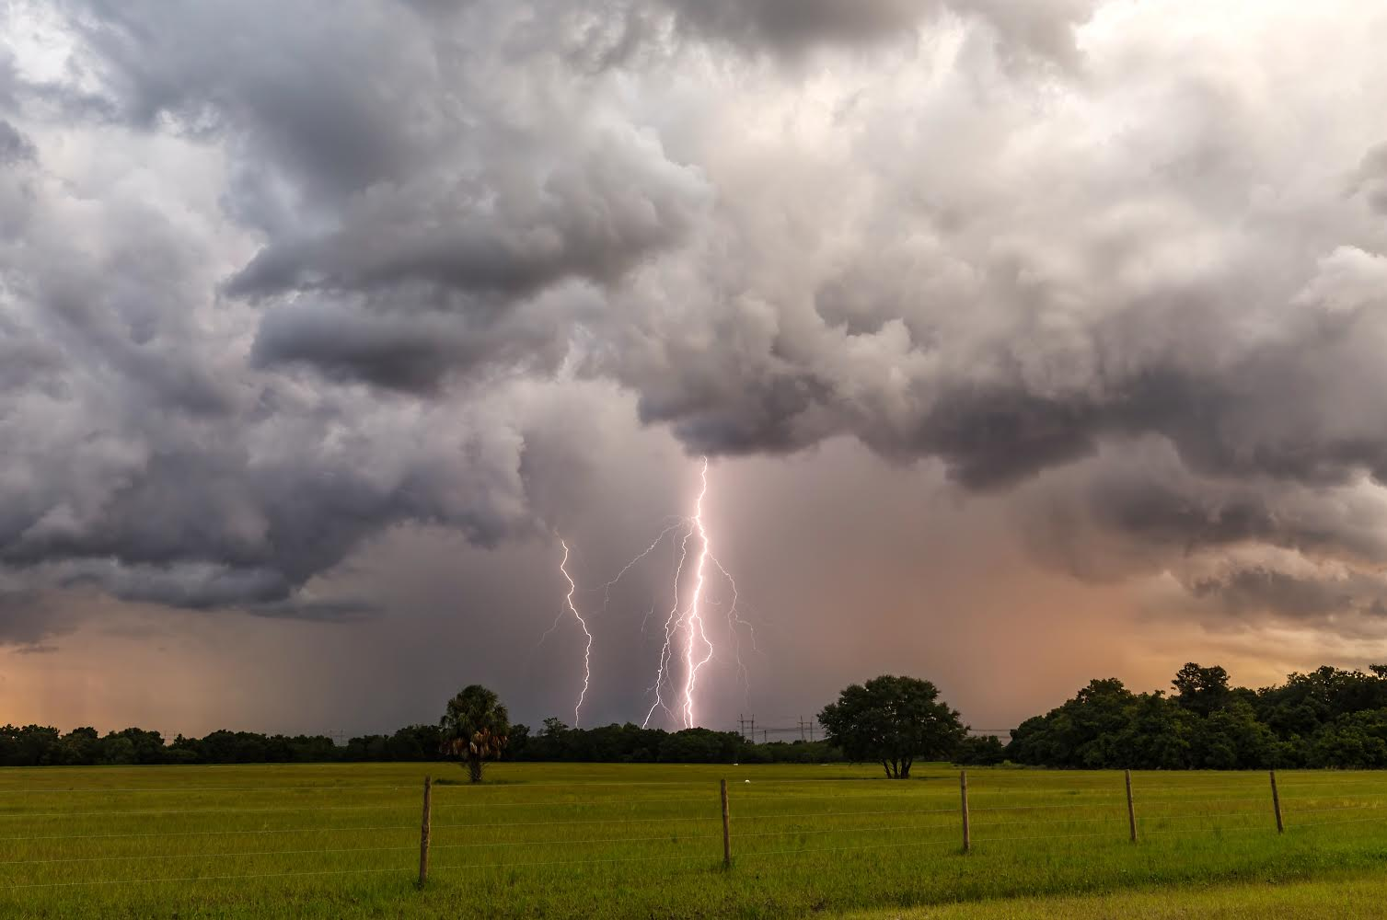
Electrical Safety outside.
Go inside when there is a storm.
Notes:
Electrical safety outside.
Go inside when there is a storm.

Slide 27
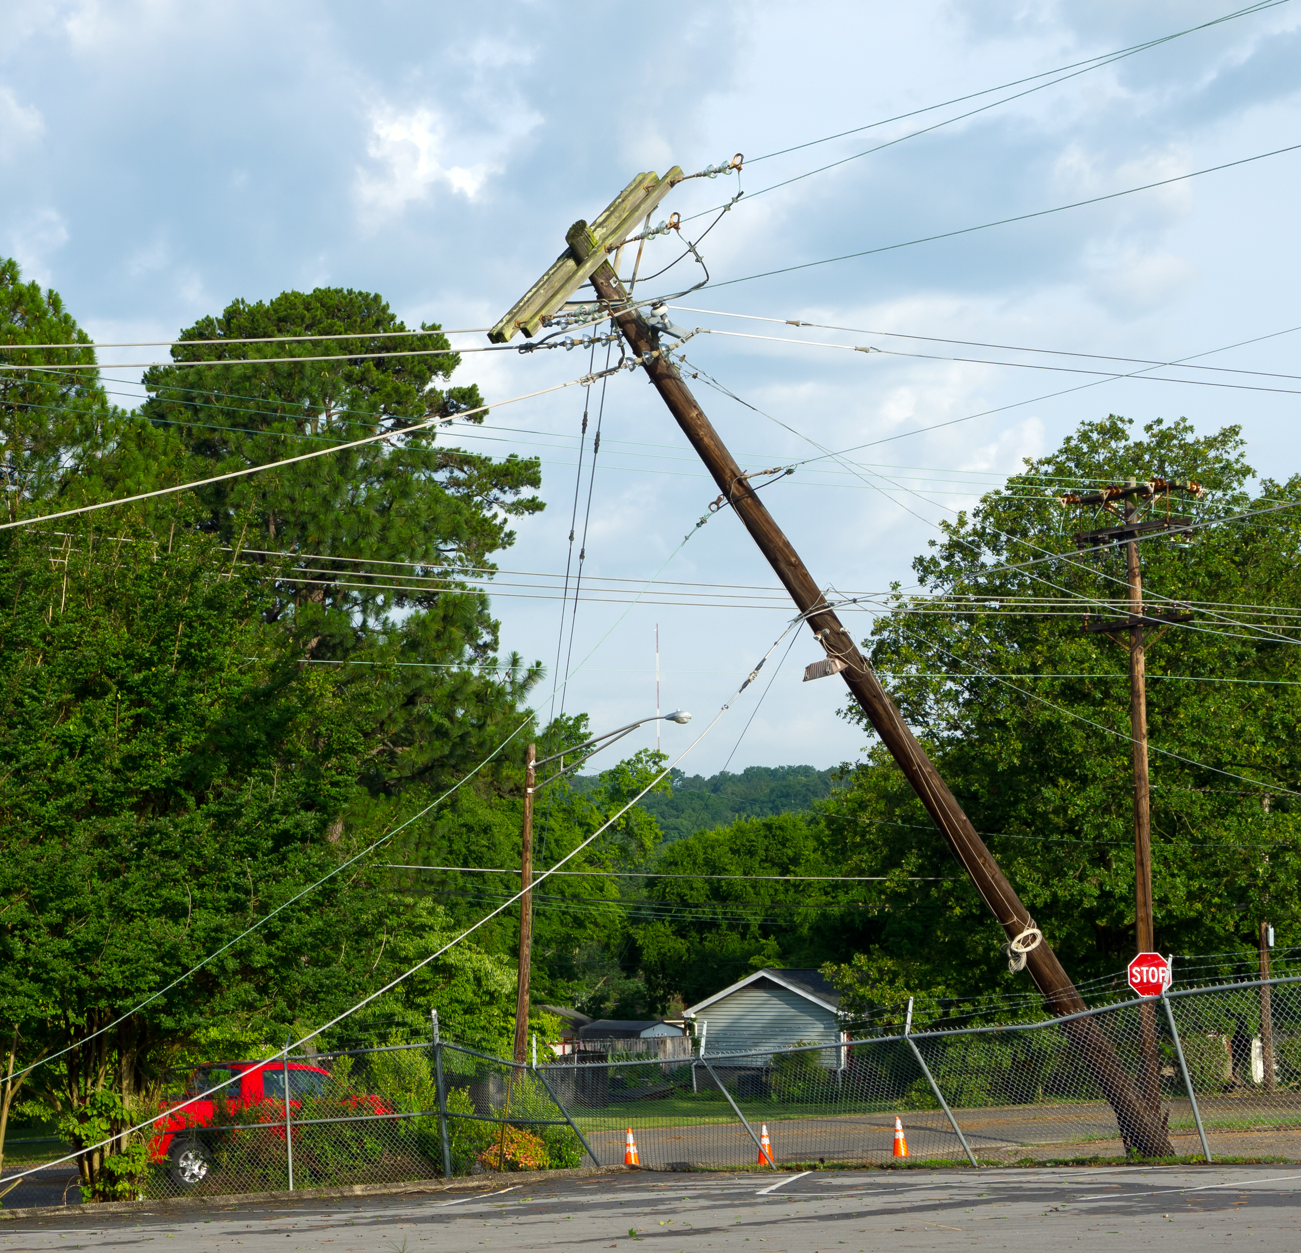
Play it safe outside.
  Stop, turn around and go the other way.
Notes:
Play it safe outside.
Stop, turn around and go the other way.
Use hand motions - both hands out in front of body for stop motion, then twirl hands around for “turn around” and then close fist thumbs out pointing backwards “go the other way.”
Stay away from downed power lines.
Tell an adult if you see downed lines and call 911.

Slide 28
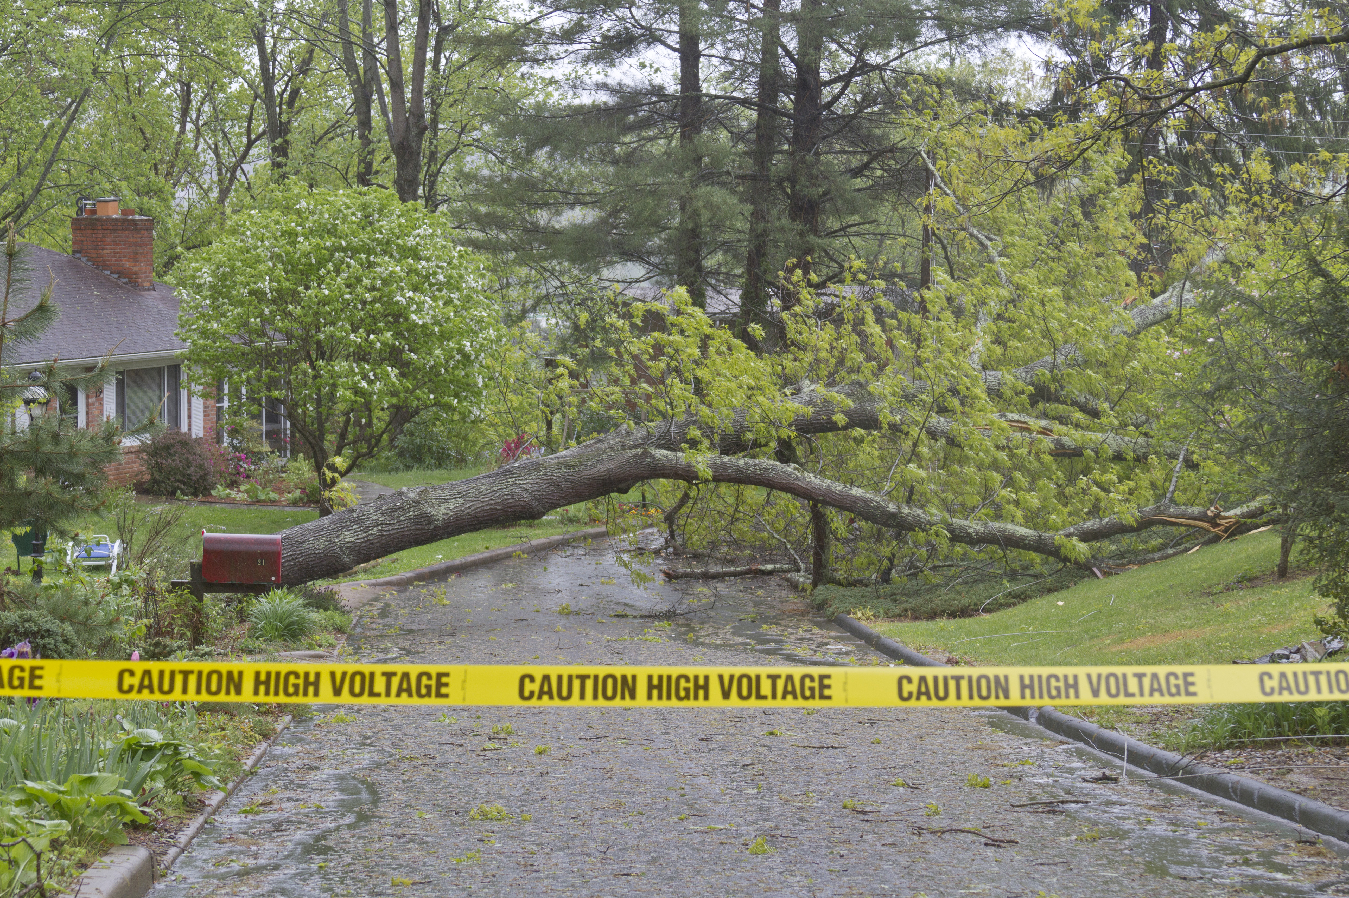
Play it safe outside.
  Stop, turn around and go the other way.
Notes:
Play it safe outside.
Stop, turn around and go the other way.
Use hand motions - both hands out in front of body for stop motion, then twirl hands around for “turn around” and then close fist thumbs out pointing backwards “go the other way.”
Stay away from downed power lines.
Tell an adult if you see downed lines.

Slide 29
Damage Prevention LINGO
Notes:
Audio clip will start automatically.

Slide 30
downed power lines
For electrical safety outside, stay away from ________ _________ __________.
TM
Notes:
For electrical safety, stay away from ____ ______ _______.
downed power lines

Slide 31
911
Tell an adult and call _____ if you see a downed power line.
TM
Notes:
Tell an adult and call ____ if you see a downed power line.
911

Slide 32
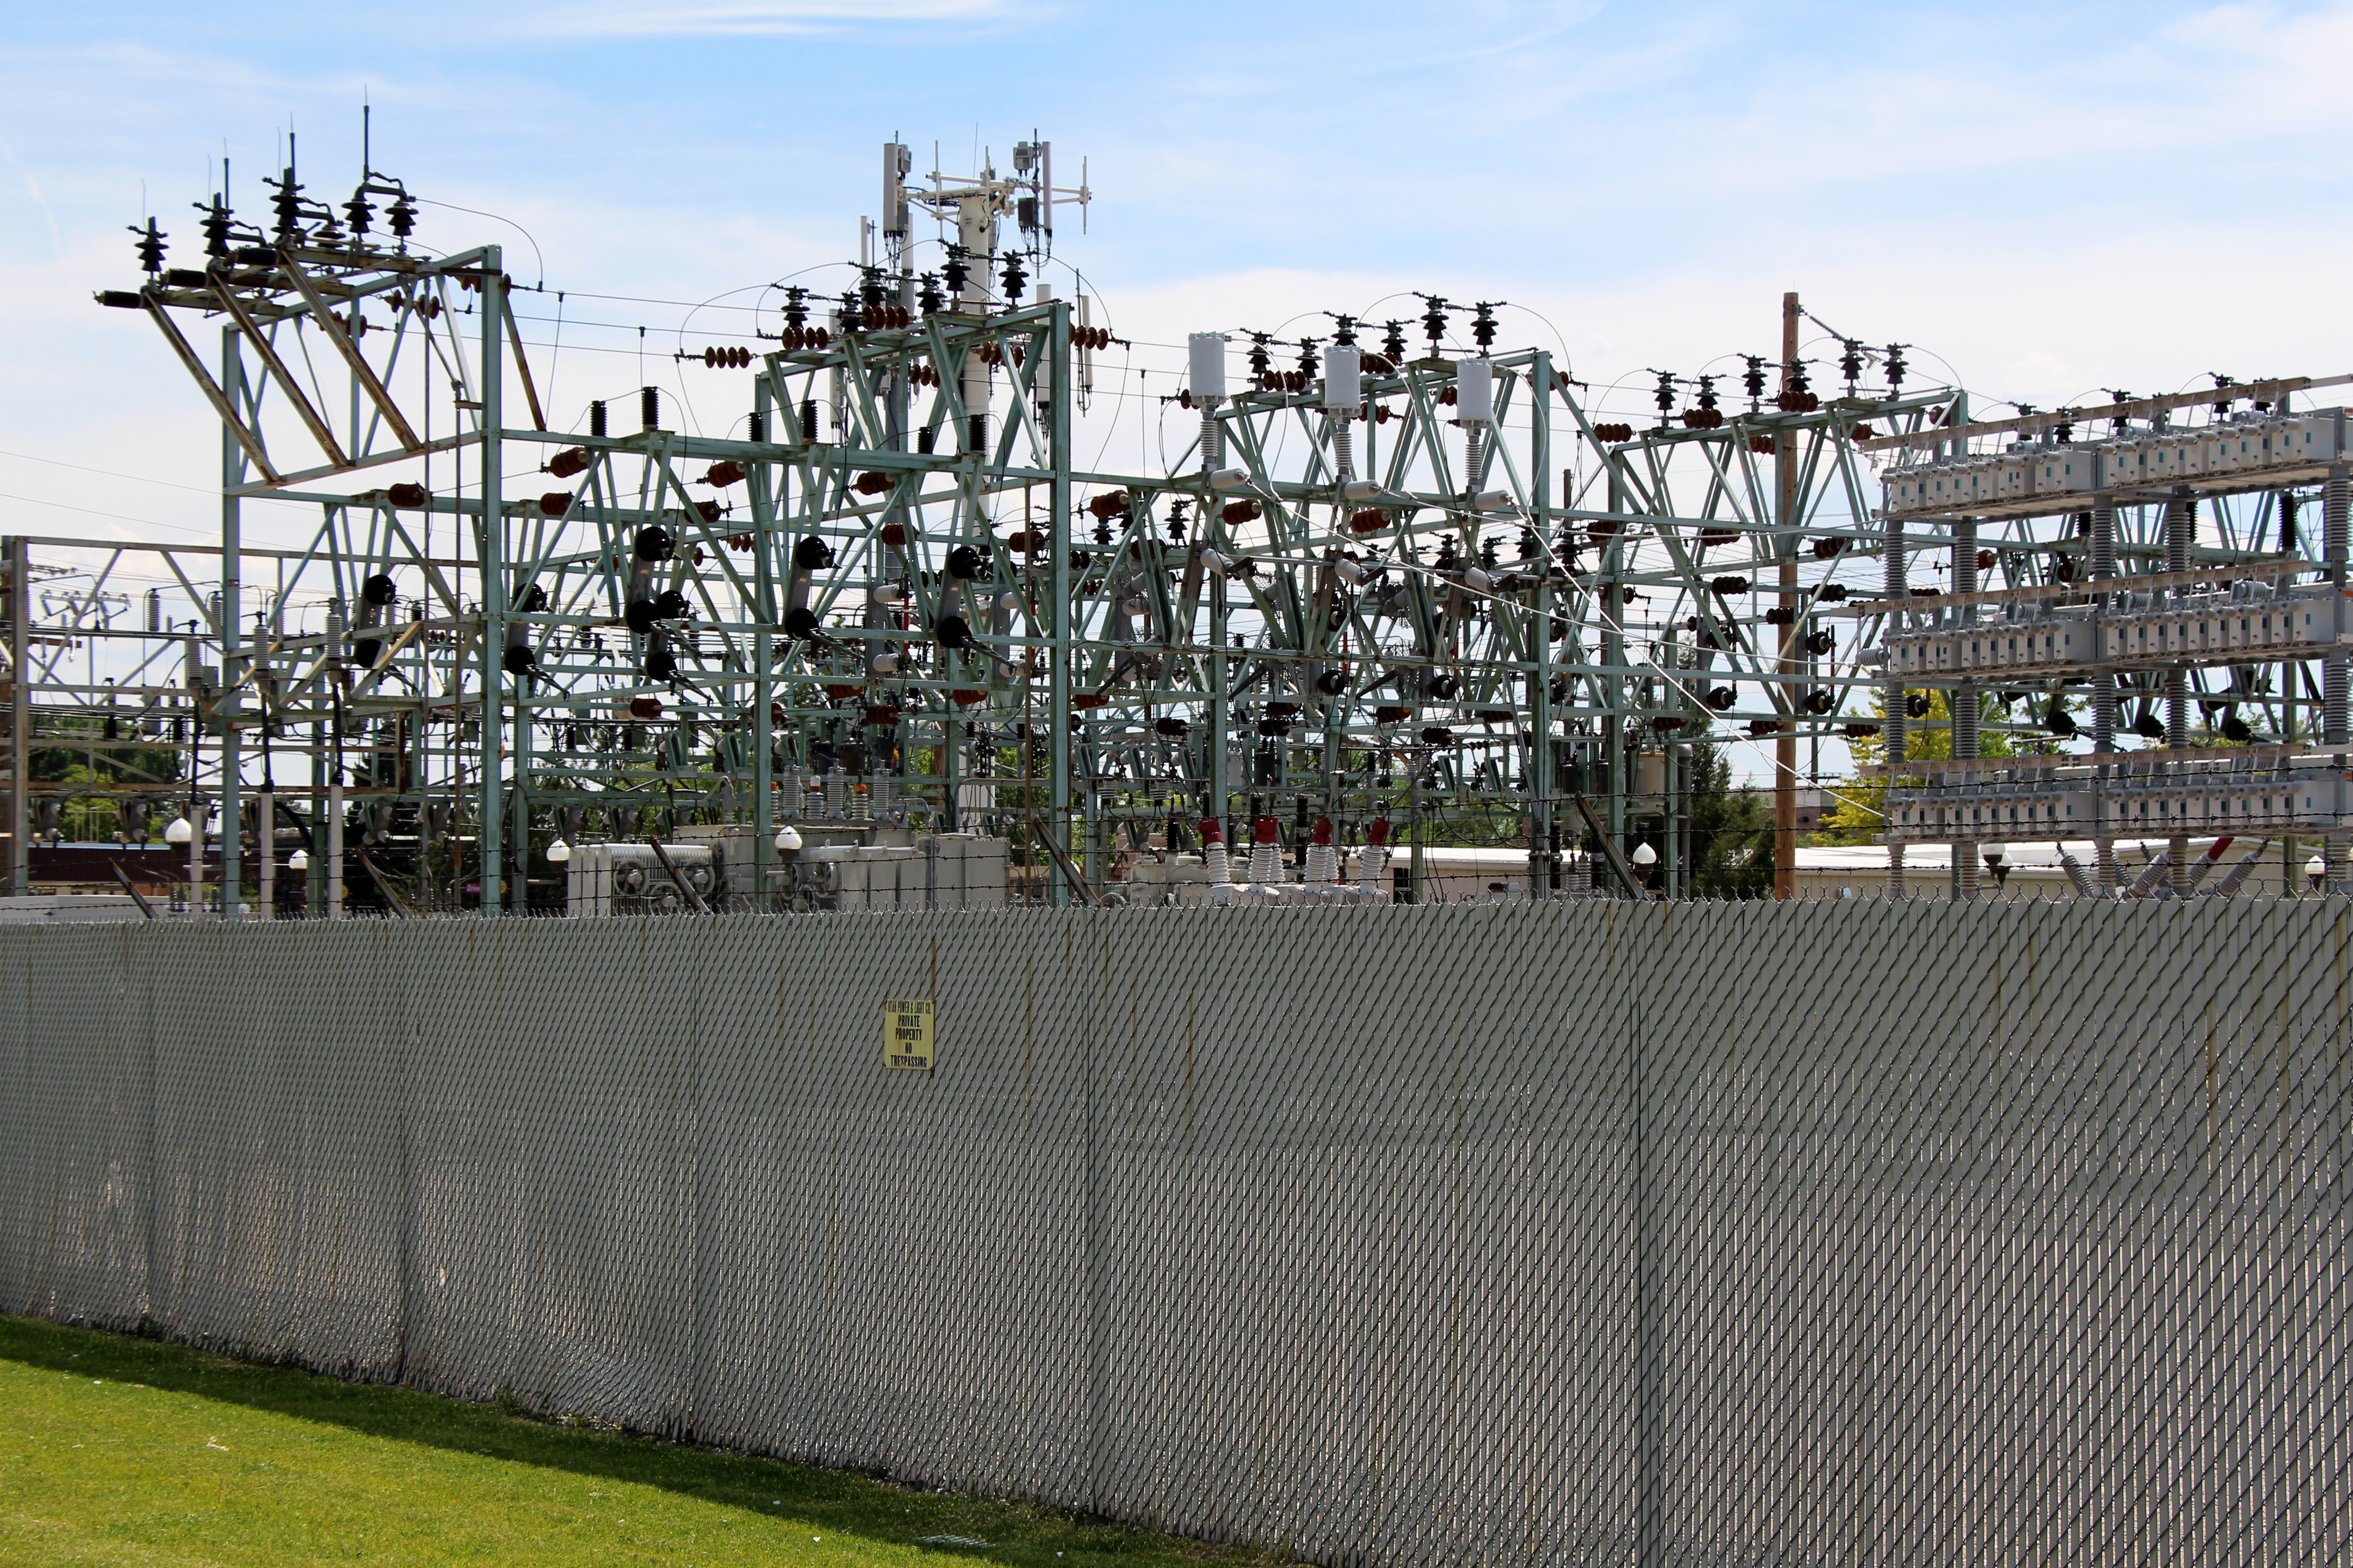
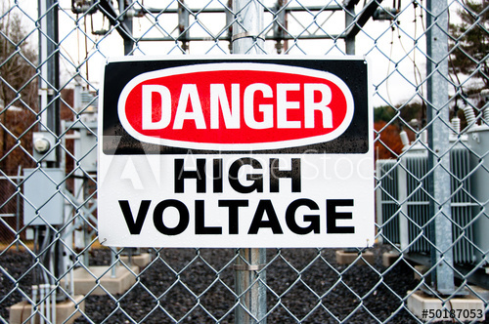
Stay away from electrical equipment.
DO NOT climb substation fences.
Play it safe outside.
Notes:
Stay away from electrical equipment.
DO NOT climb substation fences for any reason. If something goes over the fence like a ball or toy, it is gone.

Slide 33
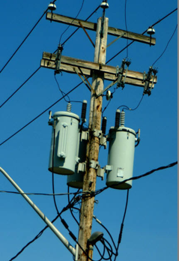
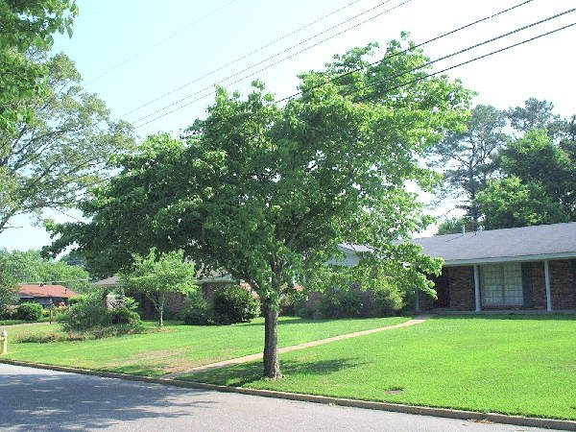
Play it safe outside.
power poles
power lines through tree top
Do not climb power poles or
trees near power lines.
Notes:
Do not climb power poles.
Do not climb trees near power lines.
Do not fly kites around power lines. Let go immediately if the kite gets near wires.

Slide 34
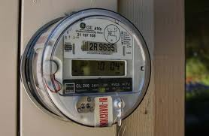
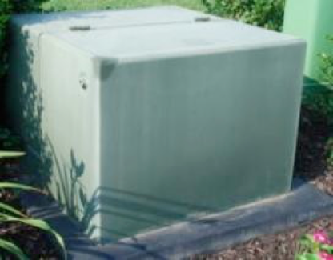
Play it safe outside.
electric meters
pad mount transformer
Stay away from electrical equipment like meters and transformers.
Notes:
Do not play around electric equipment such as meters or pad mount transformer.
Pad mount transformers are transformers for buried electrical lines. They change the voltages going into homes or business and are very powerful.

Slide 35
Damage Prevention LINGO

Slide 36
substation
Never climb the fence around a __________ for any reason because it is dangerous.
TM
Notes:
Never climb the fence around a ______ for any reason because it is dangerous.
substation

Slide 37
Pad mount _______ change the voltage of buried power lines and can be dangerous to play on.
transformers
TM
Notes:
Pad mount ___________ change the voltage of the buried power lines and can be dangerous to play on.
transformers

Slide 38
Keep electrical equipment like ____ ____ and ____ ____ ___ free of clutter and never play around them.
electric meters
circuit breaker box
TM
Notes:
Keep electrical equipment like _____ _____ and ______ _____ _____ free of clutter and never play around them.
Electric Meters, Circuit Breaker Box

Slide 39
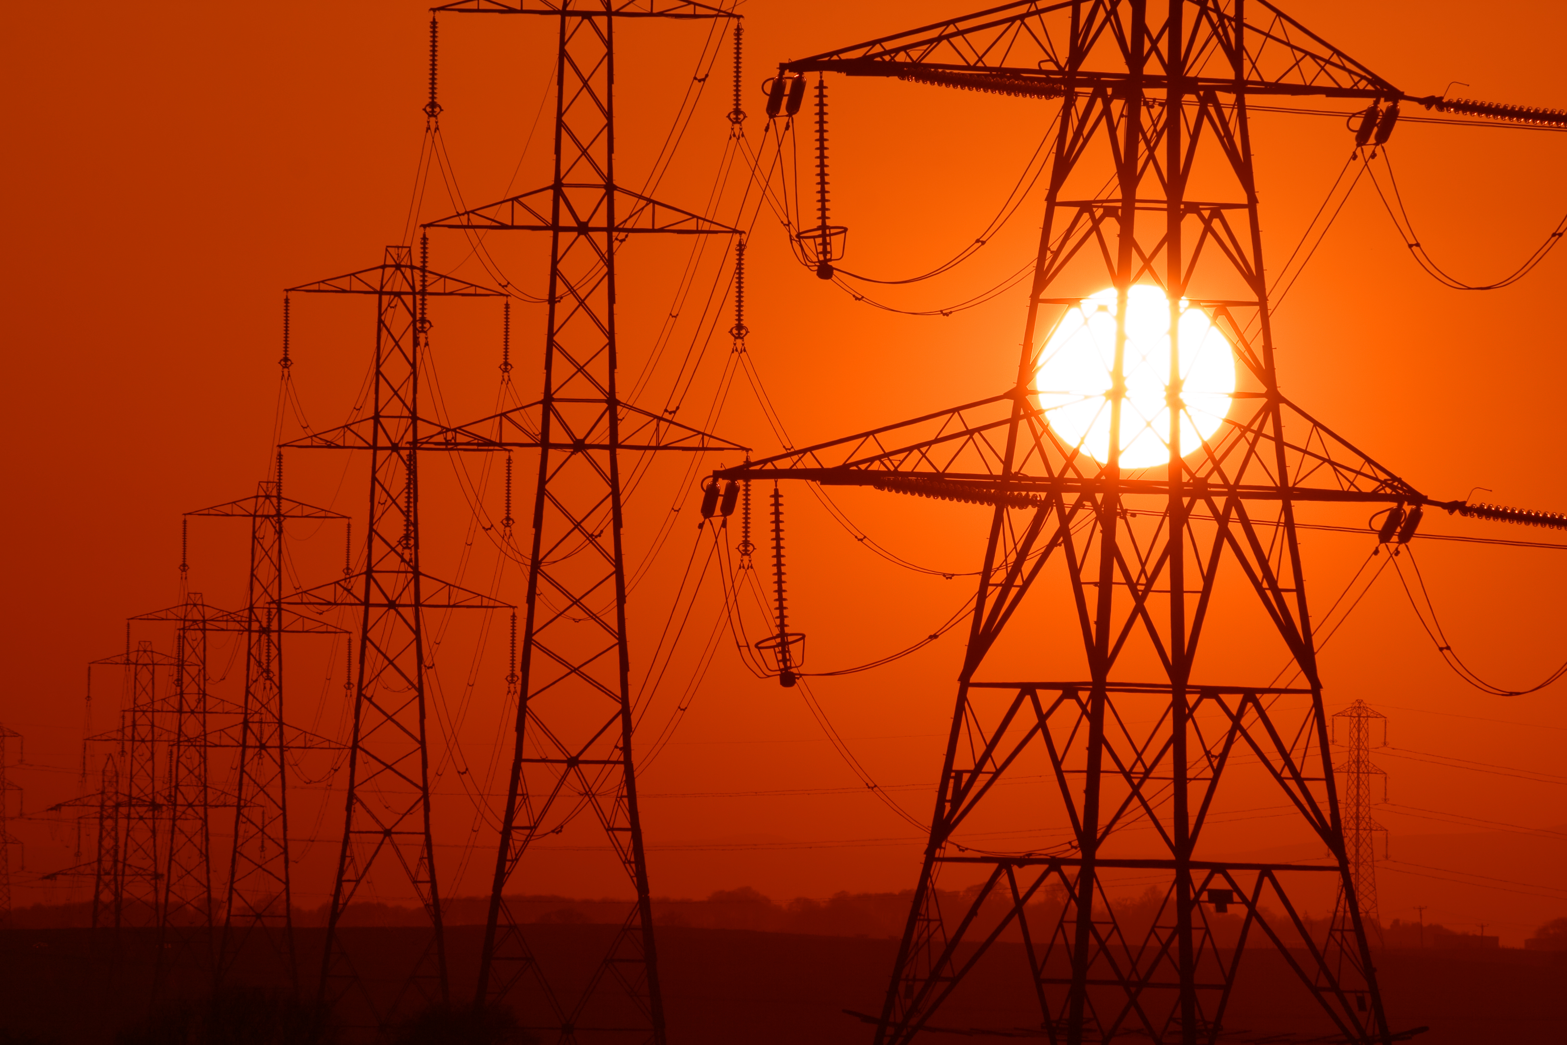
Electricity is powerful and we
must use it safely.
Notes:
Electricity is a powerful energy source and we must be safe when using it.

Slide 40










Electrical Safety Sense
Are you ready?
Notes:
Tell students – how to play the review game:
They must remember many points of knowledge that were mentioned in the presentation.
Students can be called upon individually or as a class (if you have several) or to the group as a whole.
THUMBS UP for YES, THUMBS DOWN for NO!
They complete the Electrical Safety Sense circle or pie chart by answering 10 questions. The goal is to be 100 percent correct.
With each correctly answered question, students are 10 percent closer to completing the circle.
Are you READY?

Slide 41
Do you need to be careful around electricity?
TM
Notes:
Do you need to be careful around electricity?

Slide 42
10%
Yes
TM
Notes:
Yes

Slide 43
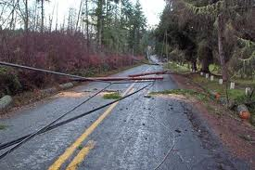
If you see a downed power line, do you TELL an adult right away?
TM
Notes:
If you see a downed power line, do you tell an adult right away?

Slide 44
20%
Yes
TM
Notes:
Yes

Slide 45
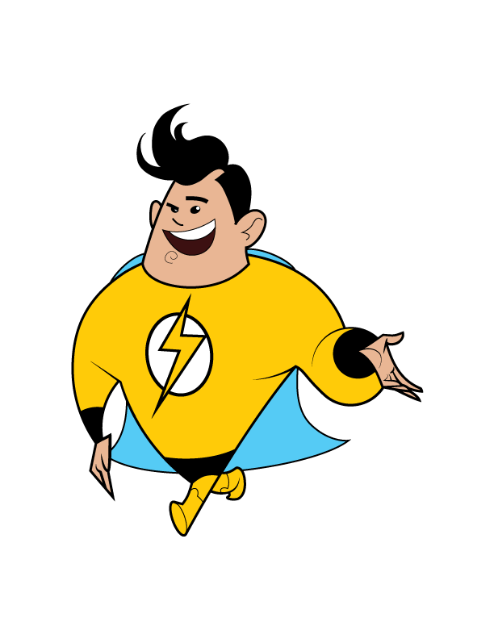
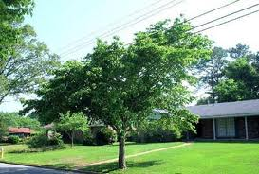
Should you play around power poles or trees that have overhead wires nearby?
TM
Notes:
Should you play around power poles or trees that have overhead wires nearby?

Slide 46
30%
No
TM
Notes:
No

Slide 47
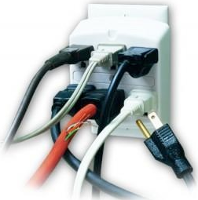
Overloading electrical _______ is dangerous.
TM
Notes:
Overloading electrical _________ is dangerous.

Slide 48
40%
Outlets
TM
Notes:
Outlets

Slide 49
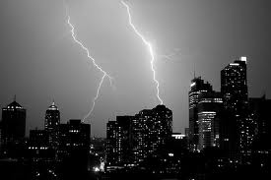
You should NOT play ________ during a storm.
TM
Notes:
You should not play _________ during a storm.

Slide 50
50%
Outside
TM
Notes:
Outside

Slide 51
  Your family should keep the area around your _____ ______ box clean.
TM
Notes:
Your family should keep the area around your circuit breaker box clean.

Slide 52
60%
Circuit Breaker
TM
Notes:
Circuit Breaker

Slide 53
You should NOT unplug appliances by the _____.
TM
Notes:
You should not unplug appliances or electronics by the _____.

Slide 54
70%
Cord
TM
Notes:
Cord

Slide 55
You should not play around electric equipment like ____.
TM
Notes:
You should not play around electric equipment like _______.

Slide 56
80%
Meters
TM
Notes:
Meters

Slide 57
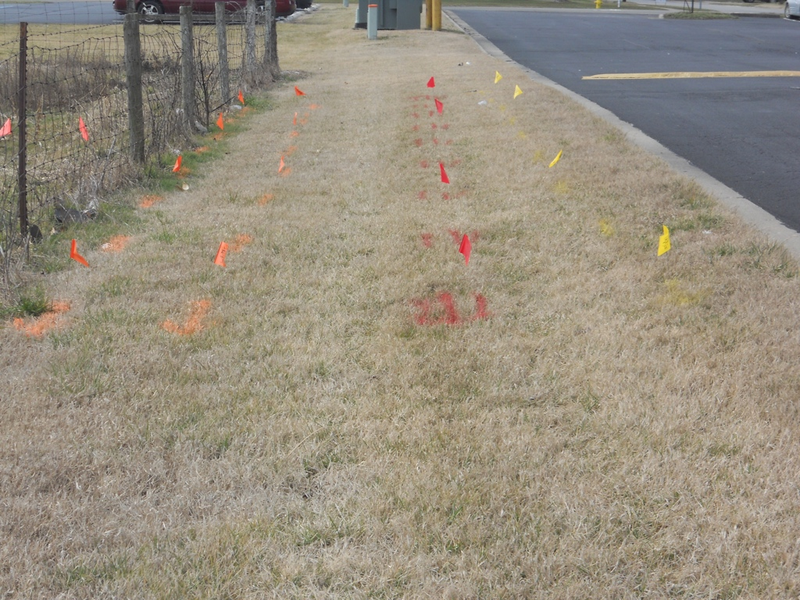
You should call _____ to mark the location of buried power lines.
TM
Notes:
You should call ______ to mark the location of buried power lines.

Slide 58
90%
811
TM
Notes:
811

Slide 59
You should never climb fences around ___________.
TM
Notes:
You should never climb fences around __________.

Slide 60
100%
Substations
TM
Notes:
Substations

Slide 61
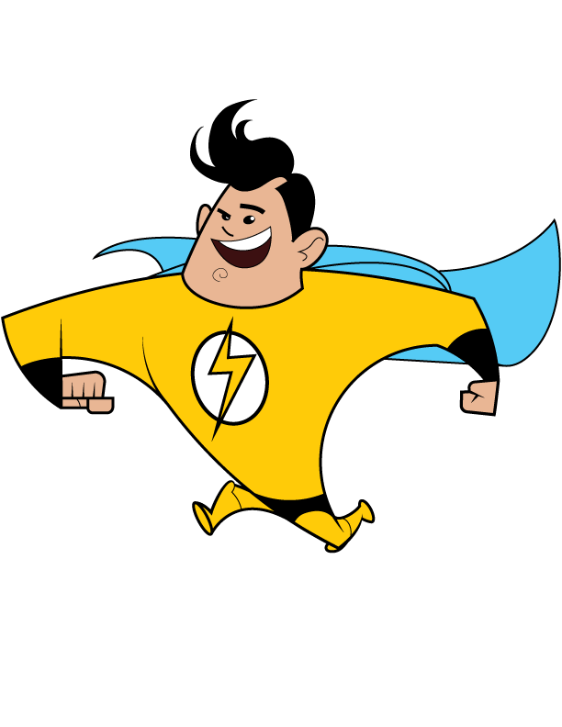
TM
ELECTRICAL SAFETY SENSE
Completed = 100% Safe
Notes:
Congratulate the students on being smart ENERGY SAFE KIDS. They have completed Electrical Safety Sense.

Slide 62
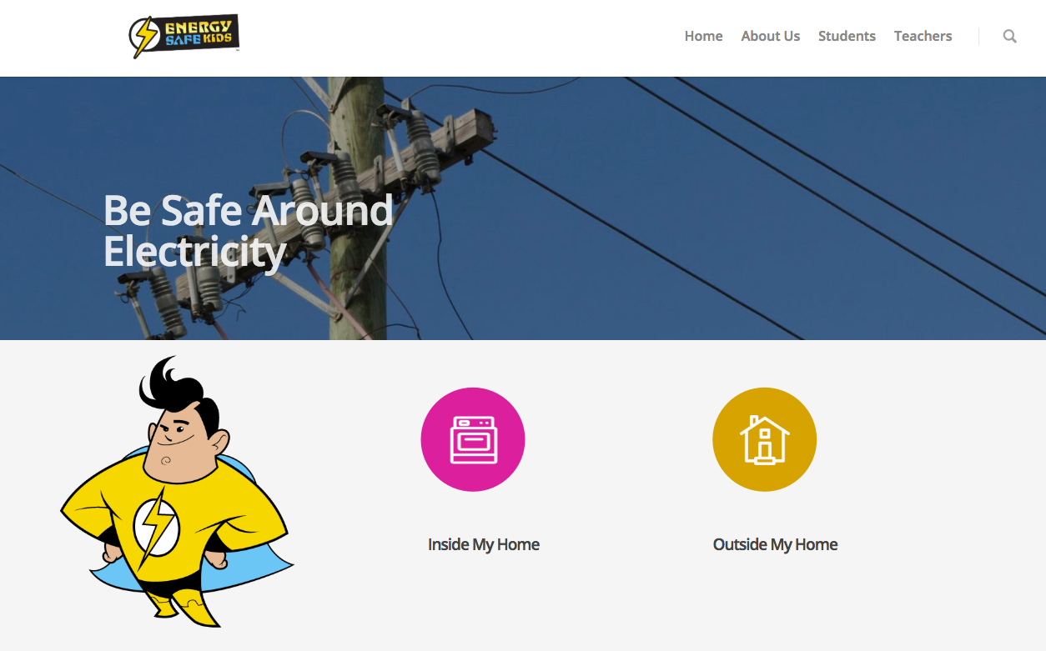
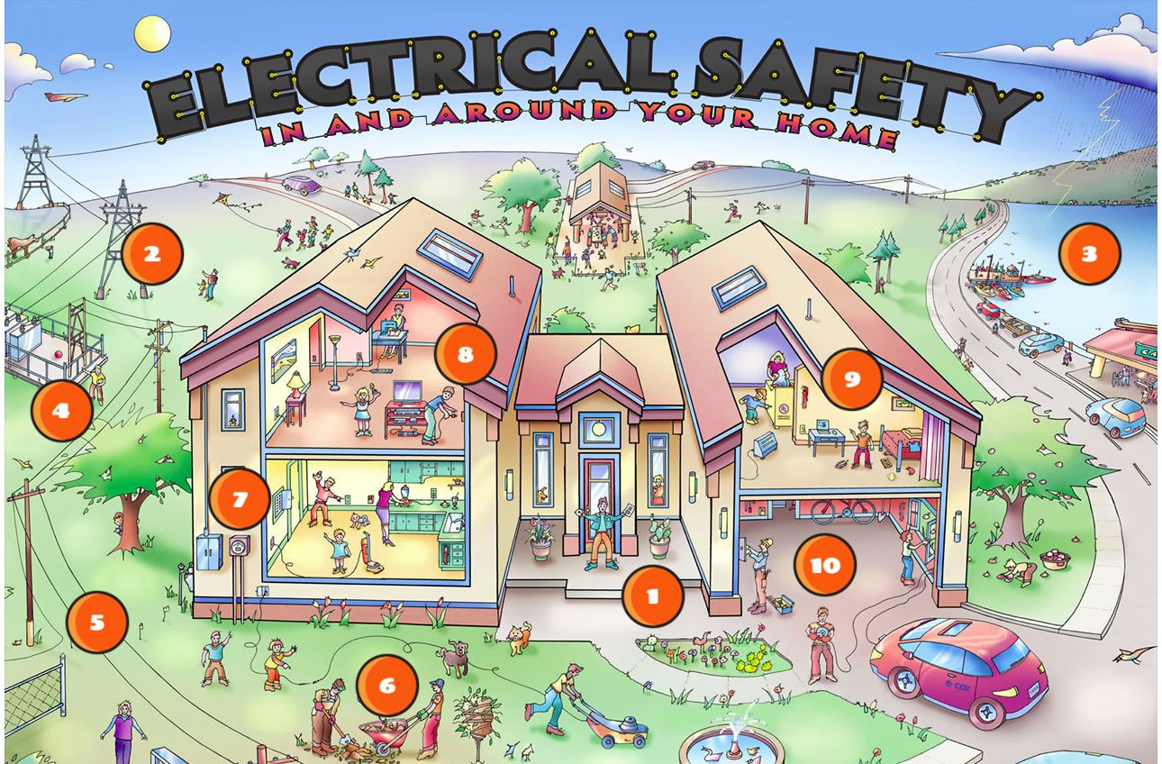
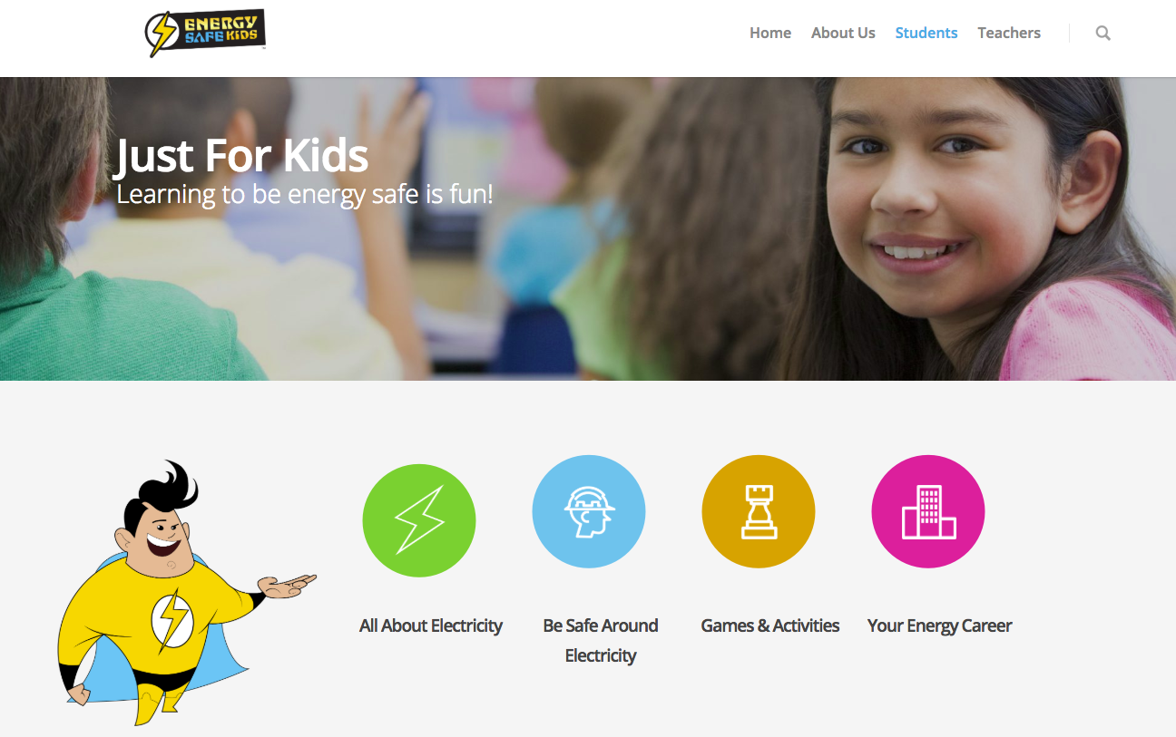
Literacy Connection
TM
TM
Notes:
The Energy Safe Kids website has so much information for students, parents and teachers.
Teachers will find resources for classroom use: lesson plans, activities and facts about electrical safety in the United States.
Students and their families can learn about electricity basics, safety and careers and test their safety IQ against “The Interactive Electrical Safety Poster.”
The interactive poster is a fun way to review electrical safety and test your knowledge. The words in the title of the poster light up with each correct answer.

Slide 63
You can be an
Energy Safe Kid!
TM
Notes:
Thank participants for letting us visit and encourage students to BE SAFE and be an Energy Safe Kid.

